Slide 1
REPORT WRITING
Supercomputing Challenge 2016-2017

Slide 2
Agenda
Video of a Final Presentation (think April)
Breaking down the Presentation
Report Elements
Activity: Build a Report
Example to use for Report Writing

Slide 3
An example of a FINAL PRESENTATION
https://www.ted.com/talks/suzanne_simard_how_trees_talk_to_each_other?language=en
Notes:
24 minutes long. You can end the video at 14:10 or again at 15:30

Slide 4
Let’s Pretend this video was a teams presentation at the Expo in April

Slide 5
What questions was she asking in her “Project”?
Can we document trees communicating in the actual forest?
Do different tree species talk to each other?
How connected is the Mycorrhizal Network?
Do trees take care of kin?
If we remove a mature tree does it affect the condition of the forest?

Slide 6
Abstraction-in your models mathematical or agent-based
Is it important for this project to have factually looking trees for us to know they are trees?
How could we show different aged trees?
How could we show the Mycorrhizal Network without making factually looking mushrooms?

Slide 7
What is a Network Problem? Hint: Traveling Salesman/School Route problem
SCHOOL
Student 1
Notes:
VERY Brief introduction to a network model. Lays groundwork for looking at a network model as an appropriate model for this project.

Slide 8
How did the authors see the Mycorrhiza Network as a Traveling Salesman Problem?

Slide 9
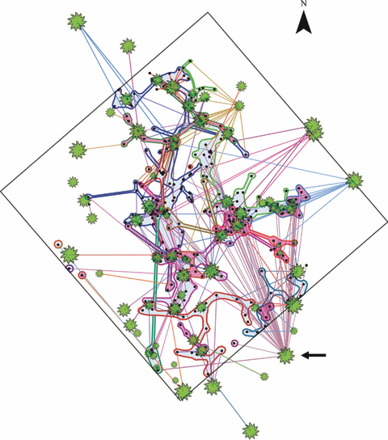
Architecture of the wood‐wide web: Rhizopogon spp. genets link multiple Douglas‐fir cohorts
New Phytologist Volume 185, Issue 2, pages 543-553, 29 OCT 2009 DOI: 10.1111/j.1469-8137.2009.03069.x http://onlinelibrary.wiley.com/doi/10.1111/j.1469-8137.2009.03069.x/full#f1
Notes:
The top‐down spatial topology of Rhizopogon spp. genets and Douglas‐fir trees in a 30 × 30 m plot. The plot (square outline) lies on a southeastern slope and contains 67 trees of various ages (green shapes; sized relative to each tree’s diameter). Small black dots mark Rhizopogon ectomycorrhiza sample locations (n = 401), 338 of which were associated with a specific tree and fungal genet based on microsatellite DNA analysis. Samples representative of each fungal genet are outlined in different colours. Rhizopogon vesiculosus genets (n = 14) are shaded with a blue background, and Rhizopogon vinicolor genets (n = 13) with pink. Lines illustrate the linkages between tree roots encountered in Rhizopogon ectomycorrhizas and corresponding source trees aboveground (‘root lengths’) and are coloured according to tree genotype. An arrow points to the most highly connected tree, which was linked to 47 other trees through eight R. vesiculosus genets and three R. vinicolor genets inside the plot. Some trees, mycorrhiza samples, and/or genets may be obscured by overlapping features.
IF THIS IMAGE HAS BEEN PROVIDED BY OR IS OWNED BY A THIRD PARTY, AS INDICATED IN THE CAPTION LINE, THEN FURTHER PERMISSION MAY BE NEEDED BEFORE ANY FURTHER USE. PLEASE CONTACT WILEY'S PERMISSIONS DEPARTMENT ON PERMISSIONS@WILEY.COM OR USE THE RIGHTSLINK SERVICE BY CLICKING ON THE 'REQUEST PERMISSIONS' LINK ACCOMPANYING THIS ARTICLE. WILEY OR AUTHOR OWNED IMAGES MAY BE USED FOR NON-COMMERCIAL PURPOSES, SUBJECT TO PROPER CITATION OF THE ARTICLE, AUTHOR, AND PUBLISHER.

Slide 10
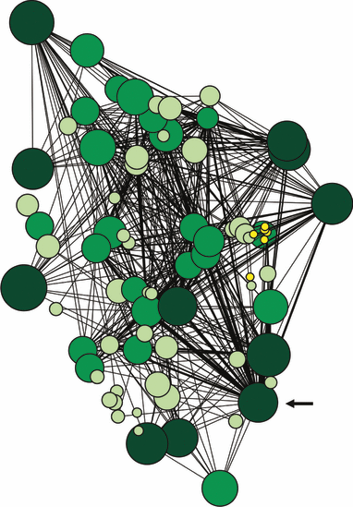
Architecture of the wood‐wide web: Rhizopogon spp. genets link multiple Douglas‐fir cohorts
New Phytologist Volume 185, Issue 2, pages 543-553, 29 OCT 2009 DOI: 10.1111/j.1469-8137.2009.03069.x http://onlinelibrary.wiley.com/doi/10.1111/j.1469-8137.2009.03069.x/full#f2
Notes:
Spatially explicit network model showing linkages between interior Douglas‐fir trees via shared colonization by Rhizopogon vesiculosus and Rhizopogon vinicolor genets. Circles represent tree nodes, sized according to the tree’s diameter, and coloured with four different shades of yellow or green that increase in darkness with increasing age class. Lines represent the Euclidean distances between trees that are linked. Line width increases with the number of links between tree pairs (i.e. repeated links through multiple fungal genets). An arrow points to the most highly connected tree, which was linked to 47 other trees through eight R. vesiculosus genets and three R. vinicolor genets inside the plot. Some tree nodes and their links may be obscured by overlapping features.
IF THIS IMAGE HAS BEEN PROVIDED BY OR IS OWNED BY A THIRD PARTY, AS INDICATED IN THE CAPTION LINE, THEN FURTHER PERMISSION MAY BE NEEDED BEFORE ANY FURTHER USE. PLEASE CONTACT WILEY'S PERMISSIONS DEPARTMENT ON PERMISSIONS@WILEY.COM OR USE THE RIGHTSLINK SERVICE BY CLICKING ON THE 'REQUEST PERMISSIONS' LINK ACCOMPANYING THIS ARTICLE. WILEY OR AUTHOR OWNED IMAGES MAY BE USED FOR NON-COMMERCIAL PURPOSES, SUBJECT TO PROPER CITATION OF THE ARTICLE, AUTHOR, AND PUBLISHER.

Slide 11
So how do we write a report about this project?

Slide 12
So how do we write a report about this project?

Slide 13
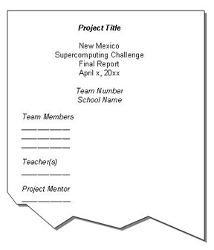
REPORT ELEMENTS
1. Cover Page

Slide 14
Report Elements
2. Table of Contents (include Appendices, Tables, Graphs, Page numbers)
3. Executive summary (the make-or-break-you part of the report)
the part of the report that the judges read to decide whether to shelve the report or to continue on to the body of the report.
covers the significant points of the report,
is well-organized and very tightly written (i.e., all necessary, but no extraneous material), and
is written in plain English rather than in technical terms (the primary users of executive summaries are generally well-educated people who do not necessarily have a technical background).

Slide 15
Report Elements
4. Body of the report -
The report must show that you conducted a scientific investigation, obtained results, and arrived at some conclusions. The following components are all critical to the reader’s understanding of and appreciation for your work. Please be sure that you address each one clearly and completely.
An introduction describes the project, your purpose in choosing it, and the problem’s significance to you and provides necessary background information to assist the reader in understanding your work.
A description of the project states all important details about the scope (limits) of your work, the materials you used, and the step-by-step methods that you incorporated.
The results include the data from your computer program and what you learned from doing this project. Please don’t mistake graphs or figures for results. Well-designed graphs with carefully crafted captions that explain the details of the figures could be included as part of the results but are no substitute for a precise, detailed, and complete description of what you did or didn’t discover in the course of your project.

Slide 16
Report Elements
4. Body of the report - continued
In your conclusions, you interpret your results based on the facts and evidence that you have gathered. You should show that you have thoroughly processed your results in the context of the original problem that you selected. It is important to clearly state what was your most significant original achievement on the project.
Recommendations are especially useful if you had to greatly narrow the scope of your project in order to complete it in the limited time that you had, if your results weren’t at all what you expected to get, or if you don’t believe your results to be complete or accurate.
Acknowledgments (optional) give you an opportunity to thank the people who have helped you on the project (mentors, teachers, administrators, etc.).

Slide 17
Report Elements
5. Reference list or bibliography
You must be sure to identify the sources from which you obtained information. You can find formats for citing the various types of printed material (books, reports, articles, etc.) in text books such as the Harbrace College Handbook (Horner et al. 1998), but several examples are provided later in this packet so that you need not go searching for another resource. The important thing is to be complete, accurate, and consistent.
The sources must listed in alphabetical order by the authors’ last names.
The sources should be readily traceable by the reader because of the thoroughness of the information you have provided.
The sources should be presented in a consistent format

Slide 18
Report Elements
6. Appendixes
One or more are optional that:
are referred to in the body of the report and that follow the body of the report in the order in which you refer to them in the body
are identified by capital letters of the alphabet, used in sequence (the exception being when you only have one appendix, in which case you just call it the Appendix)
provide information that supports your report but would serve as a distraction to your reader in the body of the text
may include data, programming codes, charts, and tables

Slide 19
Report Writing Activity
You should receive
A student worksheet
A student copy of report component
Blank sheet with report order.
Cut apart portions on the dark line.
Organize report portions in the most logical order by looking at the information it gives and comparing it to the descriptions on the wall.
Tape it to the paper in the report format order.
When complete, get a copy of the example.

Slide 20
In case you need help……
Executive summary (the make-or-break-you part of the report)
the part of the report that the judges read to decide whether to shelve the report or to continue on to the body of the report and covers the significant points of the report
An introduction describes the project, your purpose in choosing it, and the problem’s significance to you and provides necessary background information to assist the reader in understanding your work.
A description of the project states all important details about the scope (limits) of your work, the materials you used, and the step-by-step methods that you incorporated.
The results include the data from your computer program and what you learned from doing this project. Please don’t mistake graphs or figures for results. Well-designed graphs with carefully crafted captions that explain the details of the figures could be included as part of the results but are no substitute for a precise, detailed, and complete description of what you did or didn’t discover in the course of your project.
In your conclusions, you interpret your results based on the facts and evidence that you have gathered. You should show that you have thoroughly processed your results in the context of the original problem that you selected. It is important to clearly state what was your most significant original achievement on the project.

