Slide 1


ABSTRACTION
And Modeling

Slide 2
ABSTRACTION
Abstraction is the process of taking away or removing characteristics from something in order to reduce it to a set of essential characteristics.

Slide 3
Let’s look at a simple form of abstraction

Slide 4
PORTRAIT CARICATURES
Taking someone’s likeness and creating a drawing that highlights their strongest features.
Notes:
Point out that the original picture has characteristics that the artist perceives as standing out. He then draws them with greater size. He abstracts what he feels are the recognizable traits of the individual and makes them overemphasized.

Slide 5
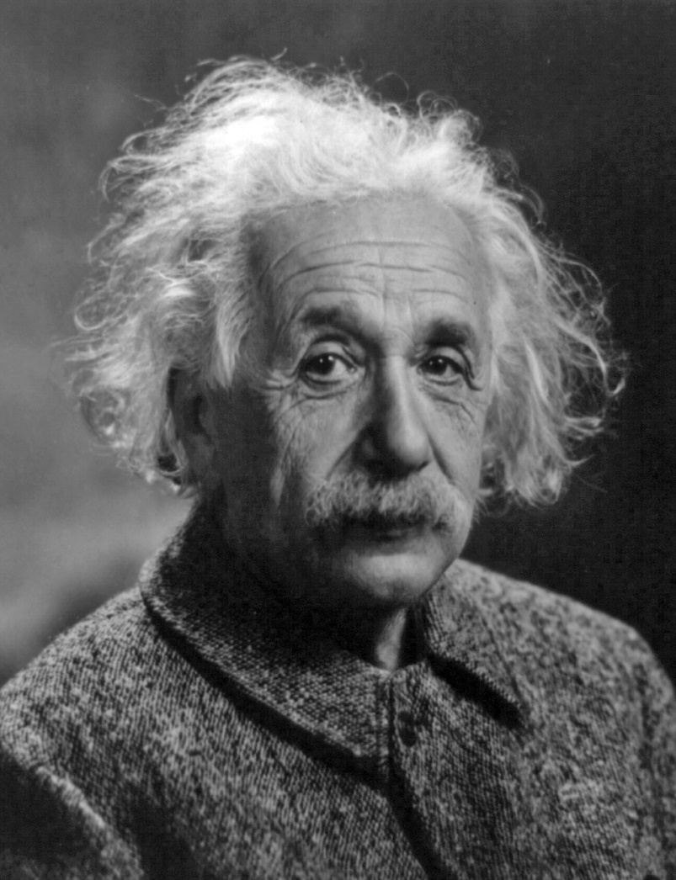
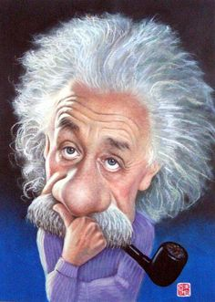
Albert Einstein
Notes:
Poll audience see if they say these. Prompt if needed.
Possible Answers: hair, mustache, nose

Slide 6
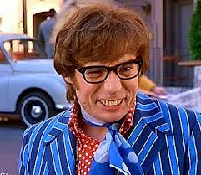
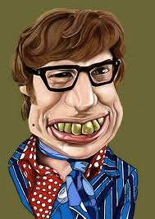
Austin Powers
Notes:
Poll Audience, prompt if needed.
Possible Answers: Teeth

Slide 7
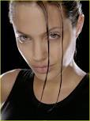
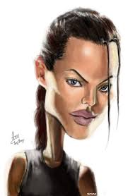
Laura Croft : Tomb Raider
Notes:
Poll audience, prompt if needed.
Possible Answers: eyes, stare, hanging hair

Slide 8
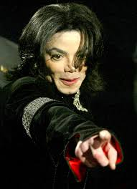
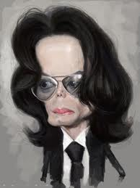
Michael Jackson
Notes:
Poll Everywhere, prompt if needed
Possible Answers: Nose, chin

Slide 9
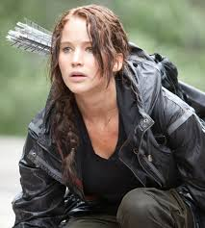
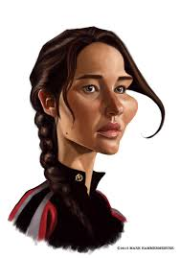
Katniss
Notes:
Poll Audience, prompt
Possible answers: Cheekbones, stare

Slide 10
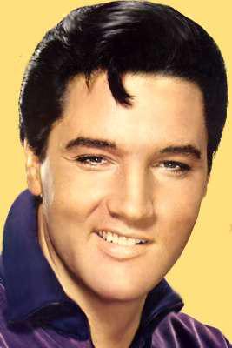
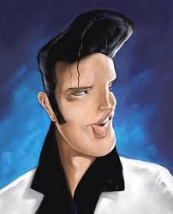
Elvis Presley
Notes:
Poll Everyone, prompt
Possible Answers: lip/sneer, hair

Slide 11
ART IS AN ABSTRACTION OF REALITY BY THE ARTIST

Slide 12
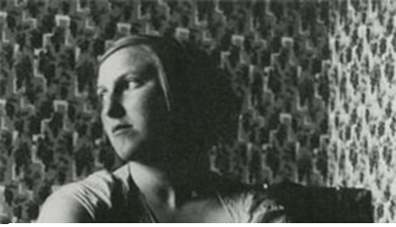
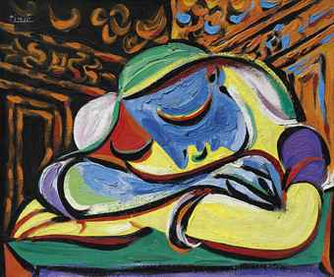
PABLO PICASSO
Notes:
Picture shows eyes arms and hair abstracted/simplier than original model. They are abstracted, but are still eyes, etc.

Slide 13
Notes:
What are these? (stick figures)
How can you tell gender? What items give you the information.
Does an arm look like a real life one? It is abstracted.
Are all heads perfectly round? Does it matter for this purpose? Will it change what we are trying to say?
You get the idea without the details and that is what we want to do with our models.

Slide 14
1 + a = 10
What does the a mean?
Math-ALGEBRA
Notes:
Algebra is a language of representing the unknown. We use a letter to abstract whatever we choose it to represent.

Slide 15
Is it always 9?
a +10 = 15 (a=5)
16 - a = 8 (a=8)
a x 3 = 18 (a=6)
ABSTRACTION

Slide 16
HOPE
What color is it?
What shape is it?
How big is it?
What does it taste like?
Can you hear it?
WORDS
Notes:
Have kids brainstorm other words that are abstract. They can mean what the writer wants the audience to feel it is.

Slide 17
THESE ARE ALL ABSTRACTIONS,
but
what about Computer Science?

Slide 18

COMPUTER SCIENCE
Choose 1:13 start, 4:50 stop

Slide 19
NETLOGO LIBRARY MODELS
Switch to NetLogo
Load NetLogo
Load Models Library
RETURN TO SLIDESHOW AFTERWARDS
Notes:
Downsize slideshow
Open Netlogo
Should have it open to Models Library
MODEL ! BEAGLE/ Evolution/Bug Hunt Speeds
Questions:
Good one to show that to rep diff bugs don’t need a fully detailed bug agent.
Can use color to rep diff types.
What does speed represent? – may not be speed, as speed just allows the prey to catch bug faster/slower. What may be abstracted is that the bugs are bigger or have a larger energy component or their food source is not available, etc.
MODEL @ NetLogo Lib/Biology/Slime
Example of how a model can change how scientists think.
This model assumes that the slime cells “sniff” pheromones either forward/left/right or a total of 180 degrees? Is that realistic? Can they “sniff” in a full circle of themselves? Does there behavior change?
What would give us data in this model? Could you draw conclusions from it?
one? What would you do to make it simpler?

Slide 20
HOW TO PARTICIPATE IN TEACHER DISCUSSION QUESTIONS:
OPEN POLL EVERYWHERE APP
      Choose Participating
      In the Keyword blank type: ITHINKTHAT and then type what you want to add to the discussion.
      Watch the Slideshow to see results!
Notes:
If enough kids have the app POLL EVERYWHERE then use the next two slides to ask kids for opinions. On the next screen they will show up on the screen live.

Slide 21

Notes:
What do you think?
http://www.polleverywhere.com/free_text_polls/JuNPV3z3PjvRQgx

Slide 22
A Good Model:
Simplified components to represent a complex problem. (Abstracted)
We don’t know the answer to our question before we begin
We have not coded every aspect of the system to do what we expect
We can say through our research or data that this is how this would function in the real world
We share our assumptions and know what we are measuring
Our sliders are our variables to change (independent variables)
We tested what we thought we were testing
Notes:
This page is meant for discussion or elaboration by the presenter
You may need to explain assumptions, variables, etc.

Slide 23
LET’S LOOK AT A PROPOSAL SUBMITTED TO THE CHALLENGE

Slide 24
Highly Caffeinated Beverages in A Community
Team: 2204
School: Western Hills Middle School
Area of Science: Biology/Sociology

Slide 25
Proposal
Starbucks coffee has more caffeine than the average cup of coffee.
An average cup of coffee (2 c.) = 95 mg of caffeine Starbucks Grande (2 c.) = 85mg - 330mg caffeine
The average of the caffeine levels = 210mg.
Starbucks iced coffee drinks = 235mg of caffeine

Slide 26
The Mayo clinic recommends that:
Adults no > 400mg daily
Tweens/Teens no > 100mg daily
For a Tween/Teen who drinks:
1 Starbucks Grande Iced Coffee = 235mg of caffeine
Which is more mg caffeine than that is
recommended (235 mg more).

Slide 27
Caffeine Intake for a Tween/Teen who drinks/eats:
a Hershey’s milk chocolate bar = 9 mg
an 8.4 oz.energy drink = 80 mg
2 mountain dews = 108 mg
An iced coffee = 235 mg
They will consume 332 mg of caffeine over the daily allowance

Slide 28
The side effects of drinking as little as 100 mg caffeine are :
        restlessness
        nervousness
        excitement
        insomnia
        flushed face
        gastrointestinal complaints
Notes:
What information have they given us?
What are they saying?

Slide 29
        At levels of 1,000 mgs of caffeine per day
        symptoms may include:
        muscle twitching
        rapid heartbeats
        abnormal electrical activity in the heart
        psychomotor agitation

Slide 30
Students at our school are having a hard time staying awake in class in the mornings. A lot of our students drink a Starbucks iced coffee before coming to school. We often see them drinking them in the cafeteria before school. We will look at the effects of drinking too much caffeine in our school.

Slide 31
Problem
We will build a NetLogo model to answer the question of whether caffeine use by students is effecting their school work.
Notes:
What is their problem they hope to solve?
How can they do this?
What will they measure ( restlessness?)
Is a model a good way to solve this problem?
What more information do they need?
What assumptions will they need to make?
What agents would you use?
What mentors could they use?

Slide 32
Team Members:
Karen Gunder
Sarah Hatner
Patty Meyer
Sponsor: Mrs. Sagartz

Slide 33
Bibliography
http://ndb.nal.usda.gov/ndb/foods
http://www.starbucks.com
http://www.mayoclinic.org/healthy-living/nutrition-and-healthy-eating/in-depth/caffeine
http://energydrink-us.redbull.com/caffeine-amount-red-bull
http://www.thehersheycompany.com/nutrition-and-wellbeing/what-we-believe/our-ingredients/ingredient-topics/caffeine-theobromine.aspx
http://www.webmd.com/diet/features/caffeine-shockers-products-surprisingly-high-in-caffeine

Slide 34
Any time left over, meet with teams to look at their proposals.
What can they do to make it better?

