Slide 1
creating a USER/HACKER model in net logo

Slide 2
NETLOGO BASICS
Tabs - Interface, Info, Code
World agent
Turtles
Patches
Interface characteristics - size of world & patch size
  x & y coordinate grid with 0,0 at center
  ability to wrap

Slide 3
START A NEW PROJECT & SET-UP WORLD
  Open NetLogo, click on File and choose New. Name your new project with your name and Hacker Model and Save (to your flash drive).
  Click on Settings, change:
    max pxcor to 50 and
    max pycor to 50 (this should also change the mix px and py for to -50)
    change the “patch size” to 5
    Be sure “world wraps horizontally” is NOT checked, and click OK.
  Use the ADD button to create two buttons: setup, and go. When creating go, check the forever box.

Slide 4
START CODING
  Go to the CODE tab
  You can add any “comments” that the computer will not read by first putting a semi-colon ;; (notice that makes the text gray)
  So, put a ; or two ;; then name your project again here
  Next, type:
        breed [ users user ]
        breed [hackers hacker]
      This tells the computer you are going to call your turtles “users” and “hackers” (you need a singular and a plural name for each breed)

Slide 5
CREATE CODE FOR THE SETUP BUTTON
  All Netlogo procedures start with TO and a command, here the command is setup, and end with END. We want this procedure to work when we push the setup button, so the spelling and capitalization of the word here needs to match exactly with the button you created on the interface. Your code should read:
  To setup
  End
  The rest of the code will go between those two commands.
  You always want to clear away everything that happened the last time you ran the model, so on the first line below To setup type:
  clear-all

Slide 6
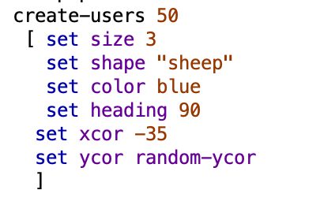
CREATE turtles
  We want to create some users and some hackers, and tell the computer what they should look like, where they should start out, and what direction they should face. Here is the code:
  You can choose other shapes by going to the top of the screen and clicking on Tools and the Turtle Shapes Editor. The heading of 90 means the users will all face the right side of the screen. The xor sets the x coordinate to -35, or partway on the left. The random y coordinate places the users at any point on the y axis.

Slide 7
CREATE hackers
  Use what we learned about the users to create 10 hackers and give them:
  a size (bigger than the users)
  a shape (a wolf, or choose your own)
  a color (not red or blue)
  set their heading to 90
  put them at xcor -45 (negative 45)
  give them a random ycor.

Slide 8
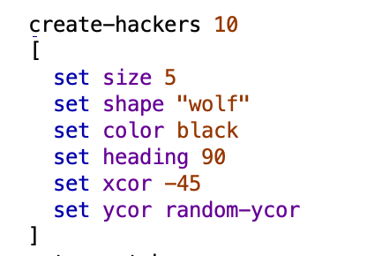
CREATE hackers
  Your code might look like this:

Slide 9
netlogo text colors
      Notice the colors of your text
      ;; Title (after semi-colons) is gray
      breed, To, and End are green - NetLogo understands those words (primitives)
      clear-all and set are blue ; size, shape, color are purple, the colors themselves and numbers are orange - this means these all have a specific meaning to Netlogo, and so you shouldn’t use those words (without at least a dash to another word) to mean anything else in the program.
      “users” and “user” and “hackers” and “hacker” are black - any black text identifies words you’ve used to name things that the computer can use, but only after you explain what they mean.

Slide 10
check Setup CODE
  At the end of the setup code, we always want the computer to keep track of “time” or “ticks” (each run of the whole code is a “tick” and it can be a substitute for keeping time in the model)
  At the end of your setup code (the last line before end), type “reset-ticks”
  Be sure to SAVE your model frequently
  Push the “check” button on the upper left of the coding window - see if the computer identifies any errors in your code so far. If not, go to the Interface screen and push the setup button. Do you get the users and hackers you expect to see?

Slide 11
More setup code: setting the “patch color”
  The model should now be creating the agents we want, but we aren’t quite finished with the background colors of the interface screen, which should also be created on setup.
  We want our model to have a “firewall” or a different colored background for agents outside the wall and inside the wall. We are going to write a procedure to make this work, but first we have to “call” the procedure within the setup code.
  After the code creating your agents, and before the “reset-ticks” type setup-patches. Notice this is in black, which means we need to tell the computer how to do it. Here, we have just named the procedure, and told the computer where to call it.
  After the “End” of the setup code, start a new procedure by typing
  To setup-patches
  End

Slide 12
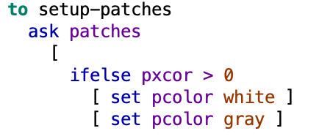
teaching the computer how to setup-patches
  We want half the screen to be gray (outside the firewall) and half to be white. In Netlogo, the patches are agents, and you can instruct them to set their patch color (pcolor)
  In between To setup-patches and End, we will use a “conditional logic” or ifelse block. We want to ask the patches to the left of center (less than 0 x coordinate) to set their color to gray, and the rest to be white. The code should look like this:
  The “ifelse” sets the test - is the x coordinate of the patch greater that 0 (the middle of the screen).
  If yes, do the action described in the first set of brackets (set patch color white).
  If no, do the second action and set the patch color to gray.

Slide 13
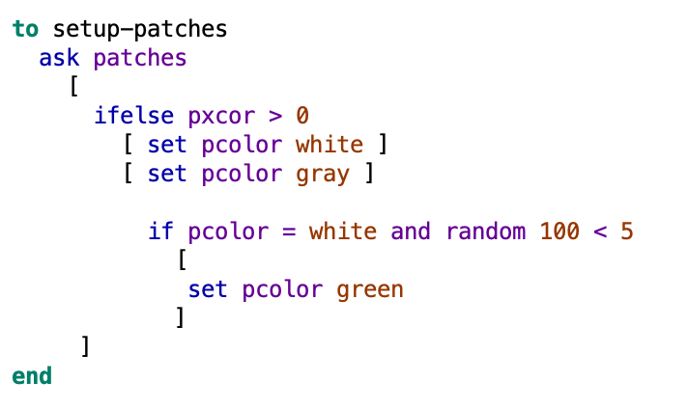
teaching the computer how to setup-patches
  Next, we want some of the white patches to turn green, to represent the internet connections inside the firewall. To do this we use a conditional logic block. The “if” code asks a true/false question, if the answer is true the computer does something, if it is false, it doesn’t do that thing
  We have a two-part question - first, we want to talk only to the white patches. Then, we ask them whether a random number between 0 and 99 is less than 5. (This is a way to make something happen a certain percent of the time). In other words, when the computer rolls a dice with 100 sides, does it get a 0, 1, 2, 3, or 4? If so, the answer is true, if not (if it rolls any other # 5-99) it’s false.

Slide 14
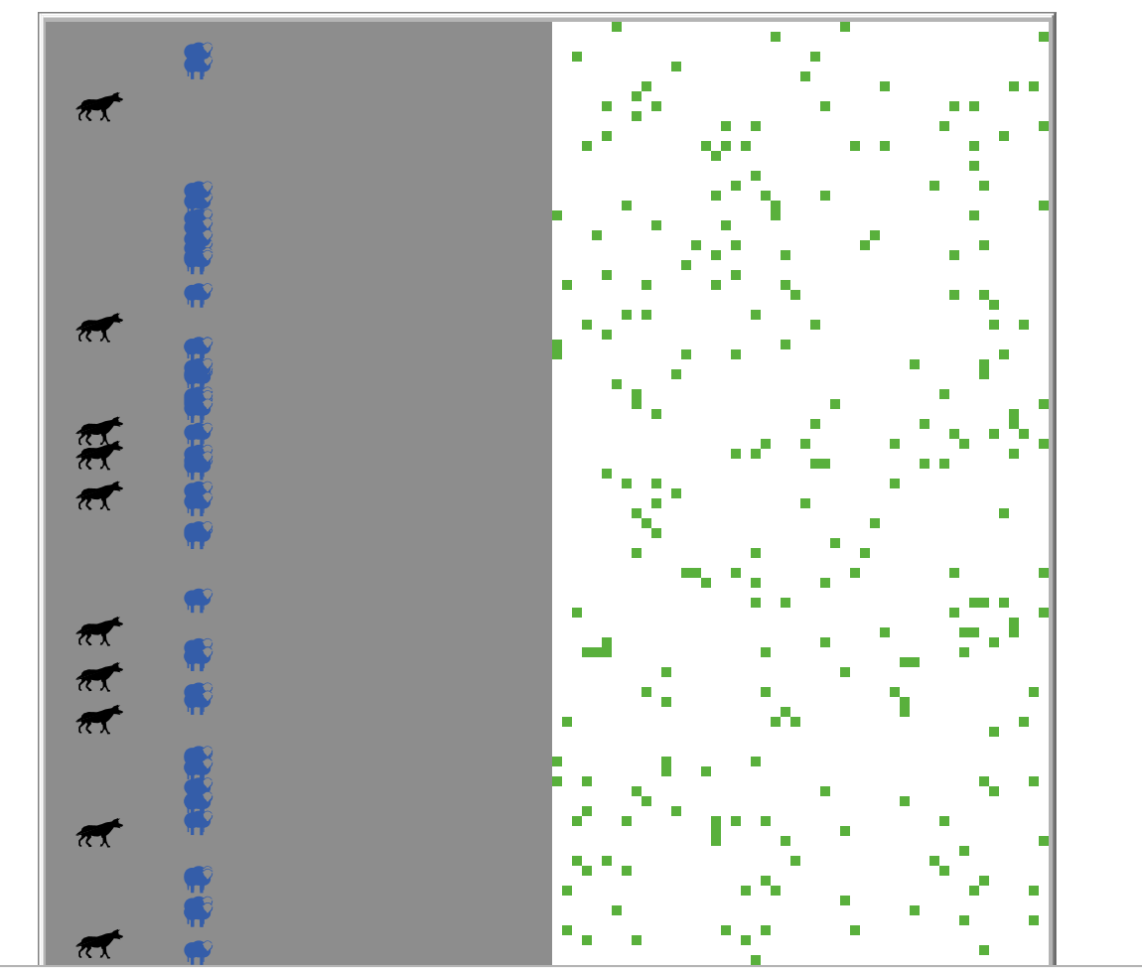
Setup code complete!
  Now, save your model, use the CHECK key to look for errors in your code, and go to the interface to hit the setup button. Do your agents line up the way you want, and does the screen look like we want? If not, let’s troubleshoot our code so far.

Slide 15
CONGRATULATIONS!
You are finished with the setup code.
Review:
Concepts | Types | NetLogo commands
agents | turtle patch world | ask-turtles ask-patches
conditionals |  | if ifelse
procedures |  | to end
Tabs | Interface Info Code

Slide 16
new procedures - GO Button
Create a go procedure - everything that should happen when you push the go button on the interface. This is a “forever” button - it will call all the procedures, in the order you place them, repeatedly until you click the button again. After the end of your setup procedure, type:
to go
end
Inside the procedure, type “tick” so the computer will count the ticks as the program runs.
Next, think about what we want the users to do.

Slide 17
Go procedures
First, the users need to walk around (moving toward the firewall, but not marching in a straight line). We are going to call this command “wiggle”, so between the TO GO and the END commands, type
ask users
[
wiggle
]

Slide 18
define the wiggle procedure
We told the computer to wiggle, but now we need to explain what that means. Create a new procedure by starting with “to wiggle” and ending with “end”. Inside, we want to tell the users to walk with a little bit of random movement (so they don’t march in a straight line). First, tell them to move left and right a random 10 degrees.

Slide 19
define the wiggle procedure
Now that the users are turning, they are ready to move forward. However, we want them to go quickly toward the firewall, but move slowly once inside it. Use an “ifelse” block to ask the users to forward 1 step if they are outside the firewall (how can they tell?) and .05 steps if they are inside. Add some comments to explain you code.

Slide 20
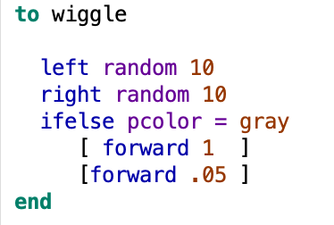
wiggle procedure
Your finished “wiggle” procedure might look like this:
Add some comments to explain your code, then save and check your model, and go to the interface to see if your users are moving the way you want.

Slide 21
Hacker procedure
If you tested your model, you notice the users are moving but the hackers are not. That’s because we haven’t included any hacker procedures in our “go” commands. Create a new “ask hackers” part of the go code, and inside it type “lope” Next, create a procedure called “to lope” We want hackers to move like users in the gray area (with perhaps a smaller wiggle angle), but to bounce off the white patches. See how far you can get using conditional logic to ask the hackers to check the patch color, and move forward with a small wiggle on the gray.

Slide 22
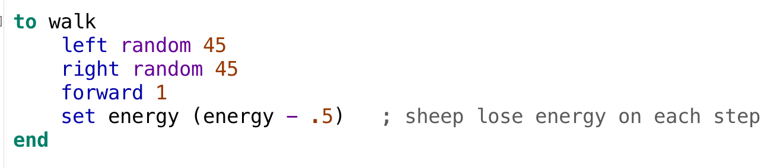
hacker procedures continued
We have the hackers loping toward the firewall but now we want them to bounce off. This is the second half of the “ifelse” command, if the pcolor is not gray, they should move back 5 and set their heading in a random direction (random 360). See if you can get the hackers to bounce off the white firewall.

Slide 23
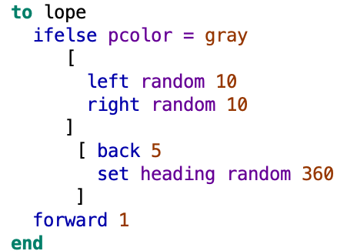
hacker procedures continued
Your lope command should be called in the forever code within the “ask hackers” and might look like this:

Slide 24
SAVE AND TEST
Save your model, and hit the “check” button in the upper left. If you do not get an error message, go to the Interface and see whether the setup and go buttons are working as you want them to. We have users and potential hackers, that are moving the way we want. To finish our model, we need to make the hackers steal the user’s passwords and so be able to go past the firewall. We also want them to “wreck” the internet connections they use inside the firewall. So, we need 2 more procedures.

Slide 25
“steal-passwords” procedure
We want the hackers to have a random chance of stealing a password from a user if they bump into the user. First, we need to add “steal-passwords” to the “ask hackers” part of the Go procedure. Then, create a steal-passwords procedure by typing
steal-passwords
end

Slide 26
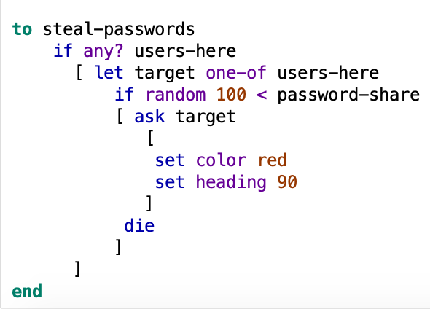
steal-passwords code
Your steal-passwords code should look like this:

Slide 27
steal-passwords
We are asking the hackers to steal the password with a random percent chance, which we want to control with a slider called password-share. (Notice that this text is in black in our code, so we need to explain it to the computer). To make this code work, we need to go back to the Interface and make a slider button. On the Interface, use the drop-down arrow to change the word “button” to “slider” and then click the Add button, and draw in a slider with your mouse.

Slide 28
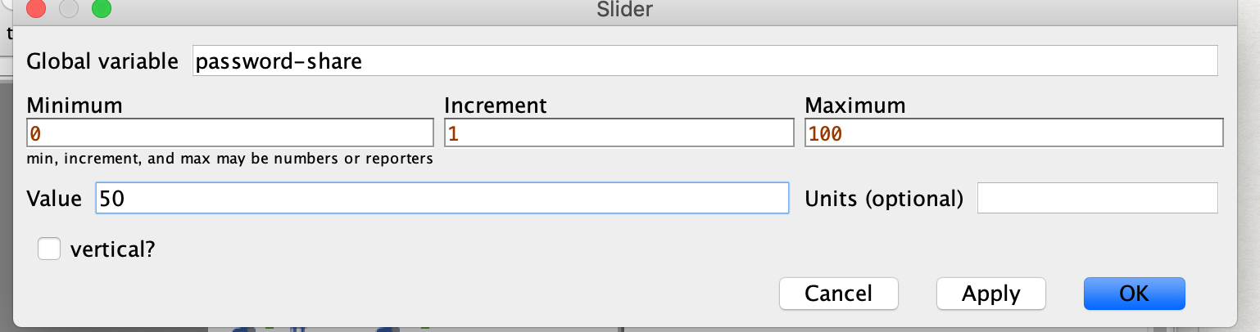
password-share slider
When you have drawn in the slider, a window will open letting you set the parameters. Since this will be a percent of the time the hacker steals the password, you want the minimum to be 0 and the maximum to be 100. The value is where the slider will be set when you open the model. When your slider settings look like this, click OK:

Slide 29
active hacker procedure
We are also going to ask the active hackers (who are a kind of super-user, so will follow the user procedures) to “wreck” the internet connections. Go back to your “go” procedure, and on the next line after “wiggle” type
    wreck
Now, we need to teach the computer how to “wreck”. Make a new procedure by typing
    To wreck
      End
      Inside the procedure, first identify the active hackers (red users) and create a conditional logic block that asks them to change the patch color of any green patch they land on to white. Put some comments in your code to explain to yourself what you are doing.

Slide 30
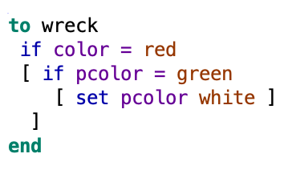
Active hacker procedure
Your code might look like this:
Add some comments after the code to explain what you are doing.

Slide 31
SAVE AND TEST
We have written all procedures, so save your model,, hit the “check” button, and go to the Interface to see if the model runs.

Slide 32
CONGRATULATIONS!
You have a model that behaves as you want it to, but you can’t collect any data yet. Let’s create some data boxes to see how the number of agents and patches change, and we can add code to make the model stop so we can collect data easily. On the interface tab, choose “monitor” from the drop down arrow on the upper left, then hit the green plus sign ADD button, then use your mouse the put the button where you want it. You should see a “reporter” screen, and to count hackers, type in “count hackers”. In the display area, we want this button to show the number of potential hackers.

Slide 33
more data boxes
Push setup, and see that the potential hackers monitor shows the number of hackers created. Push go, and the monitor should show the changing number of hackers. Once this monitor is working, make a monitor to count the number of active hackers (count users with [color = red]). Finally, create a monitor to count the internet connections (count patches with [pcolor = green]. Test the model on the interface to see if the numbers change to show what’s happening with the agents and patches.

Slide 34
we have a model!
Now that you have a working model with monitors, we can add some code to tell the model to stop when something occurs, so we can easily collect data. Let’s stop the model when all potential hackers have become active hackers. To do this, go back to the top of the “TO GO” code, and add: if count hackers > 0

Slide 35
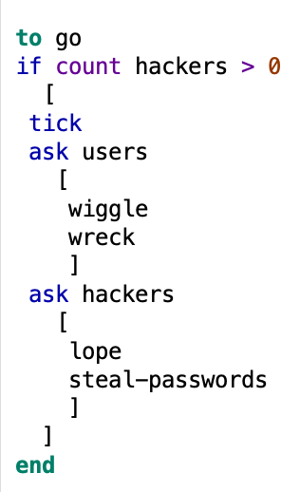
we have a model!
Your complete go code should look like this:

Slide 36
experiment!
Now that you have a working model with monitors and a stop code, think about what this model can tell us. The basic experiment we can run asks what password-share setting will keep some potential hackers out of the system, either forever or for a certain length of time (ticks). What is your prediction about how the percent of password sharing will change the results of the model? How can and should we test your prediction?

Slide 37
modify!
What else can our model easily test? We could change the “stop code” to stop the model running when all internet connections have been “wrecked”.
How can we change the model to make it a more realistic test of how password stealing occurs? What could we change about the behavior of the agents that would more closely fit reality? What could we add to the model? Do we need more or different agents, patches, monitors, behaviors? What is an interesting question we could modify our model to answer?
Thanks for your participation in the Supercomputing Challenge 2019-20! See you in April!

