Slide 1

Introduction to the Command Line
Talking Directly to your Computer!
Sara Hartse | sara.hartse@gmail.com

Slide 2


Introduction
About me
  From Santa Fe
  Project GUTS and Supercomputing Challenge
  Internships with LANL, SimTable, Microsoft
  I work at Fastly
About this talk
  What is a command line?
  Why might you want to use it?
  Getting started
  More resources
SCC 2009 - 2010

Slide 3
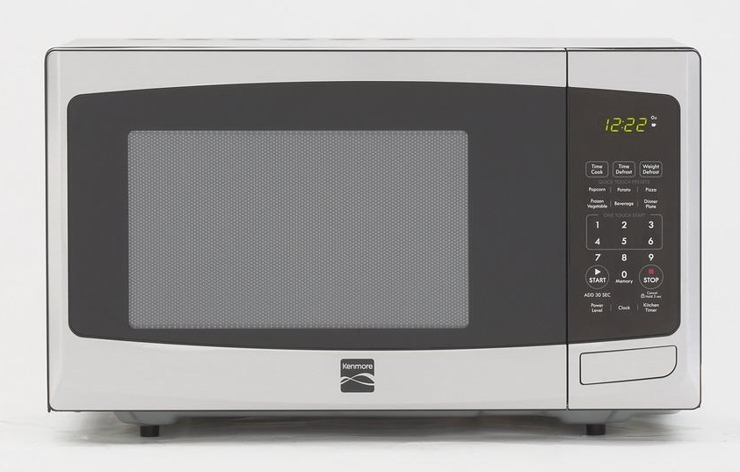
What is a User Interface?
By Consumer Reports, CC BY-SA 4.0, https://commons.wikimedia.org/w/index.php?curid=48764116

Slide 4
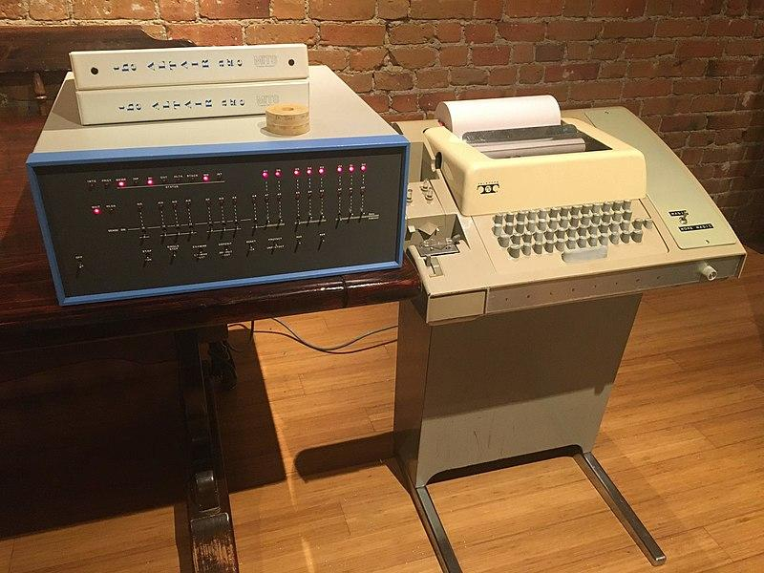
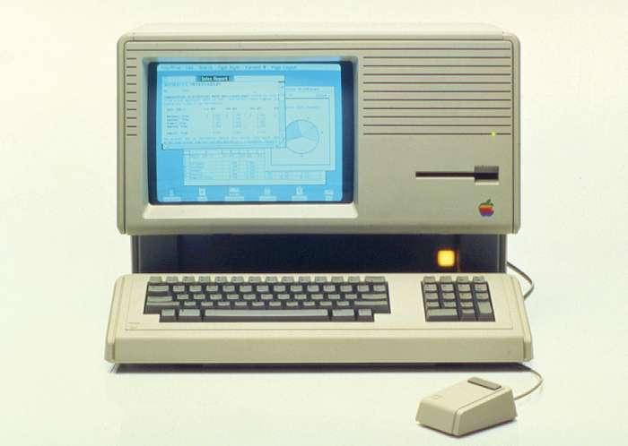
History of Computers
1975: Altair 8800 computer with terminal
1985: Apple’s ‘Lisa’

Slide 5


Slide 6
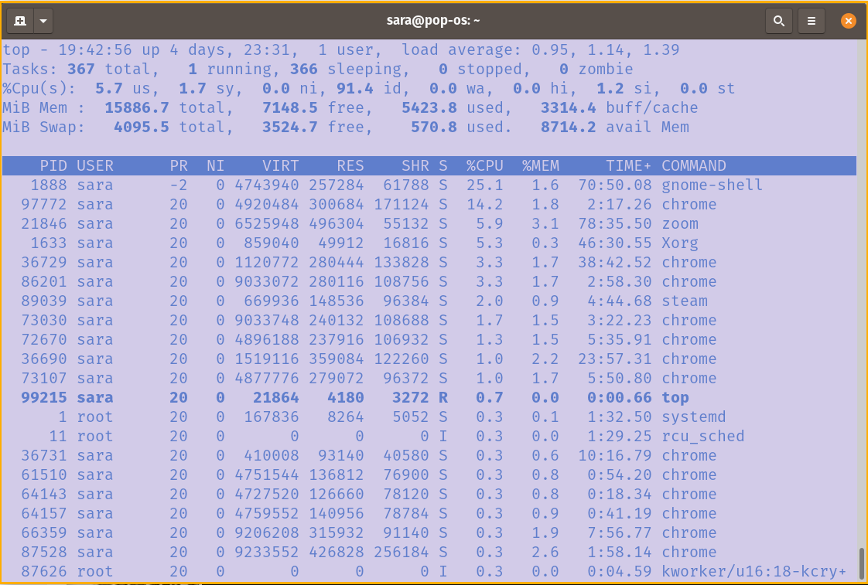
Sara in 2013

Slide 7
Why Use the Command Line?
Find information that might be hidden by default
Automate tasks that would be annoying to do with pointing and clicking
Have a finer control on what software you install
Run many different types of programs
  Some software, like git is used primary in the command line
Learn more about how computers think about themselves
  Filesystems! Operating Systems! Processes! Networks!

Slide 8



Starting the Command Line
Linux* | Mac | Windows
Search “Terminal” | Search “Terminal” | Search “Command Prompt”
sara@pop-os:~$|
*I run Ubuntu, learn more here: https://ubuntu.com/download

Slide 9
What’s running on my computer?
Linux | Mac | Windows
$ top | $ top | $ tasklist
sara@pop-os:~$ top
PID USER PR NI VIRT RES SHR S %CPU %MEM TIME+ COMMAND
25784 sara 20 0 13.1g 620868 133792 S 23.2 3.8 85:27.22 chrome
69839 sara 20 0 703552 197004 132268 S 1.7 1.2 3:48.15 steam
77595 sara 20 0 21872 4012 3228 R 0.7 0.0 0:00.07 top

Slide 10
What does a command do?
Linux | Mac | Windows
$ man uname | $ man uname | $ help systeminfo
sara@pop-os:~$ man uname

Slide 11
Where am I?
Linux | Mac | Windows
$ pwd | $ pwd | $ cd
sara@pop-os:~$ pwd
/home/sara

Slide 12
What is here?
Linux | Mac | Windows
$ ls | $ ls | $ dir
sara@pop-os:~$ ls
accounts develop Downloads Music Public Steam Videos
Desktop Documents hello.py Pictures PycharmProjects Templates

Slide 13
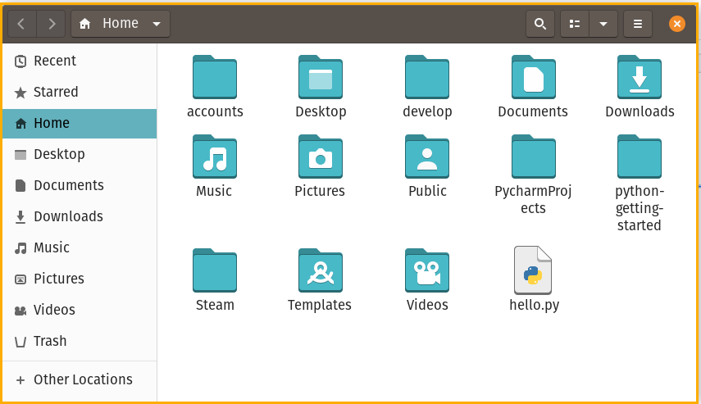
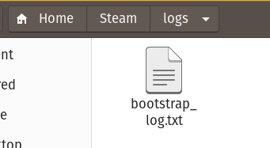
More about files
Organized in the same way you see in the GUI menu
Directories (folders) and files are located by a “path”

Slide 14
Move between different directories
Linux | Mac | Windows*
$ cd <pathname> | $ cd <pathname> | $ cd <pathname>
sara@pop-os:~$ ls
accounts Desktop develop Documents Downloads hello.py Music Pictures Public PycharmProjects python-getting-started Steam Templates Videos
sara@pop-os:~$ cd Steam/logs/
sara@pop-os:~/Steam/logs$ ls
bootstrap_log.txt

Slide 15
Create a New Directory
Linux | Mac | Windows
$ mkdir TestDir | $ mkdir TestDir | $ md TestDir
sara@pop-os:~$ mkdir TestDir
sara@pop-os:~$ mkdir TestDir/ChildDir
sara@pop-os:~$ cd TestDir/
sara@pop-os:~/TestDir$ ls
ChildDir

Slide 16
Reference Material
Linux | Mac | Windows
Introduction to Bash https://cs.lmu.edu/~ray/notes/bash/ | Index of the Apple macOS command line (macOS bash) https://ss64.com/osx/ | Index of Windows CMD commands https://ss64.com/nt/

Slide 17
Writing your own programs
We’ve learned about a few simple commands, but what if we could combine them?
  Backup all my files to an external hard drive
  Clear my browser history at midnight every night
  Make a reminder system for my TODO list
This is Shell Scripting
  On Linux and Mac, this is typically done with a language called bash. On Windows, there is called batch
You can use many programming languages to interact with the files and programs on your computer - python is a common choice

Slide 18
Installing Software
Especially on Mac and Linux, it’s common to install software using the command line
sudo apt install cowsay
brew install cowsay
Warning! Just like any new software you install (or things you download) be careful that your understand your sources
  And don’t run commands you find online unless you understand what they do!

Slide 19
More to Explore!
Dual booting Linux or installing the Windows Linux subsystem
Collaboration and backups (version control) with git
  Check out Windows specific resources here
Finding your favorite text editor or IDE
  Vim, Emacs, Nano, Sublime, Eclipse, Visual Studio, Pycharm and more!
cron - schedule programs to run at certain times
cmatrix
Make weird ascii art
  See sl
  Or watch star wars! https://asciinema.org/a/8

Slide 20
____________________________________
< That is all I have! Any questions? >
------------------------------------
\ ___-------___
\ _-~~ ~~-_
\ _-~ /~-_
/^\__/^\ /~ \ / \
/| O|| O| / \_______________/ \
| |___||__| / / \ \
| \ / / \ \
| (_______) /______/ \_________ \
| / / \ / \
\ \^\\ \ / \ /
\ || \______________/ _-_ //\__//
\ ||------_-~~-_ ------------- \ --/~ ~\ || __/
~-----||====/~ |==================| |/~~~~~
(_(__/ ./ / \_\ \.
(_(___/ \_____)_)

