Slide 1
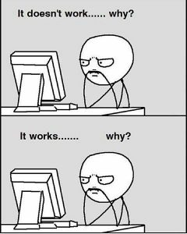
Coding Is:
30% Google Errors
10% Staring with your colleagues at the screen
40% Debugging
5 % Copy/paste solutions from stack overflow
10% Coffee Breaks
5% Actually Coding

Slide 2
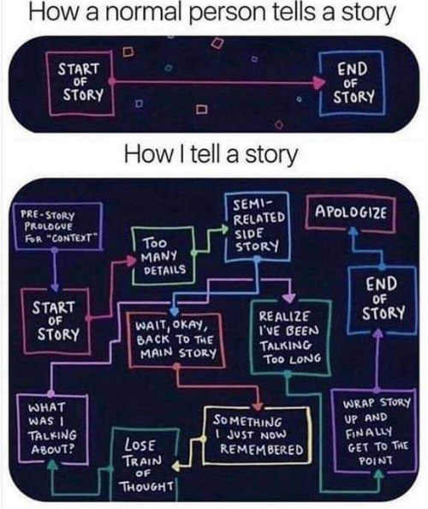
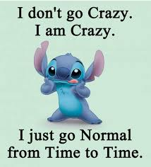
Last May I was granted a opportunity to attend a Summer PD… I was told by my family I was insane and I should breath and take a breath after the crazy year I had had. I did not know just what this opportunity would bring.
I think most of us had one of those years. Our students were relearning how to rehuman after the pandemic and so many things had changed.

Slide 3
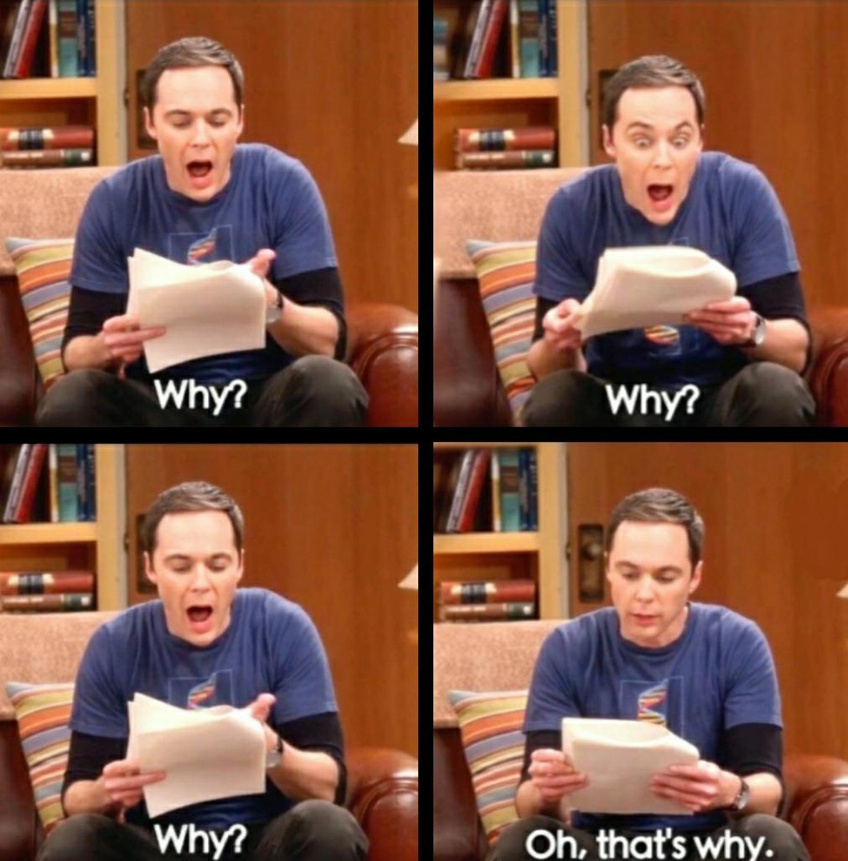
I evaluated and rediscovered my “Why”?
Some of you are probably asking she did huh/what?
Some of you are thinking “She’s GONE.”
Very serious at one point or another those of you that are human will have one of these moments and you may not only have one…

Slide 4
Why?
What is your why? (play 30 sec)
My reason- What’s yours?
Share yours with the humans around you.

Slide 5
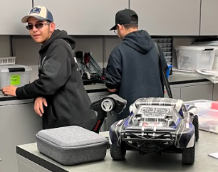
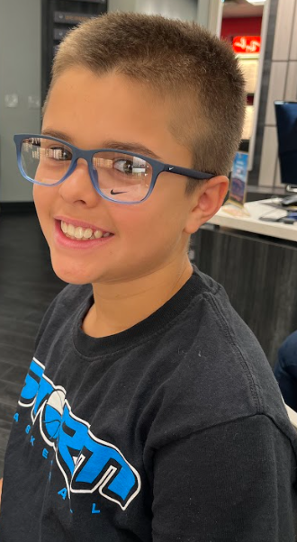
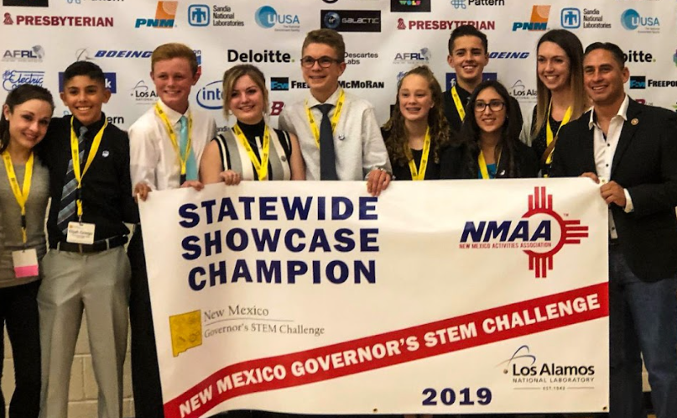
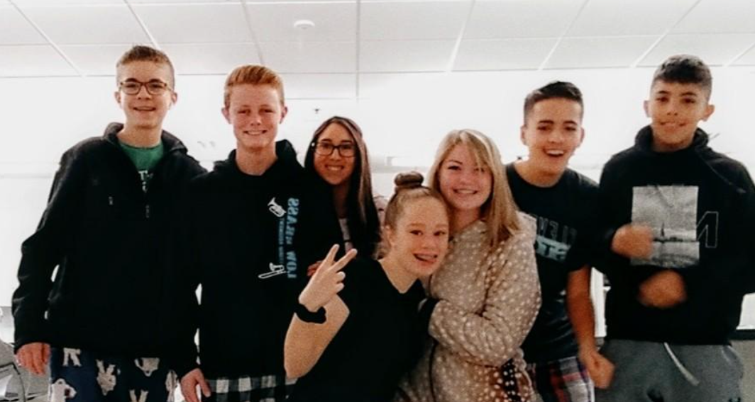
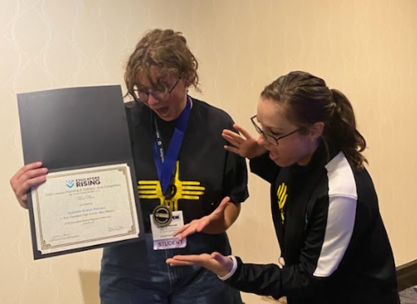
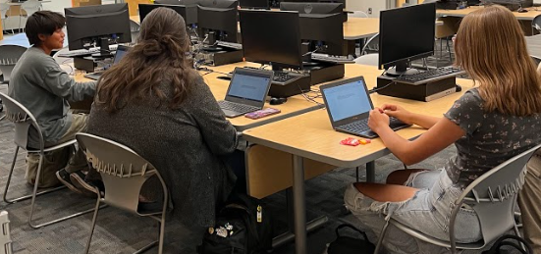
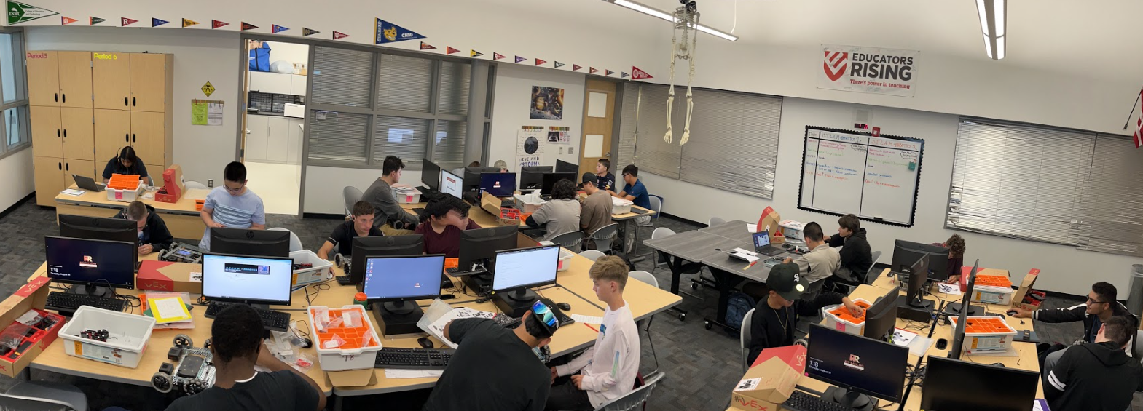
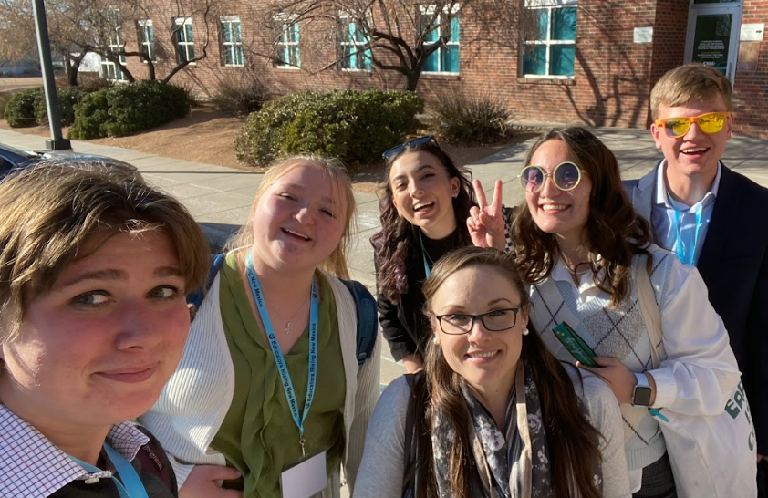
A few of my “Whys”.
Some of them stay with me and always will.
My “Why”, could not be more proud and blessed to have him.
Every year I get about 175-180+ more “Whys”.

Slide 6
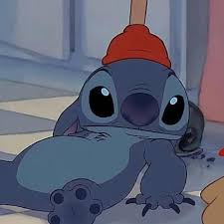
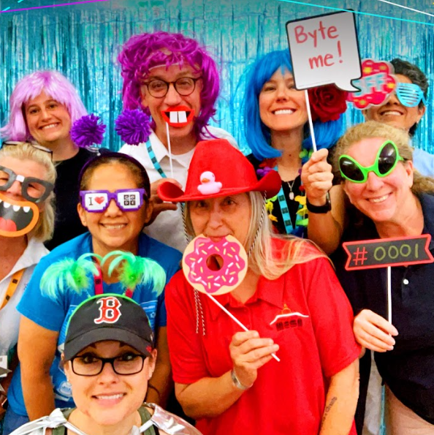
What I learned
How amazing it was to work with humans in person again.
This experience reset my passion for teaching.
If you get the chance to attend the NM Computer Science Alliance PD GO!
Arduino is a friend not foe. I gained skills-Who knew?!
Tinkercad Rules
Random Nerd Tutorials
Random Nerd Tutorials Specific to Arduino
Real
Educators hard at work!

Slide 7
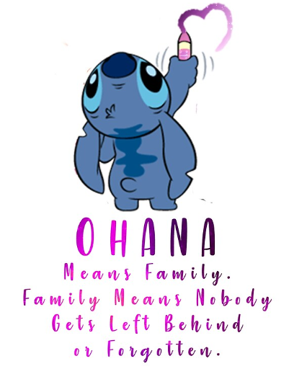
What I Made/Accomplished
I teach S.T.E.A.M. +Robots-my course has a TON of flexibility and my goal is to expose my students to as much as I can in the brief time I have them.
PD I selected: “One Lane Bridge” Challenge presented by Dr. Steve Cox (Northern Community College & Ester (Santa Fe High Engineering Teacher).
My Project
Working on the project, collaborating with others reset my teaching.
I came back with avengence this school year. (4 clubs, competitions: Supercomputing, NASA, Robot Combat, Ed. Rising State, Expo, New partnerships, etc.)
AGAIN- If you get the chance to attend the a NM CS Alliance PD GO!

Slide 8
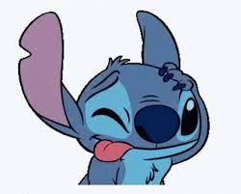
Things to Make you think, ALL the thinks…
These are a few resources I have come across. Teachers are professional borrowers. These are a few things I have collected.
A world where fish are no longer forced to climb trees.
A few resources for all ages.
Tinkercad Rules
Random Nerd Tutorials
Random Nerd Tutorials Specific to Arduino

