Slide 1
Data Visualization
New Mexico Supercomputing Challenge Webinar
January 19, 2023

Slide 2
Agenda
Intro
Why visualize data?
Visualization greatest hits
Q&A

Slide 3
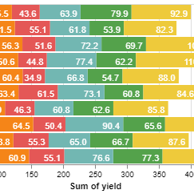
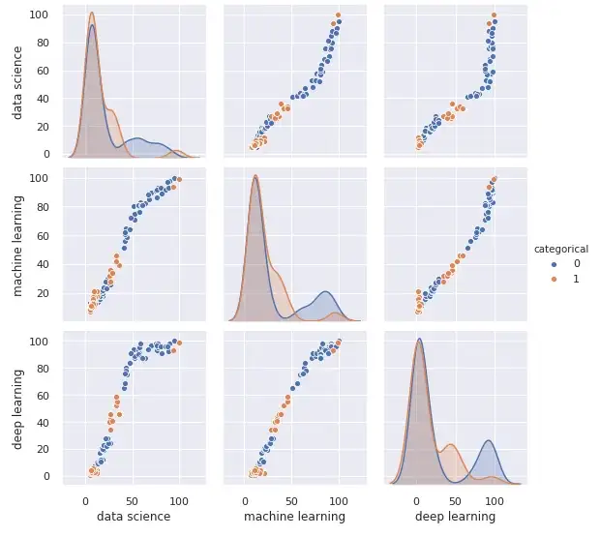
Introduction
Welcome to the January 2023 webinar hosted by the NM Supercomputer Challenge!
Today’s topic is data visualization: what it means, why it’s important, and some thoughts on how to use visualizations effectively.

Slide 4
Why visualize data?
Understanding across contexts

Slide 5
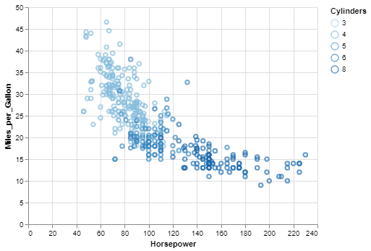
Why invest in visualizations for your data?
Contextual understanding is critical but not obvious
Comparative analysis is the basis of all useful conclusions drawn from data
Diverse audiences mean you must take a multi-faceted approach

Slide 6
Visualization greatest hits
What excellent looks like

Slide 7
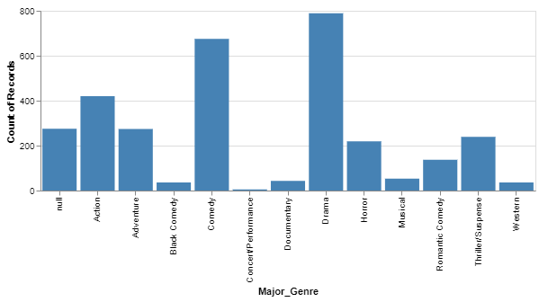
Example – Descriptive Visualizations

Slide 8
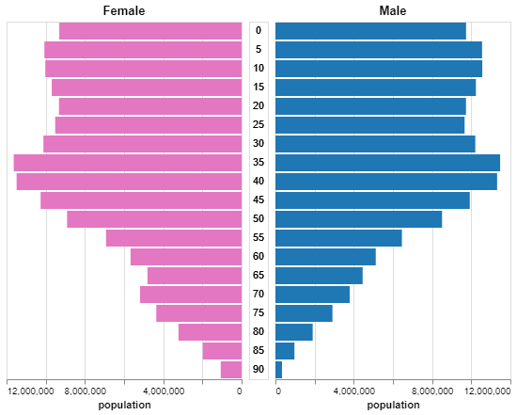
Example – Descriptive Visualizations

Slide 9
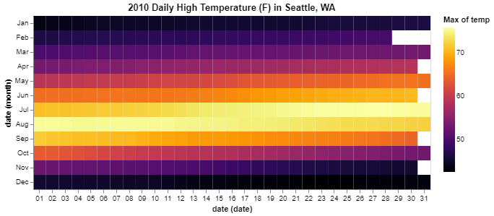
Example – Chronological Visualizations

Slide 10
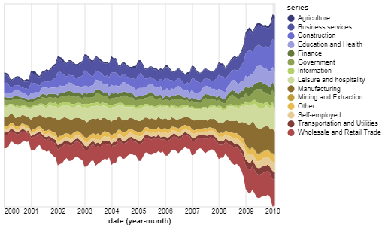
Example – Chronological Visualizations

Slide 11
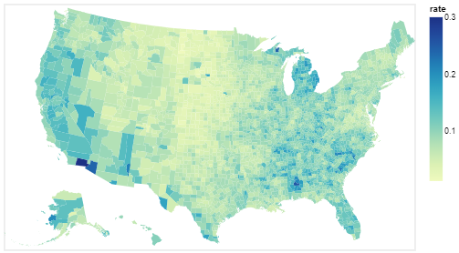
Example – Geographic Visualizations

Slide 12
Thank you
Mariah Carter
mariahfrancescarter@gmail.com
Link to example gallery

