Slide 1
THE CLASSROOM TECH TALK
AI:
SMART, SAFE
& SUSTAINABLE?
What counts as AI? • Who does it affect? • What does it cost?
NO HYPE. JUST THINK.
ARTIFICIAL INTELLIGENCE • ETHICS • ENVIRONMENT
01 / 16

Slide 2



AI / THINK LAB
TODAY’S MISSION
3 BIG QUESTIONS
No memorizing a buzzword. We are here to THINK about technology.
01
02
03
WHAT COUNTS
AS AI?
WHAT IS
FAIR?
WHAT DOES
IT COST?
Spot the difference between AI and ordinary code.
Debate privacy, bias, honesty, and responsibility.
Explore AI’s energy, water, and real-world impact.
DISCUSS • QUESTION • DECIDE
02 / 16

Slide 3
Intro To artificial Intelligence!
Notes:
Okay, so this class is all about artificial intelligence.

Slide 4
Key points
Throughout the lesson, these are the key points to emphasize…
Most AI is made up of 3 components: a dataset, an algorithm, a prediction
These 3 components can be used as criteria to evaluate if a technology is AI or not.
A dataset is a collection of curated data
Data can be images, videos, music, text, gestures, etc., really any collection of information
Notes:
For Teacher Reference (not student facing)

Slide 5
What does
“Artificial Intelligence”
make you think of?
Notes:
Have you heard this word before? What do you think it means? What does it make you think of?

Slide 6
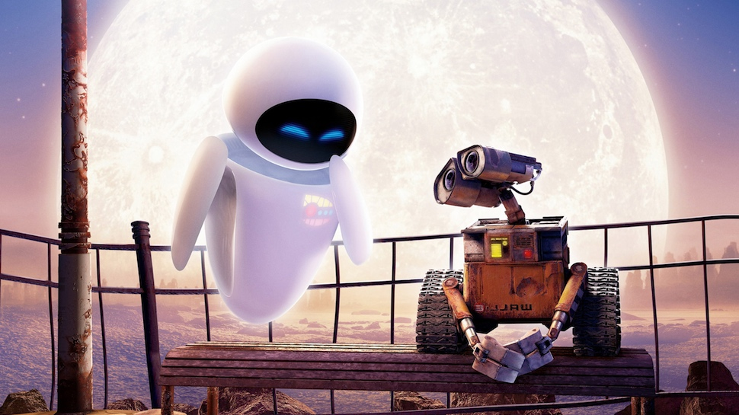
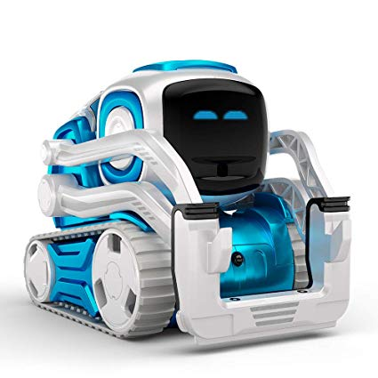
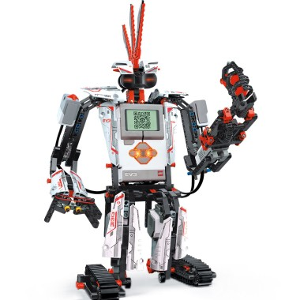

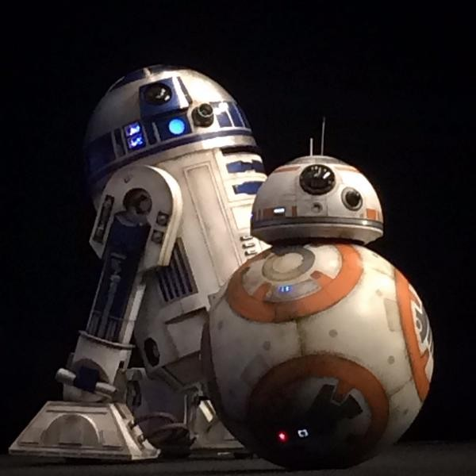

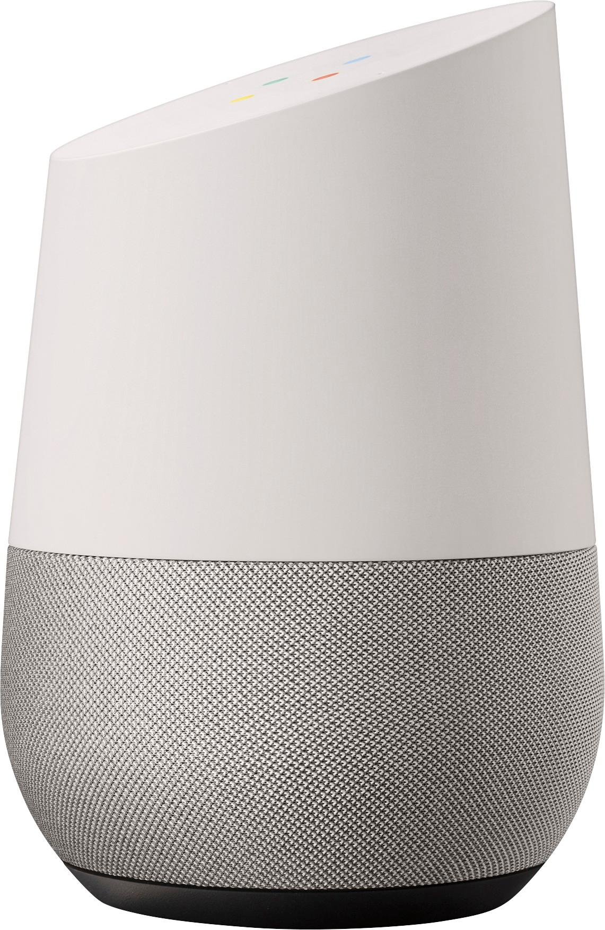
Notes:
So most people think of artificial intelligence as robots. Does anyone recognize these robots here? Which one is your favorite? Write them in chat, or say it out loud.

Slide 7

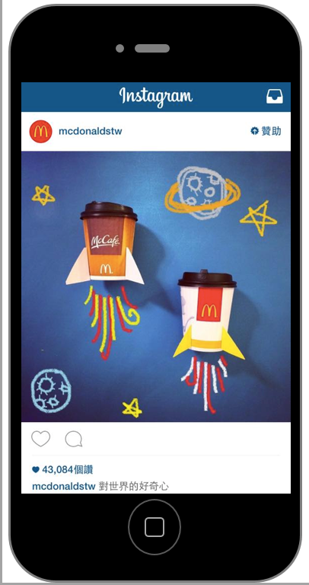
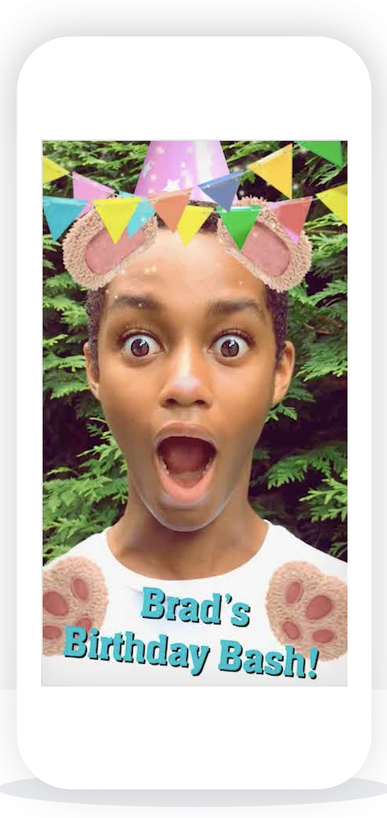
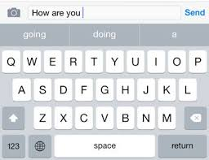

Notes:
Robots are my favorite type of AI, but they aren’t the only type. AI is actually present in many technologies that we use every day. For example, it is found in YouTube, in text messaging, our instagram and tiktok feeds, and in camera filters. AI can be categorized as something that uses data to make a prediction about something. Let’s explore that more.

Slide 8
"Making computers perform “intelligent” tasks such as recognizing things, understanding them, and making decisions about them."
Notes:
AI is defined as "Making computers perform “intelligent” tasks such as recognizing things, understanding them, and making decisions about them."
AI can be categorized as something that uses data to make a prediction about something. Let’s explore that more.

Slide 9
Parts of machine learning
learning algorithm
prediction!
dataset
Notes:
Most types of AI can be broken down into 3 parts. A Dataset, a learning algorithm, and a prediction. We’ll go more into detail to each one of these. The goal of an algorithm is to make a prediction about something.

Slide 10
Parts of machine learning
dataset
Notes:
Has anyone heard of a dataset before? What does it make you think of?

Slide 11
What is a
“dataset”?

Slide 12
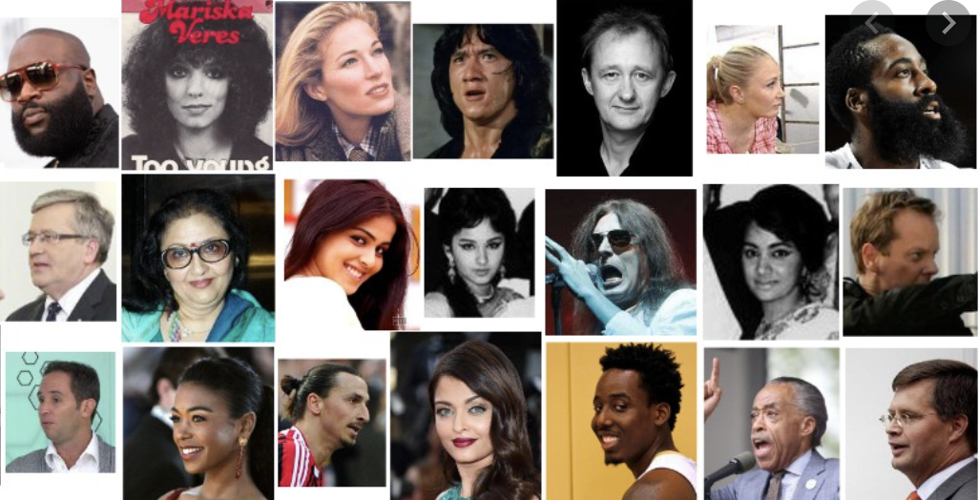
Datasets
A dataset is a collection of curated data
Images
Measurements (time, views, inches, etc)
Text
Video recordings!
VGG Face2 Data Set– paperswithcode.com
Notes:
A dataset is a collection of data that you put together. Data can include anything! We typically think of data as numbers, but it could also be a collection of text, video, or images.

Slide 13
Parts of machine learning
dataset
Notes:
So, a dataset gets fed into a learning algorithm in order to make a prediction.

Slide 14
Parts of machine learning
dataset
learning algorithm
Notes:
Does anyone know what an algorithm is?
An algorithm also includes three parts: input, steps to change the input, and then output. For example, adding a contact to your phone is kind of like an algorithm. You take a contacts name and phone number, you put it into your address book, and you get out a new contact.

Slide 15
Algorithm
learning algorithm
prediction!
dataset
Notes:
The last part of AI is a prediction. This can be anything such as what YouTube video you might like or what a face is for a filtering app.

Slide 16
Let’s try some examples
Notes:
Let’s put it all together with some examples!

Slide 17
Instagram advertisement
prediction?
Notes:
What is instagrams algorithm trying to predict? Think about what kinds of ads you get?

Slide 18
Instagram advertisement
What you will click on

Slide 19
Instagram advertisement
learning algorithm
What you will click on

Slide 20
Instagram advertisement
learning algorithm
What you will click on
dataset?
Notes:
What kind of dataset do you think this learning algorithm is learning from… do you notice patterns?

Slide 21
Instagram advertisement
learning algorithm
What you will click on
Past clicks
Brands you follow and people like you
Text in captions

Slide 22
EMAIL SpAM filter
learning algorithm
prediction!
dataset

Slide 23
EMAIL SpAM filter
prediction?

Slide 24
EMAIL SpAM filter
If email is spam or not

Slide 25
EMAIL SpAM filter
learning algorithm
If email is spam or not

Slide 26
Email Spam Filter
learning algorithm
If email is spam or not
dataset?

Slide 27
Email spam Filter
learning algorithm
If email is spam or not
Past emails you have labeled as spam
Text of emails

Slide 28
AI or not??

Slide 29


Slide 30
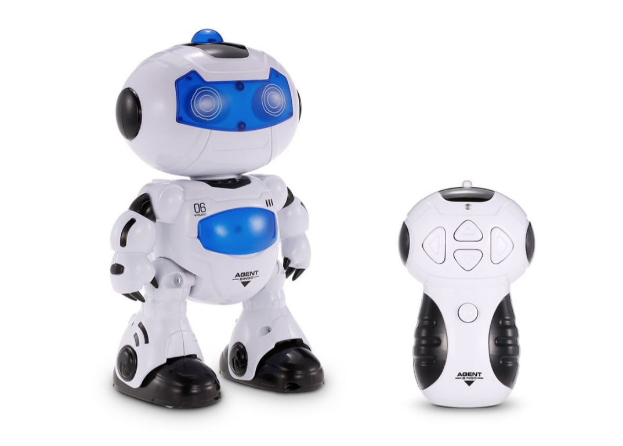

Slide 31
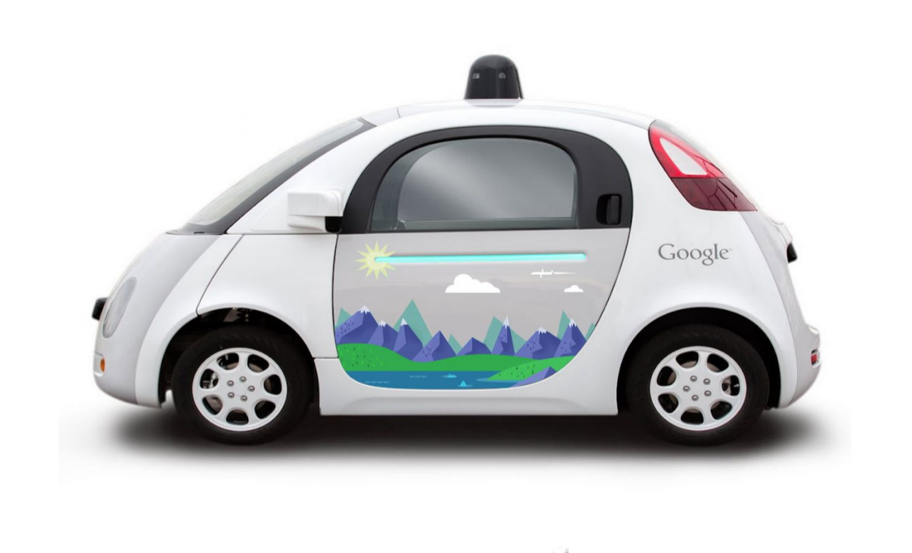

Slide 32
Dataset:
Prediction:

Slide 33
Dataset: routes that people have taken in the past
Prediction: how to get somewhere

Slide 34
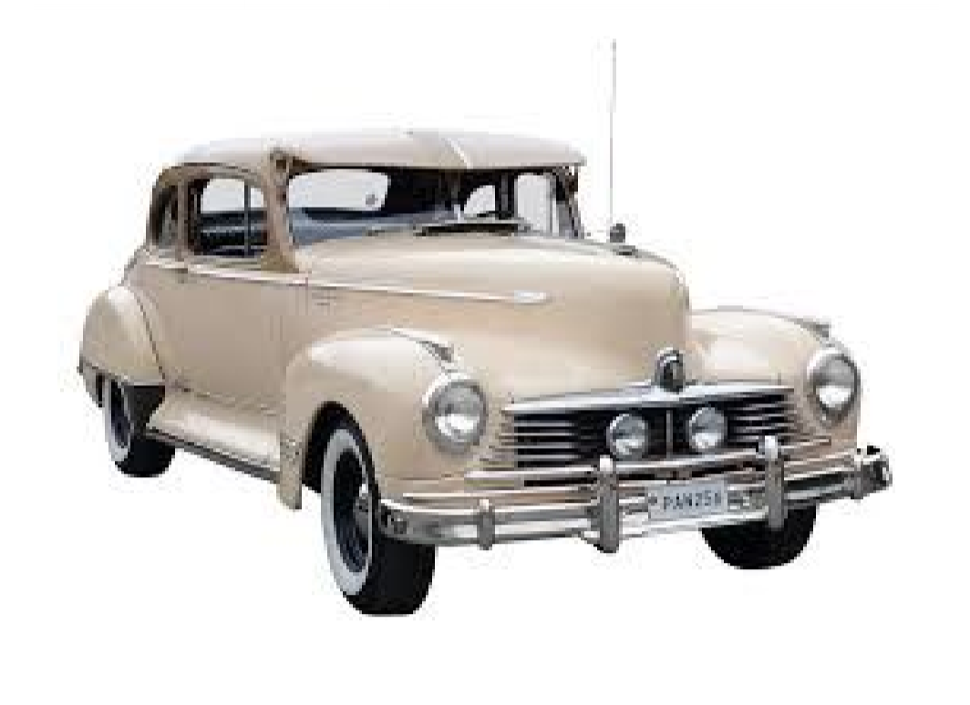

Slide 35
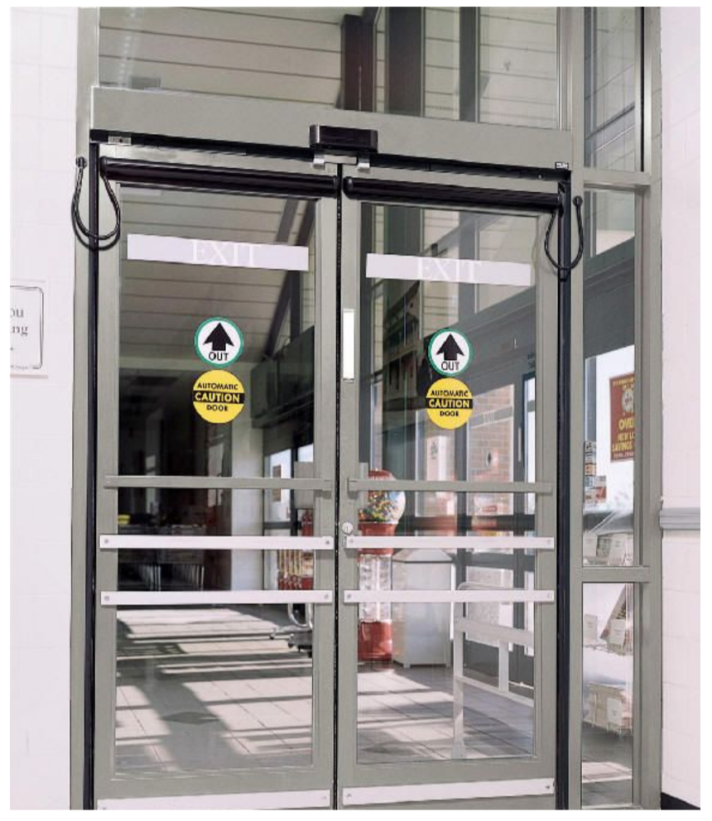

Slide 36
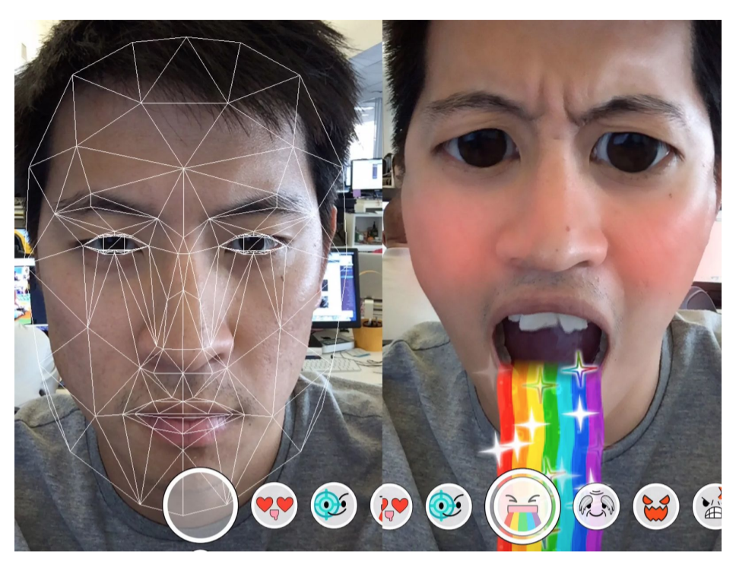

Slide 37
Dataset:
Prediction:

Slide 38
Dataset: examples of faces
Prediction: where to put the filter on your face

Slide 39
Now you try! AI or NOT
Notes:
Assessment

Slide 40




AI / THINK LAB
SPOT IT IN REAL LIFE
YOU PROBABLY USED AI TODAY
Different AI tools do different things. They are not all chatbots.
RECOGNIZE
PREDICT
A camera app identifies a face or object.
An app estimates tomorrow’s traffic.
RECOMMEND
GENERATE
A playlist suggests your next favorite song.
A chatbot drafts text from your prompt.
AI ≠ JUST CHATBOTS
04 / 16

Slide 41


AI / THINK LAB
MINI CHALLENGE
AI? NOT AI? IT DEPENDS?
Make your call first. Then tell a partner WHY.
A
A thermostat turns on at 68°F.
B
A photo app identifies dog breeds.
C
A vending machine gives exact change.
D
A chatbot writes an original story.
VOTE WITH YOUR HANDS / NO PEEKING!
06 / 16

Slide 42

AI / THINK LAB
MINI CHALLENGE • REVEAL
THE ANSWER IS…
Explain what each system does behind the scenes.
A + C
B + D
NOT AI
AI
Fixed temperature thresholds and exact-change rules can work with ordinary programming.
Image classification and generative writing commonly use trained AI models.
KEY IDEA • A fancy interface does not prove something uses AI.
07 / 16

Slide 43
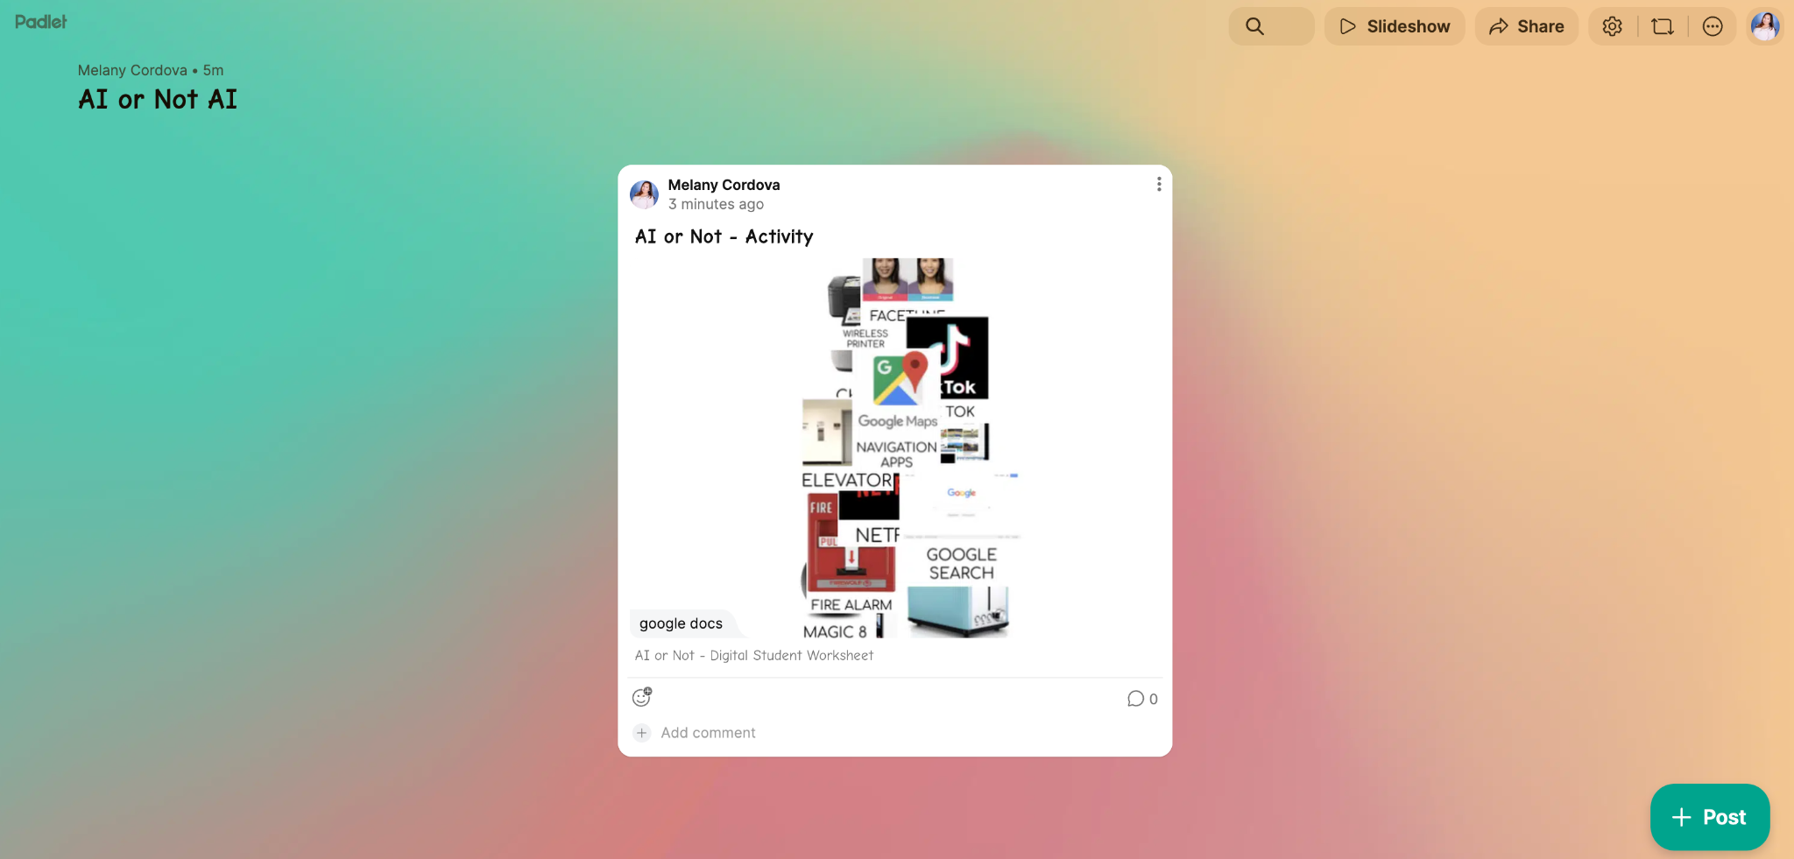
Now is your turn!
https://bit.ly/4rWZPXG

Slide 44


AI / THINK LAB
THE BASICS
SO… WHAT EVEN IS AI?
AI can use data to infer outputs, spot patterns, or generate content.
→
→
INPUT
AI SYSTEM
OUTPUT
Text, images, sound, numbers, or other data.
A model uses patterns and learned relationships.
A prediction, recommendation, or new content.
IMPORTANT: AI is not automatically correct, conscious, or human-like.
03 / 16

Slide 45
AI / THINK LAB
AI VS. NON-AI
AI OR JUST AUTOMATION?
A tech product can look “smart” without using artificial intelligence.
USUALLY NOT AI
CAN USE AI
Basic calculator
Speech transcription
Countdown timer
Image recognition
Fixed light schedule
Predictive spam filtering
Simple “if / then” rule
AI writing assistant
PLOT TWIST: Some products combine both AI and regular code.
05 / 16

Slide 46


AI / THINK LAB
AI ETHICS
JUST BECAUSE
FAIRNESS
WE CAN…
Could it treat some people unfairly?
SHOULD WE?
PRIVACY
Who controls personal data?
Ethics asks who benefits, who might be harmed,
and who takes responsibility.
ACCOUNTABILITY
Who checks and fixes mistakes?
08 / 16

Slide 47



AI / THINK LAB
SPOT THE RED FLAGS
4 AI ETHICS RED FLAGS
If you notice one, slow down and ask questions.
BIAS
MISINFORMATION
It treats people differently or repeats stereotypes.
It gives convincing but false answers or fake media.
PRIVACY
OVERRELIANCE
Someone’s personal information gets exposed.
We trust an answer without checking its sources.
PAUSE. CHECK. THINK.
09 / 16

Slide 48
consequences?
Notes:
Instructor: We have talked about various technologies that use AI. You have even tried making your own AI projects with Teachable Machine!
We have also talked about various considerations to take into account when creating AI, such as algorithmic bias.
Now, we’re going to talk a bit more about what might happen after our technology is put into the world.
Specifically, the consequences of what we create.
Let’s unpack the word “consequences”. What does this word mean to you?
[Wait for students to answer]

Slide 49
Key points
Throughout the lesson, these are the key points to emphasize…
Consequences can be positive or negative
One consequence can lead or snowball into a larger benefit or problem than imagined
People developing technology products should weigh the consequences of building something vs the benefit it brings to the world

Slide 50
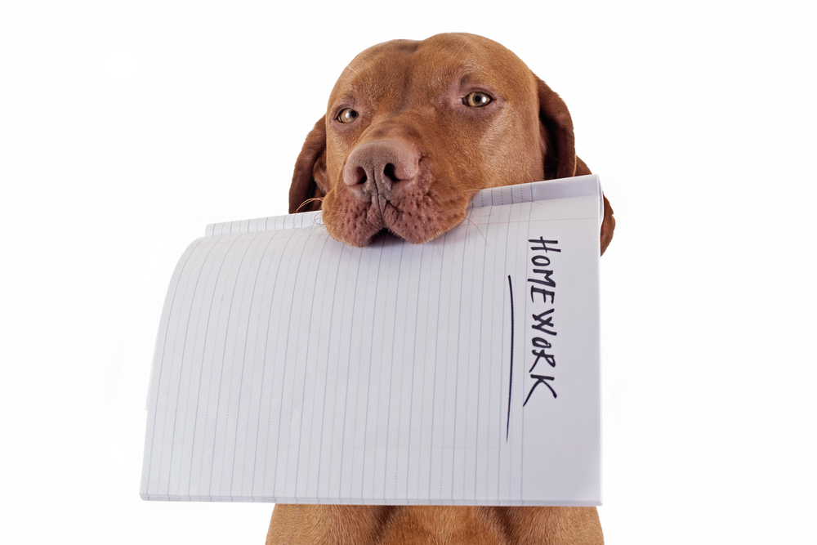
Notes:
We can think of consequences as “results” or “effects”. Let’s talk about some examples of consequences. For example, if you forget to hand in your homework at school, what might be a consequence?
[Wait for students to answer.
Notice if students are giving mostly negative consequences (very common).]

Slide 51

Notes:
Instructor: How about, what might be a consequence of watching a lot of YouTube videos about basketball tricks?
[Wait for students to answer.
Notice if students are again giving only negative consequences, and remind them that consequences can all be good.
Example of a good unanticipated consequence -
A consequence of watching a lot of YouTube videos about basketball tricks is that I get new ideas on what to do during a practice (a consequence), the new ideas encourage me to go to the park (another consequence), at the park I see some people playing basketball and ask to play with them (may be an unanticipated consequence), after playing we exchange numbers so we reach out to each other to play again (an unanticipated consequence).

Slide 52
Game!
Notes:
We’re going to play a game that allows us to think of the consequences of various scenarios. We’ll start off in our groups by coming up with a consequence of a GAN technology. Then, we’ll share that consequence (but not the technology!) with another group. We’ll continue to do that until we have 5 consequences for each starting technology!
[Play the game, then come back]
[View the lesson extension for a suggestion on how else to introduce the game]

Slide 53
Unanticipated Consequences!
Let’s see what will happen...

Slide 54
Directions!
(PART 1) (for online activity)
Directions for the First Group:
Read Slide 3, the Technology.
With your group, decide on a consequence of this technology.
Write your answer on Slide 4.
Cover the previous slide (Slide 3) with a rectangle shape.
Pass this slide deck to the next group.

Slide 55
Copy & Paste this box!

Slide 56
THE TECHNOLOGY
The Age Machine is a software that takes a photo of you right now and lets you know what you will look like in 20 years.

Slide 57
CONSEQUENCE 1

Slide 58
Directions!
(Part 2) (for online activity)
Directions for the next four groups (pretend you’re the next group):
Read only the uncovered text (in this case it’s Slide 9).
With your group, decide on a consequence of this technology.
On the next slide (Slide 11), write your answer on the next blank slide.
Cover the slide you read with a rectangle shape.
Pass this slide deck to the next group.

Slide 59
CONSEQUENCE 2

Slide 60
CONSEQUENCE 3

Slide 61
Directions!
(PART 1) (for in person activity)
Directions for the First Group:
Read the Technology.
With your group, decide on a consequence of this technology.
Write your answer underneath the technology.
Fold the paper so the technology is covered.
Pass the paper to the next group.

Slide 62
Let’s practice!

Slide 63
Unanticipated Consequences Practice
Let’s see what will happen…
Fold once!
Technology | The Age Machine is a software that takes a photo of you right now and lets you know what you will look like in 20 years.
Unanticipated Consequence 1
Unanticipated Consequence 2
Fold twice!
Notes:
Notice that there are boxes in the margin of this slide that you can use to model folding the paper!

Slide 64
Your turn!!
Notes:
Let’s share all the technologies, and the consequences we came up with for each.
[Have group leaders share]
What do we think of the consequences all of the groups came up with? Did they make sense, or did they surprise you?
[Wait for students to respond]
[View the lesson extension for a suggestion on how else to introduce the discussion]
What does the word anticipated mean?
[Wait for students to answer]
Yes, we can think of the word unanticipated meaning “not expected” or “not prepared for”. Did you anticipate the consequences that your classmates came up with?
[Wait for students to answer]
So, we could call the consequences we came up with today “unanticipated”. And when we put it together-- unanticipated consequences are effects that we didn’t expect would happen.
Do you think that technologists and designers anticipate the consequences of their own technologies? Why or why not?
Why do we think it is important to understand the unanticipated consequences of different technologies?
[Wait for students to answer, allow time for multiple perspectives]
It’s important to think about unanticipated consequences because we want to make sure that the technologies we make do not cause any harm to particular groups of people.

Slide 65
discuss
Notes:
Instructor: Let’s share all the technologies, and the consequences we came up with for each.
[Have a representative from each group share…
their group’s final consequence
the technology they started with
[After each representative shares, ask…
What do we think of this consequence? Does it make sense? Is it surprising?
[Wait for students to respond]
[When finished hearing from all groups, ask… ]
Were these unanticipated consequences? What does the word unanticipated mean?
[Wait for students to answer]
Yes, we can think of the word unanticipated meaning “not expected” or “not prepared for”. Did you anticipate the final consequence that your classmates came up with?
[Wait for students to answer]
So, we could call the last consequence each group came up with today “unanticipated”. And when we put it together-- unanticipated consequences are effects that we didn’t expect would happen.
Do you think that technologists and designers anticipate the consequences of their own technologies? Why might they want to anticipate the consequences? Why might they not want to anticipate consequences?
[Wait for students to answer]
Why do we think it is important to understand the unanticipated consequences of our technologies?
[Wait for students to answer, allow time for multiple perspectives]
It’s important to think about unanticipated consequences because we want to make sure that the technologies we make do not harm anyone.

Slide 66

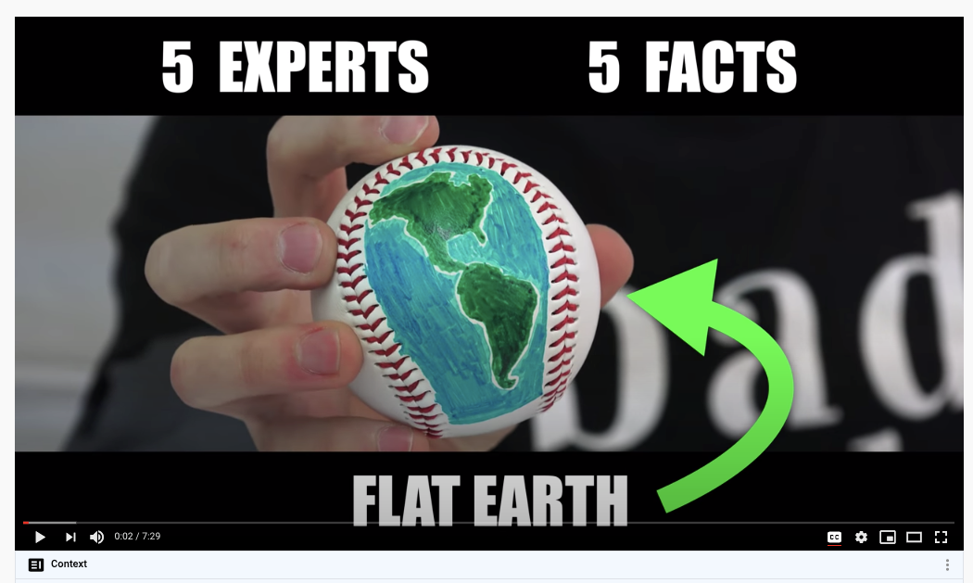
recommendations
Notes:
Instructor: Let’s talk about a real-world example of unanticipated consequences of technology.
YouTube’s recommender system! Has anyone had a video recommendation on YouTube before? How do you think Youtube decides which video to show you?
Research has shown that recommender systems seem to suggest increasingly conspiratorial or extreme content to its users, regardless of whether the user was searching for it or not. The article shows screenshots of “suggested videos” that were recommended to a brand-new user with no previous viewing history. For example, When the user searched for “lunar eclipse”, they were recommended videos implying that the Earth is flat (“Lunar Eclipse doesn’t work on your Globe!”). (citation: Wall Street Journal published an article entitled “How YouTube Drives People to the Internet’s Darkest Corners)
Let’s think about this for a moment. This is already a few steps into a string of unanticipated consequences, but let’s stretch our brains and taken this a step further: What might be an unanticipated consequence of YouTube recommending conspiratorial or extreme content to its users?
[wait for students to answer]
Yes. Some of your answers sound risky. Do you think there’s a risk that these unanticipated consequences could harm some people?
[wait for students to answer]
Then, we (as future AI developers) shouldn’t design our YouTube recommendation systems to recommend extreme content. What might we (as future AI developers) do to make sure that our algorithms don’t recommend extreme content?
[Wait for students to answer. Student answers might vary, but teachers are encouraged to remind students of lessons learned from the following lessons…
Lesson 0.4 Decision Trees, Activity #2 Is It for Winter?, where students adjusted the training dataset to teach an AI how to label clothes for the seasons. This suggests that we could change the way our training dataset is labeled so that extreme content doesn’t creep in by accident. Maybe we change the labels so that our algorithm notices extreme content and removes it.
Lesson 1.2 Teachable Machines, Activity #3 Re-curate, where students adjusted a dataset to make it more diverse. This suggests that we could make a more diverse (less extreme) dataset.

Slide 67
What can we do?
Question the technology in your life and play this game in your head! Think about the unanticipated consequences.
Change the training data labels to spot negative content
Curate datasets to make them more diverse!
Notes:
Instructor: What’s the big picture here? What can we do to make better algorithms? Any ideas?
[ wait for students to answer ]
Yes, and we can weigh the consequences of building something vs the benefit it brings to the world.

Slide 68

AI / THINK LAB
CLASS DEBATE
YOU BE THE PRINCIPAL
A school wants AI to flag students who may need extra academic support.
POSSIBLE WIN
POSSIBLE HARM
Teachers could identify struggles earlier and offer help.
AI could mislabel students, expose data, or amplify unfair patterns.
YOUR MOVE: What rules, human reviews, and appeal options would you require?
10 / 16

Slide 69
THE TECHNOLOGY
ReportMaker is a website that generates book reports that are ready to be handed in. You just need to type in the name of the book and another book report that you have written, and it generates a new report in your style.

Slide 70
THE TECHNOLOGY
Lady GAN is a new pop star whose music is created completely by generated music and lyrics to match the style of Lady Gaga.

Slide 71
THE TECHNOLOGY
The Age Machine is a software that takes a photo of you right now and lets you know what you will look like in 20 years.

Slide 72
AI / THINK LAB
SMART HABITS
YOUR AI PLAYBOOK
Five moves for safer, fairer, more thoughtful use.
01
CHECK FACTS
Verify important claims with reliable sources.
02
KEEP IT PRIVATE
Don’t share sensitive or personal information.
03
BE TRANSPARENT
Follow class rules and credit AI help when needed.
04
WATCH FOR BIAS
Look for missing viewpoints or stereotypes.
05
OWN THE DECISION
Keep humans responsible for high-stakes choices.
GOOD TOOL + GOOD JUDGMENT = BETTER OUTCOMES
11 / 16

Slide 73



AI / THINK LAB
ENVIRONMENT
THE CLOUD HAS A FOOTPRINT
Digital tools still need physical machines, resources, and power.
ELECTRICITY
WATER
MATERIALS
Power for computing and cooling.
Some cooling systems use water.
Chips and servers must be made and replaced.
Footprints vary with model size, energy sources, location, and hardware.
12 / 16

Slide 74
tons of Co₂
What it costs to train AI.
Notes:
Instructor: Welcome everyone, today we are going to talk about the environmental impact of training AI. We’ll talk about the title of this lesson (300 tons) in a moment. First, I have a question for you…

Slide 75
Key points
Throughout the lesson, these are the key points to emphasize…
Changing our behaviors can certainly help the environment, but our individual behaviors have a relatively small impact on the environment relative to the companies and governments training AI on big datasets.
To mitigate the environmental impact of AI, it is important to consider when training AI is necessary and understand that algorithms can be optimized to save some training time.
Notes:
For Teacher Reference (not student facing)

Slide 76
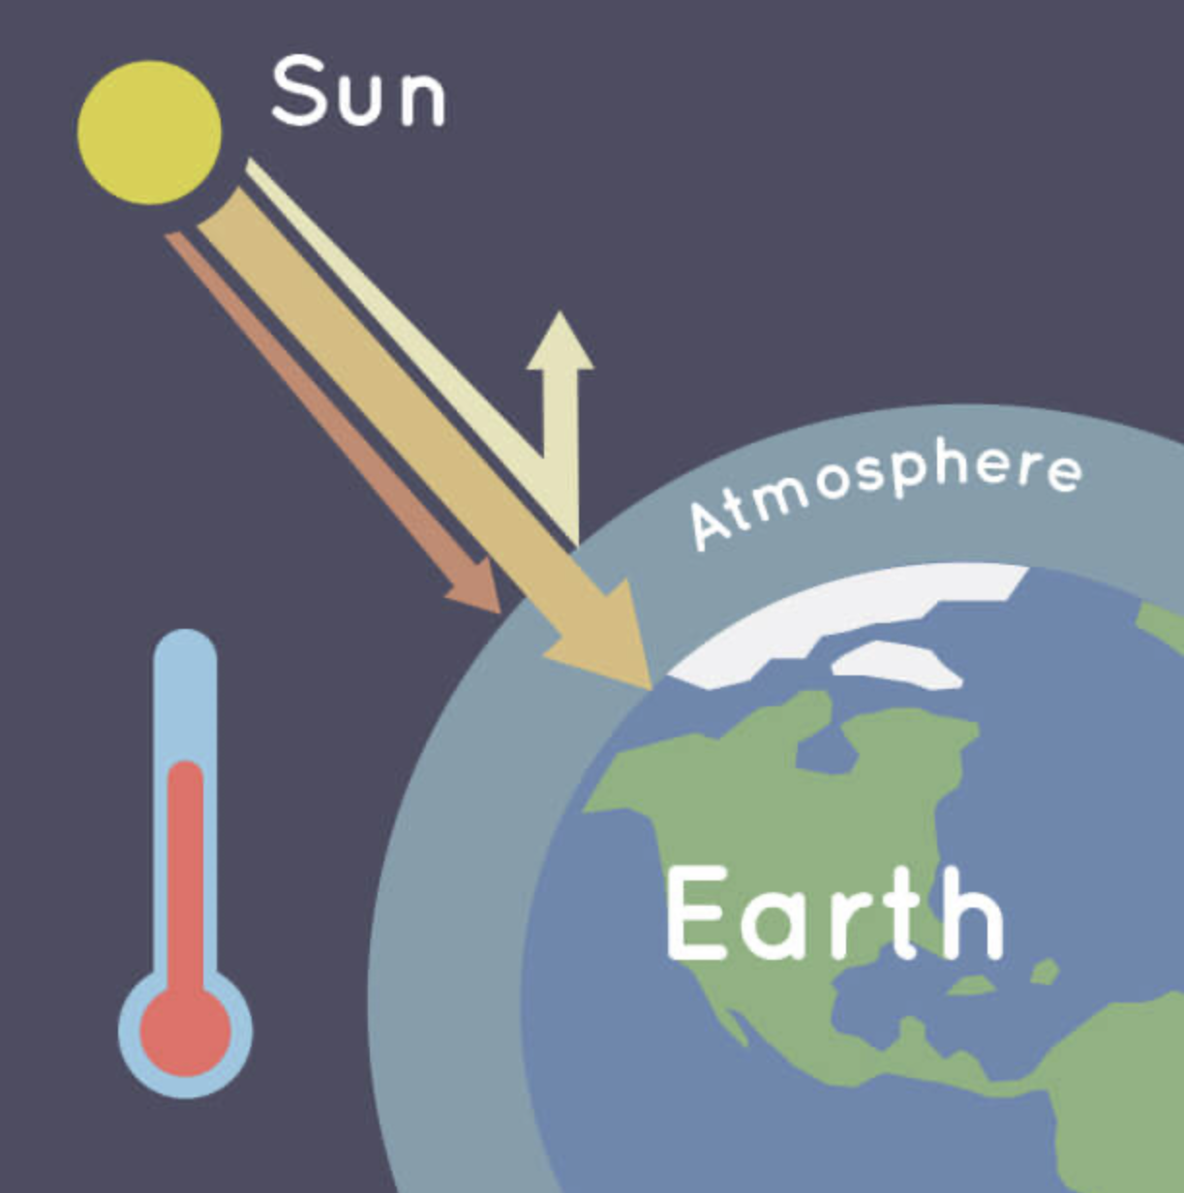
What is the greenhouse effect?
Notes:
Image credit: Credit: NASA/JPL-Caltech
Instructor: Has anyone heard about the term greenhouse effect the news, your science classes, or somewhere else? Can you tell me what they mean?
[Students may be more familiar with the phrase “global warming”. You may choose to modify this slide to ask “What is global warming?”
Answers in following slide]

Slide 77
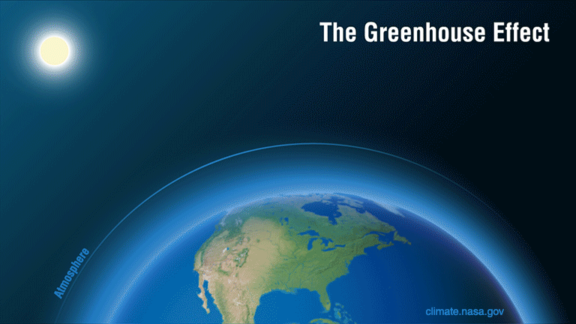
Notes:
Instructor: The greenhouse effect is the process by which the Sun’s heat is trapped by Earth’s atmosphere to warm up the temperature. (Sources: What is the Greenhouse Effect?, NASA: Weather, Global Warming and Climate Change)
It makes Earth a comfortable place to live.
However, when too much heat is trapped for a long time, the greenhouse effect causes the average temperature of the planet to increase, also known as global warming.

Slide 78
HAVE YOU HAD ANY EXPERIENCE WITH THE CONSEQUENCES OF global warming?
Notes:
Instructor: Have you (or anyone in your family) had any personal experience with the consequences of global warming?
Answers might include:
Elevated/lower temperatures
More natural disasters (fires, flooding, hurricanes, hirer tides)
Thank you for sharing. Do you think global warming is a good or a bad thing for the environment? Why or why not?
Answers might include:
Good make Earth warmer than space and habitable
Sea level to rise threatens cities and countries near the ocean.
Extreme drought and floods due to disruption of the water cycle threatens food distribution and human health.

Slide 79
To SUM UP
Greenhouse gas keeps Earth warm enough for plants and animals to live.
Too much global warming can be harmful.
Notes:
Instructor: Great points. To sum up, the greenhouse effect is necessary to some extent to keep Earth warm enough for animals and plants to live. However, human activities can release extra carbon dioxide that leads to global warming that can harm our planet in many ways. (One example is changes in the water cycle, which cause the sea level to rise and extreme weather to occur more frequently).
What human activities do you think can make global warming worse or more intense?
[Answers might include:
Burning fossil fuels like coal and natural gas
Deforestation through burning trees
Livestock farming
Fertilizers
… all of these are correct, but burning fossil fuels is the greatest contributor to global warming.
More info:
https://ec.europa.eu/clima/climate-change/causes-climate-change_en

Slide 80
training AI tools increases
global warming
Notes:
Instructor: One activity increases global warming is Training AI models. Why?

Slide 81
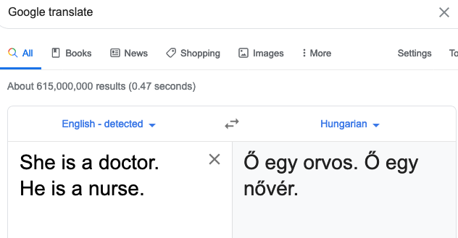
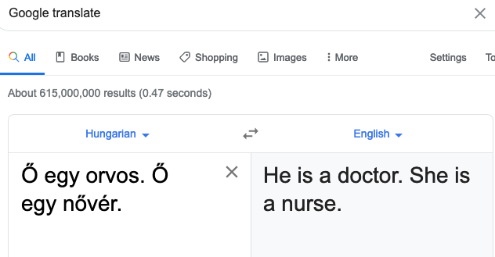
It costs 300 tons of carbon dioxide to train AI models like the one Google uses to make Google Translate.
Notes:
Instructor: Does anyone remember the Google translation activity we did in the Investigating Bias lesson? Remember the “She is a doctor, he is a nurse” example?
Yes, as we discovered, Google translate turned out to be biased about which roles can be played by which genders. As imperfect as Google translate is, it still takes a LOT of data to train its AI.
Using a lot of data takes a lot of time and energy to process (and crunch those numbers!).
It costs 300 tons of carbon dioxide (313.078 tons to be exact) to train AI models like the one Google uses to make Google Translate automatically translate text into almost any language (link to source, see information on “the Transformer'').

Slide 82
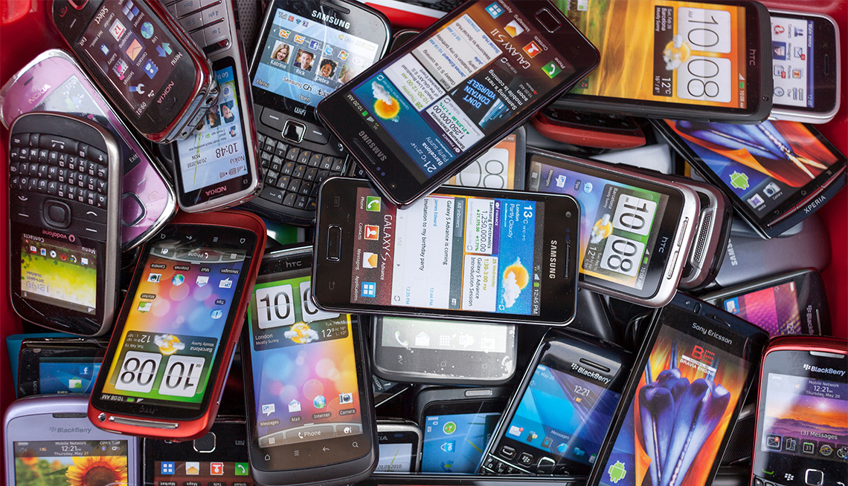
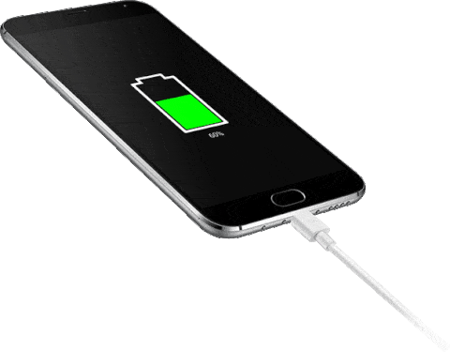
environmental impact of AI
Notes:
Instructor: To try to put that in perspective - think about the electricity a cell phone needs to charge. It would take about 36 million charging cell phones to produce that much carbon emissions. That’s a lot. Does anyone know of a city that size?
[Give students time to think and answer. Maybe even let them use the computers or cell phones to look up cities with a population of 36 million.]

Slide 83

environmental impact of AI
Notes:
Instructor: Yes! That’s like everyone in the metropolitan area of the largest city in the world Tokyo, Japan plugging in their cell phones for a full change at exactly the same time!
… or imagine it was just you charging your cell phone 36 million times. How long would that take?
[Give students time to think and answer.
Follow-up question:
How long does it take you to charge your phone? Multiply that times 36 million…

Slide 84
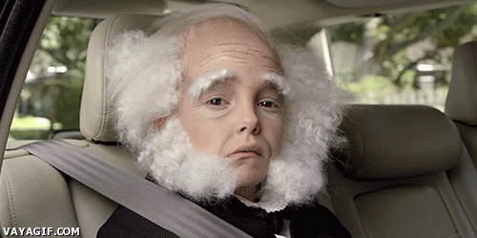
environmental impact of AI
If you live till you’re 90,
10-11 life times
1,000 Years
Notes:
Answers might be roughly around…
1000 years
If you live till you’re 90, then it will take you about 10 or 11 lifetimes
[See other numbers that might make 300 tons of carbon more meaningful to your students with this calculator: https://www.epa.gov/energy/greenhouse-gas-equivalencies-calculator
]
These numbers are huge! Why do you think training AI releases a lot of carbon dioxide?

Slide 85
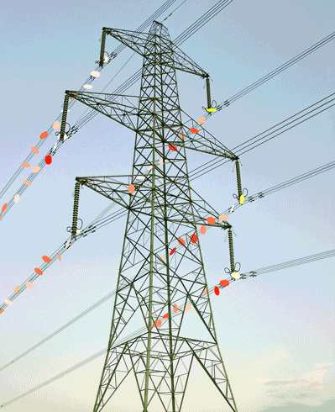
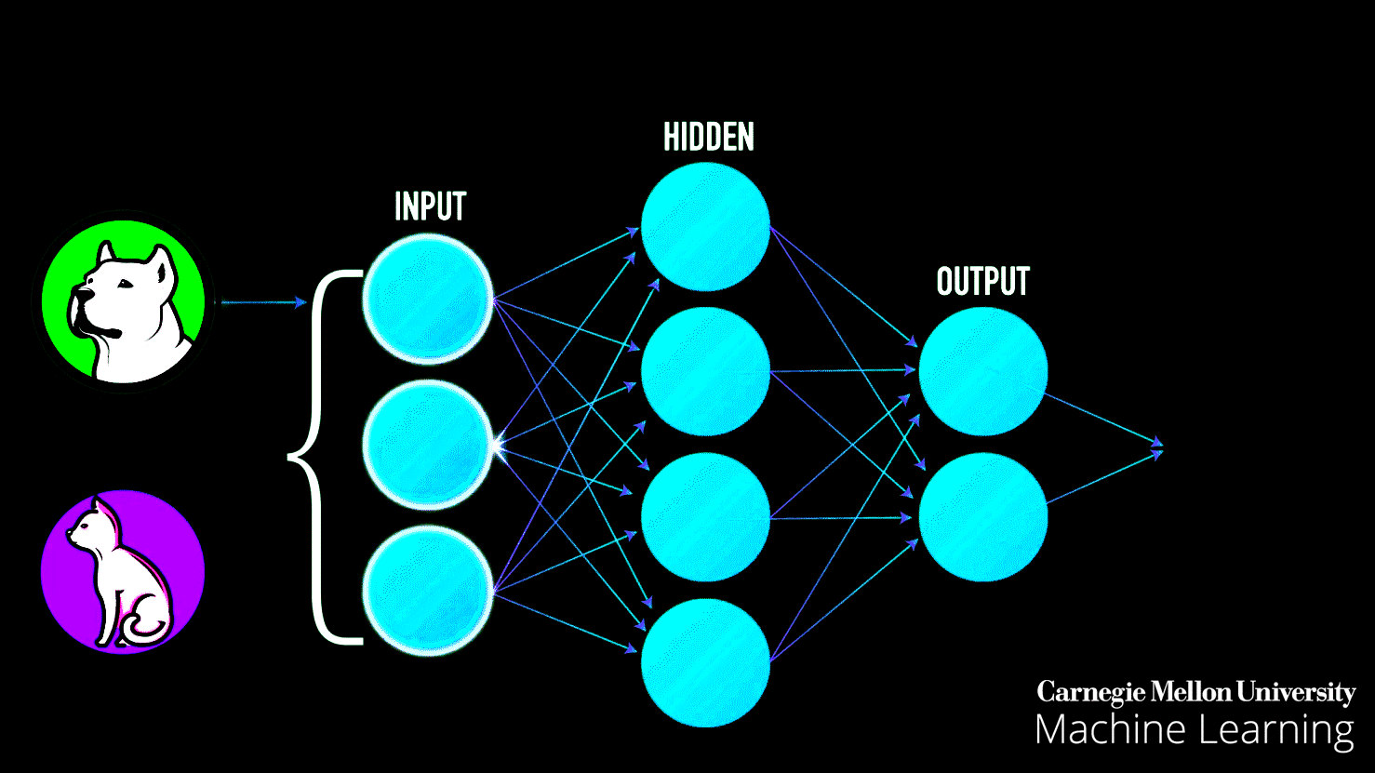
Notes:
[Answer: Computers - whether they use energy from an internal battery or not - eventually need to be plugged into a wall outlet in order to continue functioning. The electricity that runs from these outlets into our computers comes from electric cables that carry electricity generated by power plants.

Slide 86
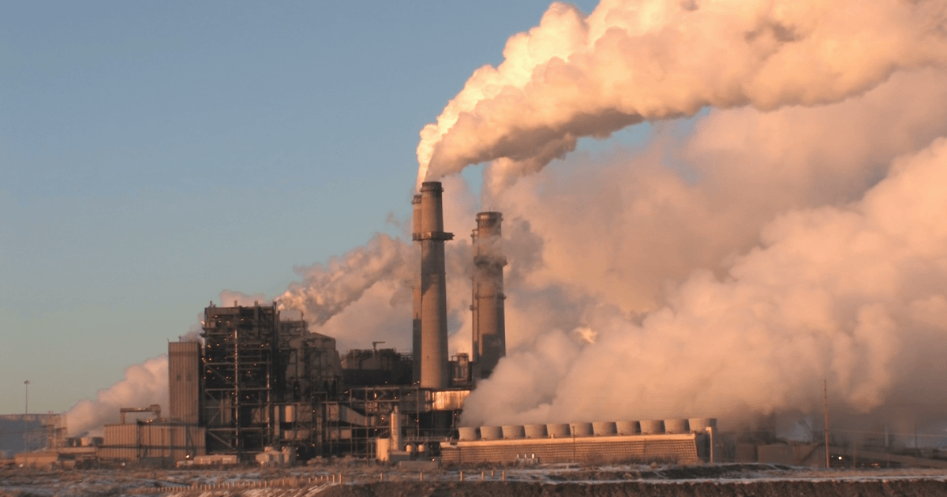
environmental impact of AI
Notes:
In the U.S., about ⅓ of our electricity is generated by coal power plants. Another ⅓ by natural gas. The remaining ⅓ is a combination of nuclear and green energy. Source: https://www.washingtonpost.com/graphics/national/power-plants/
Coal and fossil fuels contain a lot of carbon that interact with oxygen to form carbon dioxide (CO2) when they burn.
So, if AI is trained in the U.S., and many AI are, it is likely that it is drawing energy from power plants that are contributing to global warming.

Slide 87
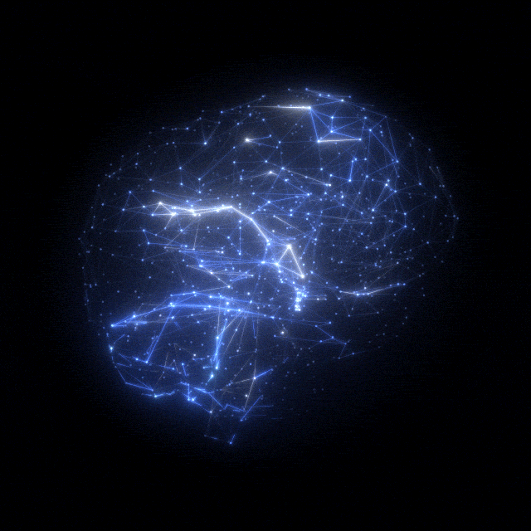
Complex Algorithms
Big data
Notes:
Instructor: This can become a problem when AI systems get bigger and more complex.
Complex algorithms demand bigger datasets demand more training time, and thus more electricity and power
… which puts an ever greater burden on our power plants.
It’s likely that Google's translator is one of these big AI systems with a 300 ton carbon footprint.

Slide 88
What is a
carbon footprint??
Notes:
Optional Activity: A carbon footprint is the amount of carbon compounds emitted as a result of daily activity a person or a group.

Slide 89
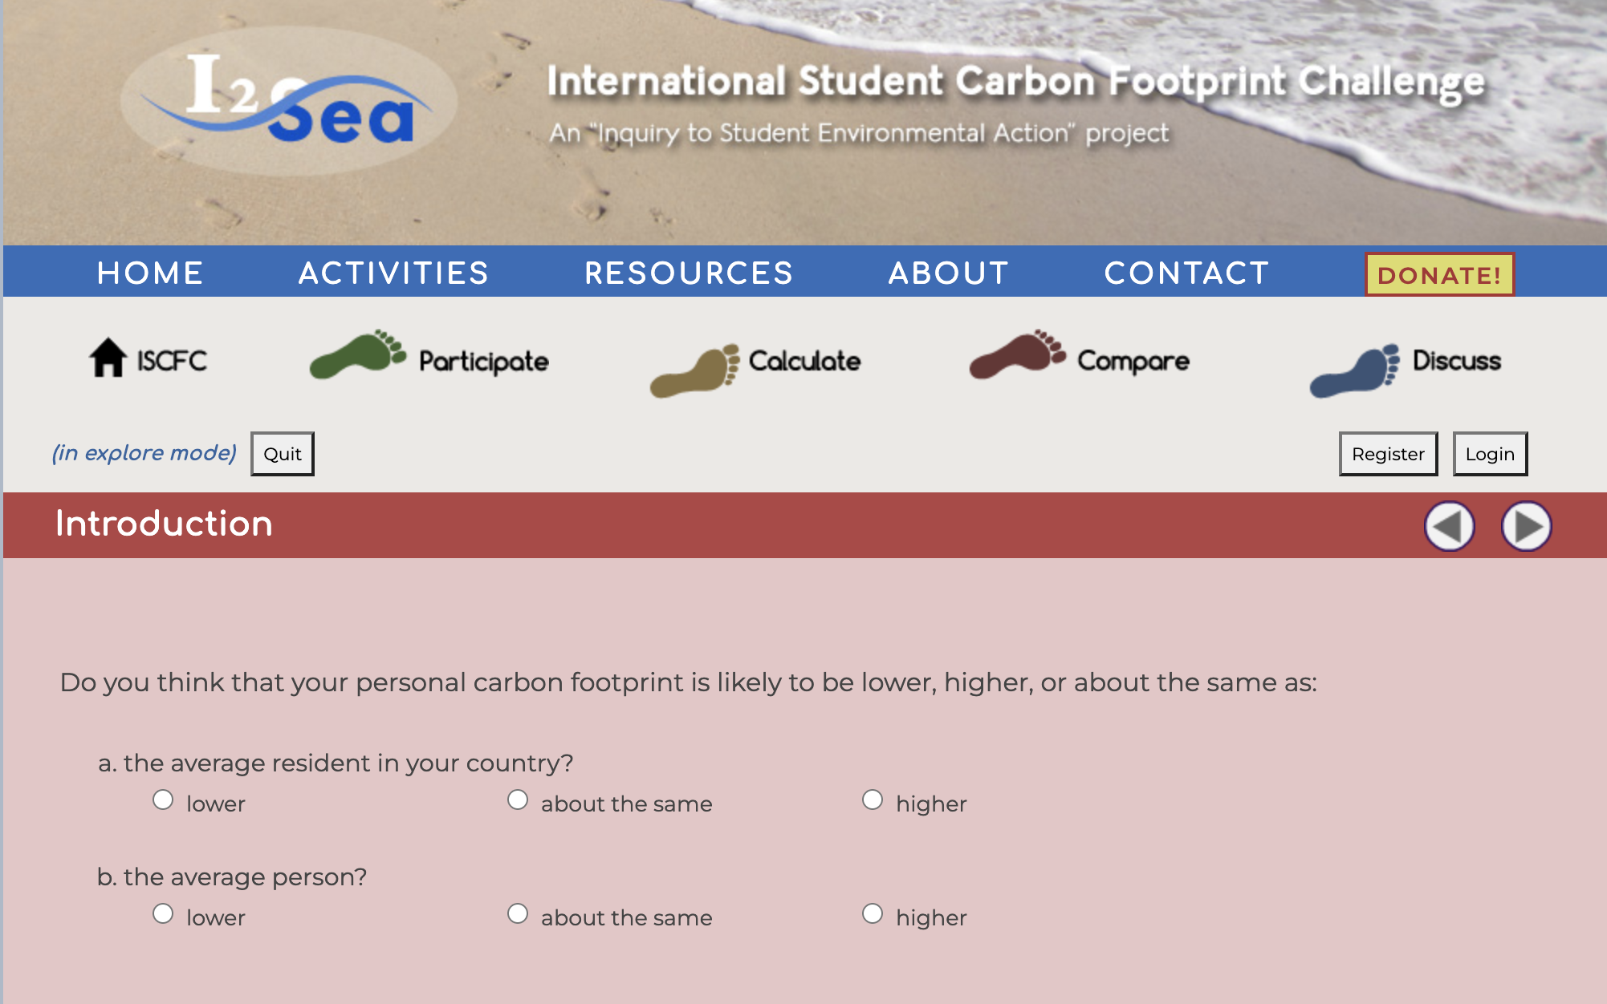
Calculate your carbon footprint to compare!
Notes:
Optional Activity:
Now let’s go to this “Calculate Your Carbon Footprint” website to calculate how much carbon your regular activity releases. This might help us get a better sense of how large a number 300 tons is. I will show you how to get there and complete the survey.

Slide 90
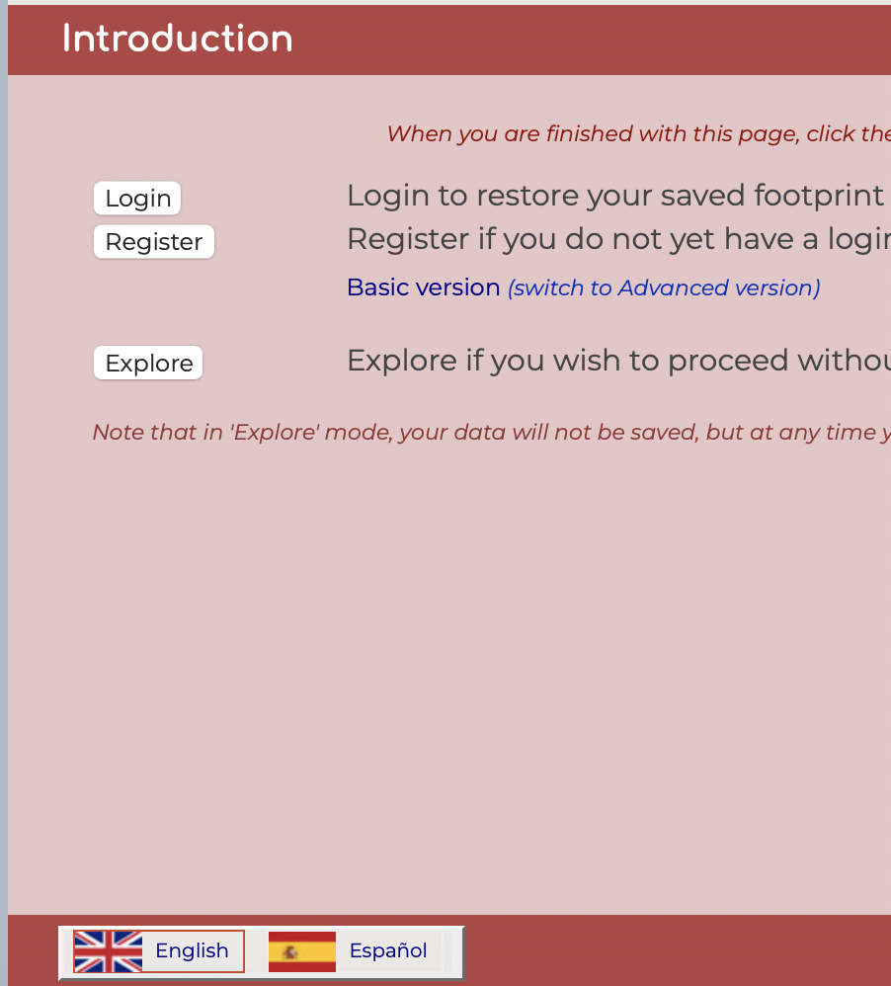
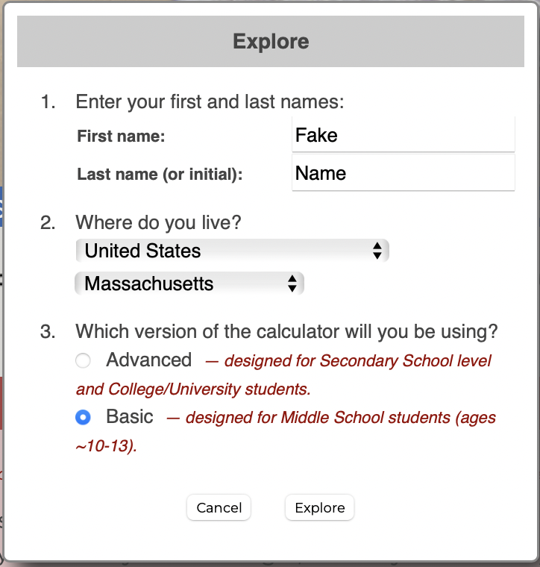
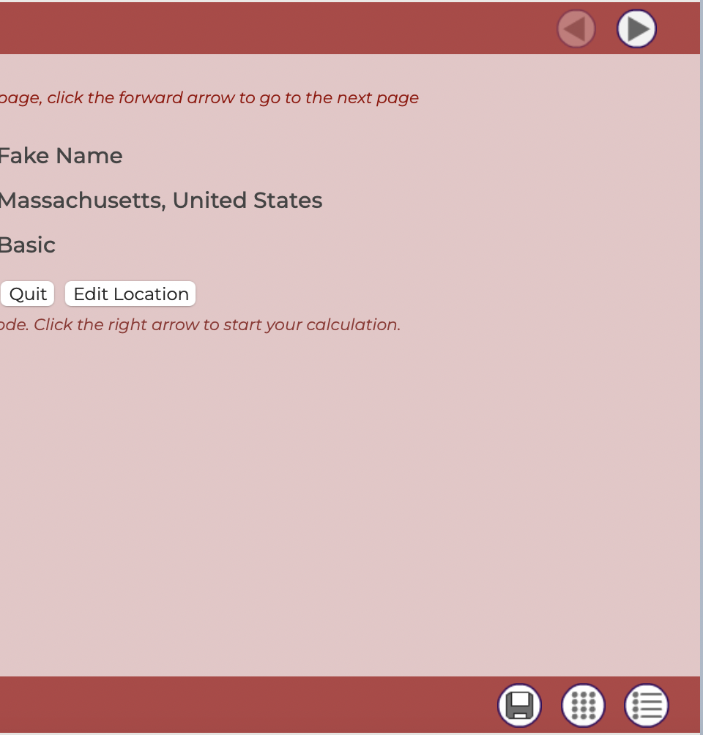
Once on the website,
Click explore
2. Fill out info
3. Click arrow
Notes:
I’ll have these instructions up for you in a moment. Let me walk you through the website briefly.
Once on the website, First you click explore, so you don’t have to log in.
You are asked to enter some information. Fill in a fake name, your location, click on basic, and continue by clicking on explore.
Then, you can advance to the questions by clicking on the arrow at the top right.
And at the bottom right you will find a calculator in case you need to make any conversions while using this website.
[Walk students through the website. You might project the site for the whole class to see. Then you can…
complete it with them,
model how to answer the questions, and
answer any questions students have.]

Slide 91
When you’re On the website…
Step 2
Click on the link
Click “Explore”
Type in a fake name
Select your country and state
Choose Basic
Click Explore
Notes:
Feel free to change the timer.
Select Insert
Select Video
Click Search
Type in “15 minute timer” (or any other time you would like)
Choose the timer you would like.
Adjust the size to fit your slide.
Done!

Slide 92
share!
What is your carbon footprint?
How many people like you do you think it takes to emit 300 tons of carbon dioxide?
Notes:
Great, now let’s share our footprints.
[You can have students Turn & Talk to a partner for 5 minutes, or your students might prefer to share their results with the whole class.]
Teaching Tip: This conversation is not about changing their personal behavior. There is no need to critique how much energy each student uses. Students tend to have relatively low carbon footprints (they don’t drive cars), so it’s reasonable to expect your students will all have relatively small footprints. Praise them for this. Find ways to show that you are impressed by some of the little things they do to be more energy efficient.]
Very impressive. Thank you for sharing. How many people like you do you think it takes to emit 300 tons of carbon dioxide?
[Give students time to use their calculators or computers. Consider modeling this calculation for them.]
Note: The average carbon footprint for a person in the United States is 16 tons (one of the highest rates in the world)
The average carbon footprint of a non-American is closer to 4 tons.
Source: The Nature Conservancy
300/16 = 18.75 → Google’s translator’s carbon footprint is equal to about 18 average Americans.
300/4 = 75 → Google’s translator’s carbon footprint is equal to about 75 average people (non-Americans).
End of Optional Activity.

Slide 93
What should we do to lower the environmental impact of training AI?
DON’T USE UNNECESSARY ELECTRICITY
LEAVING THE LIGHTS ON OR THE WATER RUNNING IS A NO NO
CUTTING BACK ON CPU AND PHONE USAGE.
LESS AI = LESS CARBON FOOTPRINT
Notes:
Instructor: That’s a lot! Thinking about these numbers can feel overwhelming. How can one person (with such a small impact on the environment relative to a company like Google) make a difference? Well, there are actually some ways that we can address the problem of the environmental impact of AI. Before I give some of the answers that I have, what do you think? How do you think we can change the environmental impact of training AI?
[Give students time to think and answer. Consider having students quickly Turn and Talk to brainstorm some ideas. Other ideas for this moment in the discussion are described in the lesson plan.]

Slide 94
What should we do to lower the environmental impact of training AI?
Change the way we design AI algorithms. For example:
  Use smaller datasets.
  Design simple algorithms.
  Use less repetition
Use more green energy to power AI systems.
Offset the environmental impact of AI, for example plant trees!
Notes:
Great answers. As you mentioned, we can (summarize students' answers). We can also (if not mentioned by students yet)...
Change the way we design AI algorithms. If they require less time and energy to make their predictions, then they will have less of a negative impact on our environment. How can we design them to take less time? We could design them to…
Use less training data.
Include less calculations.
Use less repetition
Use less AI in our lives.
Design more energy efficient computer hardware.
Use more green energy to power AI systems.
Offset the environmental impact of AI, for example
by sequestering carbon
planting trees
These are just a few ways that we can lessen the environmental impact of AI.
Great job everyone!

Slide 95
AI / THINK LAB
THE ENERGY QUESTION
DATA CENTERS USE LOTS OF ENERGY
IEA estimates for all data centers worldwide — NOT just AI.
2024
415 TWh
MORE THAN 2×
2030*
~945 TWh
*2030 = IEA base-case projection, not a guaranteed outcome.
Source: IEA, Energy and AI (2025) | iea.org/reports/energy-and-ai
13 / 16

Slide 96


AI / THINK LAB
TRADEOFFS + SOLUTIONS
CAN AI HELP THE PLANET, TOO?
Sometimes. We need to weigh measured benefits against the full costs.
POTENTIAL WINS
SMARTER CHOICES
Monitor wildlife and ecosystems
Use AI only when it adds value
Optimize buildings and power grids
Choose efficient tools and hardware
Study climate and weather data
Support clean energy and transparency
Find leaks and reduce waste
Measure results, not just promises
BIG TAKEAWAY • AI can have environmental benefits AND costs.
14 / 16

Slide 97
AI / THINK LAB
EXIT TICKET
LEVEL COMPLETE. WHAT STUCK?
Think solo, then compare with a partner.
01
Name one technology that is NOT AI. Why?
02
Identify an AI ethical risk AND a safeguard.
03
Explain one environmental cost AND one benefit.
04
When should a HUMAN make the final decision?
STAY CURIOUS.
15 / 16

Slide 98
AI / THINK LAB
KEEP EXPLORING
DON’T TAKE OUR WORD FOR IT
Good questions deserve trustworthy sources.
IEA
Energy and AI (2025)
https://www.iea.org/reports/energy-and-ai
UNESCO
Recommendation on the Ethics of AI
https://www.unesco.org/en/artificial-intelligence/recommendation-ethics
NIST
AI Risk Management Framework
https://www.nist.gov/itl/ai-risk-management-framework
UNICEF
Policy Guidance on AI for Children
https://www.unicef.org/globalinsight/reports/policy-guidance-ai-children
ASK • VERIFY • KEEP LEARNING
16 / 16

