Slide 1
CREATING AN ECOSYSTEM MODEL USING NETLOGO WEB

Slide 2
START A NEW PROJECT & SET-UP WORLD
Open NetLogo Web - netlogoweb.org
The program will open to an already existing model - click NEW on the upper right to get a blank screen
Click on the lock in the upper left, then click in the title to name your model (use your name and fish & plankton).
With the lock still open, right click anywhere in the green area, and choose “Create Button.” In the new box that appears, type “Setup” in the Commands line, and click OK.

Slide 3
START A NEW PROJECT & SET-UP WORLD
Right click again in the green area to create another button, and name it Go.
When creating Go, check the forever box before clicking OK.
Move the buttons where you want them, then click on the lock again to return to Interactive Mode.

Slide 4
NETLOGO BASICS
Tabs - Interface, Info, Code
World agent
Turtles
Patches
Interface characteristics -
  size of world & patch size
  x & y coordinate grid with 0,0 at center
  ability to wrap

Slide 5
START CODING - GO TO THE CODE TAB
  Scroll down to the bottom of the screen, and use the down arrow to open the NetLogo Code window. Put a ; or two ;; then name your project here (your name and something about fish & plankton)/ The computer does not read any text after the ;;, so this is a comment for humans (notice the text after the ;; is gray).
  Next, create two breeds, fish and plankton. Don’t forget to use both singular & plural forms of the breed names.
        breed [ planktons plankton ]
        breed [ fishes fish ]
      This tells the computer what you are going to call your turtles (agents).

Slide 6
GIVE THE FISHES AN ENERGY VARIABLE
      Next, give the fish their own trait called “energy”. This will let us set and change the energy level of the fish as the model runs, and let things happen based on the energy level of the fish. You can give turtles, patches, specific breeds, or links specific traits, called “agents-own” variables in Netlogo.

Slide 7
GIVE THE FISHES AN ENERGY VARIABLE
      Next, give the fish their own trait called “energy”. This will let us set and change the energy level of the fish as the model runs, and let things happen based on the energy level of the fish. You can give turtles, patches, specific breeds, or links specific traits, called “agents-own” variables in Netlogo.
      Your code should be on the line under the breeds, and read:
      fishes-own [ energy ] ;; gives fish the trait of "energy"

Slide 8
CREATE CODE FOR THE SETUP BUTTON
      All Netlogo procedures start with to and a name (here the name is Setup) and end with end. We want this procedure to work when we push the Setup button, so the spelling and capitalization of the word Setup here needs to match exactly with the button you created on the Interface.

Slide 9
CREATE CODE FOR THE SETUP BUTTON
  Your code should read:
  to setup
  end
  The rest of the setup code will go between those two commands.
  First, you always want to clear away everything that happened the last time you ran the model, so on the first line below to setup type:
  clear-all

Slide 10
NETLOGO TEXT COLORS
      Notice the colors of the text in Netlogo
      ;; Title (after semicolons) is gray - computer doesn’t read any of this text - you will want comments in your finished code
      breed, to, and end are green - NetLogo understands those words to be commands within the program (primitives)
      When we add clear-all and set they will be blue ; size, shape, color are purple, the colors themselves and numbers are red - all these colors show that the words have a specific meaning to Netlogo, and so you can’t use those words (without at least a dash to another word) to mean anything else in the program.
      Any words in black are words you’ve used to name things that the computer can use again, but only after you explain what they mean.

Slide 11
CHANGE THE BACKGROUND
We want our world to look like the agents are underwater, so first let’s make the background a light blue color. Inside the setup code (between the to setup and the end), we want to ask the patches to set their color (since they are patches, we call this “pcolor”) to cyan.
  Your setup command so far should look like this:
to setup
clear-all
ask patches
[ set pcolor cyan ]
  end

Slide 12
CREATE AGENTS
  We want to create some fishes and some planktons and tell the computer what they should look like, where they should start out, and what direction they should face. This code goes inside the setup code, below what we have typed and above the word end.
  Let’s start with 500 planktons, that have a random heading and random x and y coordinates, are green circles, and are size 0.75.

Slide 13
CREATE AGENTS - PLANKTONS
  We want to create some planktons and tell the computer what they should look like, where they should start out, and what direction they should face. Let’s start with 500 planktons, that have a random heading and random x and y coordinates, are green, are circles, and are size 0.75. Here is the code for plankton (inside the setup code):
create-planktons 500 ;; Create 500 planktons
[
set heading random 360
setxy random-xcor random-ycor ;; random place
set color green
set shape "circle"
set size .75
]

Slide 14
CREATE AGENTS - FISHES
  We also want to create some fish and tell the computer what they should look like, where they should start out, and what direction they should face. Create 20 fishes, with the shape of a fish, size 2, and the same random coordinates and headings as the plankton.

Slide 15
CREATE AGENTS - FISHES
  We want to create some fish and tell the computer what they should look like, where they should start out, and what direction they should face. Create 20 fishes, with the shape of a fish, size 2, and the same random coordinates and headings as the plankton. Here is the code for our fish (inside the setup code):
create-fishes 20 ;; Create 20 fish placed randomly
[
set heading random 360
setxy random-xcor random-ycor
set shape "fish"
set size 2
set energy 50
]

Slide 16
CHECK SETUP CODE
  At the end of the setup code, we always want the computer to keep track of “time” or “ticks” (each run of the whole code is a “tick” and it can be a substitute for keeping time in the model)
  At the end of your setup code (the last line before end),
  type reset-ticks
  Push the Recompile Code button at the top of the coding window - see if the computer identifies any errors in your code so far. If not, the button will turn gray. You need to push this button any time you change the code, for the program to run the new code.
  Scroll up to the Interface screen and push the setup button. Do you get the agents you expect to see?

Slide 17
CONGRATULATIONS!
You are finished with the setup code.
Review:
Concepts | Types | NetLogo commands
agents | turtle patch world | ask-turtles ask-patches
procedures |  | to end
Tabs | Interface Model Info NetLogo Code

Slide 18
NEW PROCEDURES - GO BUTTON
You have already created a go button on the Interface. This is a “forever” button - it will call all the procedures, in the order you place them, repeatedly until you click the button again. After your setup procedure, type:
to go
tick
end
Inside this procedure (just above end), we have added the command, tick so the computer will count the ticks as the program runs - in other words, it will count how many times it runs through the commands listed in the “go” button. Next, think about what we want the agents to do when we push go.

Slide 19
GO PROCEDURES
First, the agents need to move around. Let’s call this command “wiggle”, so between the to go and the end commands, type
ask planktons
[ wiggle ]
That’s all the planktons need to do for now.
Inside to go procedure start a similar procedure to ask fishes, and list wiggle as the first command in the brackets. Leave some empty lines inside the brackets for the fishes, because we will need them to have other behaviors also.

Slide 20
DEFINE THE WIGGLE PROCEDURE
We told the computer to wiggle, but now we need to explain what that means (the word appears in black in the code, which means we need to teach it to the program).
Create a new procedure by starting with to wiggle and ending with end. Inside, we want to tell the agents to walk with a little bit of random movement (so they don’t march in a straight line). Tell them to move left and right a random 10 degrees.

Slide 21
DEFINE THE WIGGLE PROCEDURE
Now that the agents are turning, they are ready to move forward.
Since we are going to have them interact with other agents (the fish with the plankton), they should move forward 1 step at a time.
More than 1 step can cause the agents to “jump” over each other rather than colliding, so 1 step forward is best. If you need some agents to move faster than others, make the slow agents move less than 1 step - like 0.5 steps - at a time.

Slide 22
WIGGLE PROCEDURE
Your finished “wiggle” procedure might look like this:
to wiggle ;; Turn randomly right & left, then step forward
right random 10
left random 10
forward 1
end
Add a comment after semicolons ;; so the computer doesn’t read them), then Recompile Code). Go to the Interface to see if your agents are moving the way you want.
The fishes & the plankton should be wiggling when you push go.

Slide 23
OTHER PROCEDURES
We need to create several more procedures. Each procedure must start with to and end with end.
We also need to call each procedure (write the exact name of the procedure, like wiggle) inside the ask fishes brackets.
First, create a procedure that imposes an energy cost on the fishes’s movement - with every step, they should lose 1 unit of energy. Name this procedure move-cost.

Slide 24
OTHER PROCEDURES
Your finished procedure might look like this:
to move-cost ;; Fish lose energy when they move
set energy energy - 1
end

Slide 25
EAT PROCEDURE
We want the fishes to “eat” the plankton and gain energy.
First, tell the fishes to look for planktons on the same patch, then ask them to choose one of the planktons (there might be more than one). This requires us to use a LOCAL VARIABLE (using let). The procedure must tell the plankton to die, and add 10 units of energy to the fish. Your finished procedure might look like this:

Slide 26
EAT PROCEDURE
We want the fishes to “eat” the plankton and gain energy.
First, tell the fishes to look for planktons on the same patch, then ask them to choose one of the planktons (there might be more than one). This requires us to use a LOCAL VARIABLE (using let). The procedure must tell the plankton to die, and add 10 units of energy to the fish. Your finished procedure might look like this:
to eat
if any? planktons-here
[
let target one-of planktons-here
ask target [ die ]
set energy energy + 10
]
end

Slide 27
FISH REPRODUCE PROCEDURE
We want a fish to create another fish if it gains enough energy. But, we want it to only create one fish, and then continue moving and eating and changing its own energy until it gains enough to reproduce again (in other words, there is an energy cost to reproduction - this is true in science and important in modeling).

Slide 28
FISH REPRODUCE PROCEDURE
Your fish reproduction code might look like this:
to more-fishes ;; With enough energy, fish reproduce
if energy > 100
[
set energy energy - 50 ;; energy cost to parent
hatch 1 [ set energy 40 ] ;; new fish energy
]
end

Slide 29
ONE MORE FISH PROCEDURE
Finally, we want the fish to die if they lose all their energy. Netlogo already knows the word die, so write a procedure with a different name (like check-death) that tells the fish to die if it has 0 or less energy.
Why 0 or less - why not just 0? Because sometimes the program will cause the relevant agent to skip from a positive to a negative number, without ever being 0. This makes the fish die when they don’t have any more energy, without the possible error of allowing them to live on with a negative amount of energy (zombie fish).

Slide 30
ONE MORE FISH PROCEDURE
Finally, we want the fish to die if they lose all their energy. Netlogo already knows the word die, so write a procedure with a different name (like check-death) that tells the fish to die if it has 0 or less energy.
Your finished procedure might look like this:
to check-death ;; Too little energy, fish dies
if energy <= 0
[ die ]
end

Slide 31
TIME TO CHECK
First, check that you have called each procedure (listed it by exact name) inside the brackets for ask fishes inside the go procedure.
If you told the computer what to do (how to wiggle,or etc.) but not when to do it (in the go procedure), your new procedure won’t work.
If you have called all procedures and saved your model, push the Recompile Code button to check your code. If no error message happens, go to the Interface tab and see if your model is working.
We are almost finished - just a few more procedures and other things to add.

Slide 32
One example of a finished go code:
to go
ask planktons [ wiggle ]
ask fishes
[
wiggle
move-cost
eat
more-fishes
check-death
]
tick
end

Slide 33
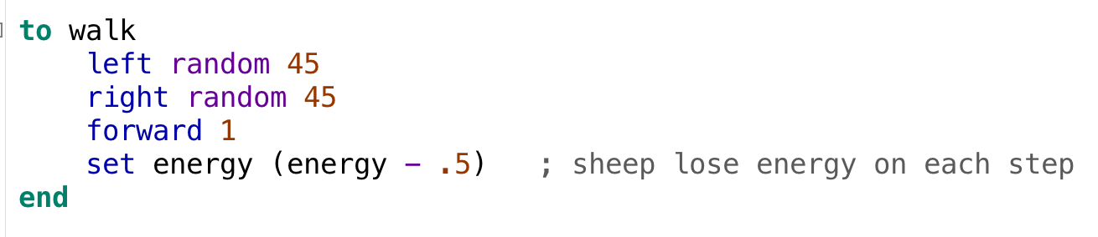
TIME TO CHECK AGAIN
If your go-code looks right (you have called all your procedures by name, and included the instruction “tick” at the end) push the Recompile Code button to check your code, and if no error message happens, go to the Interface tab and see if your model is working.
You should see plankton wiggling, getting eaten, and sometimes new ones appearing, and you should see fishes wiggling, eating plankton, reproducing, and dying.
YAY! You made a working model.

Slide 34
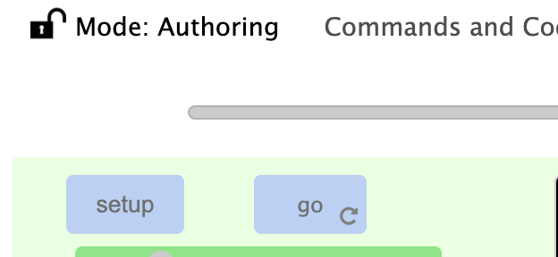
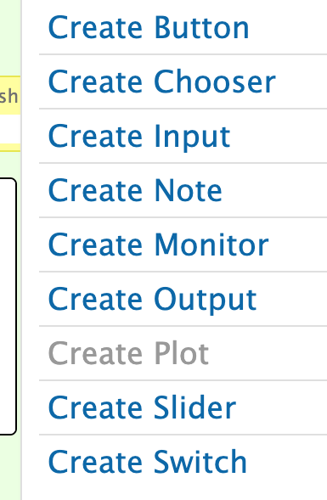
CREATE SLIDER in Netlogo Web
To run experiments with your model, we need an easy way to change some settings from the Interface window.
Make a slider on the Interface tab:
Click on the lock on the upper left to unlock the interface
Right click on the green background to bring up the drop-down menu
Choose slider,and a window will open.

Slide 35
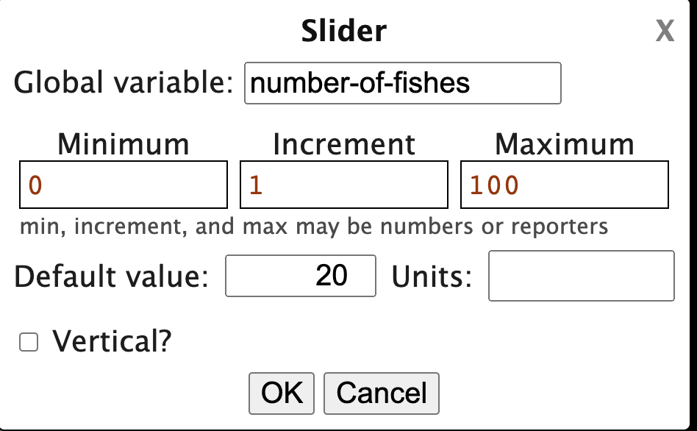

SLIDER - Web version
When you have created the slider on the Interface, a window will open letting you name it and set the parameters. Since this will set the number of fish we get at the beginning of the model, name the slider something like number-of-fish (don’t use a word we are using somewhere else, or a word Netlogo already knows). Set the minimum to be 0 and the maximum to be 100. The value is where the slider will be set when you open the model, so make that 20. When your slider has these settings, click OK, and on the interface, move the slider button to where you want it, and click the lock again to close it.

Slide 36
CODE THE SLIDER
We have a slider, but we haven’t explained to the computer how to use it. Think of a slider as replacing a number in your code -- where is the number for how many fish are created on setup? When you find that number, replace it with the exact name of your slider.
Click the button to Recompile Code, and go to the Interface to run experiments - move the slider to the top and hit setup, and then to the bottom and hit setup again.
Are you creating the number of fish shown in the slider setting?

Slide 37
DATA - COUNT THE PLANKTONS
You have a model that behaves as you want it to and lets you run an experiment, but you can’t collect any data yet. Let’s create some data boxes to see how the number of fish and plankton change.
To create a data box, make a monitor on the Interface tab. Follow the same instructions as the slider to find the list of interface buttons, and this time choose monitor.
To count plankton, type in count planktons (notice the plural)
In the Reporter area. The name of the button on the interface will be the same as this reporter, unless we change it in the Display Name area. You can change the displayed name if you like, to make it show “Number of plankton” or whatever you want the name of the data box to read on the interface.

Slide 38
MORE DATA - COUNT THE FISHES
Push Setup, and see that the number of plankton monitor shows the number of plankton created. Push go, and the monitor should show the changing number of plankton.
Once this monitor is working, follow the same steps to make a monitor to count the number of fish.
Test the model to see if the numbers change to show what’s happening with the agents.

Slide 39
STILL MORE DATA!
Monitors (data boxes) are nice, but plots (graphs) allow you to see what’s happening as the model runs.
Follow the same steps as to create a monitor or slider but choose Create Plot.
Name it Population over Time
Click on Add Pen, click on the black box to choose the pen color (by clicking on it).
In the Pen update commands line, type plot count planktons. You can name Pen 1 plankton.
Follow the same process to create another pen, to plot count fishes. Choose pen colors that make sense and are visible in the plot.
When you have finished, click “OK, move the plot where you want it on the screen, and click the lock to lock it.

Slide 40
MORE CODING!
If you have more time, you can add a few extra things to your model. First, write a procedure which allows the model to create planktons as it runs, at a fairly slow rate. Don’t forget to start the new procedure with to, and end it with end.

Slide 41
WE NEED MORE PLANKTONS!
We want to write a procedure which allows the model to create planktons as it runs, at a fairly slow rate.
Write a procedure that gives the model a 1/10 chance of creating a plankton (at each tick), and give the new plankton all the same characteristics as the original ones (copy & paste from the setup code).
When you have finished writing this procedure, be sure to call it in the go procedure, but not within the brackets for either the fishes or the plankton - this is something the program itself will do (the observer).

Slide 42
WE NEED A STOP-CODE!
Our last procedure will be to make the model stop if all the fish die, so that we can easily record data (the # of ticks, or time it took for that to happen) because the goal of our model is to run experiments.
So, add this code as the first statement of the go procedure:
if not any? fishes [ stop ]
You can tell by the colors of the text that Netlogo already knows all these words except “fishes” which is what we named this breed.
Now, the model will run (or go) only as long as there are fish, and will stop as soon as the last fish dies.

Slide 43
WE NEED MORE PLANKTONS!
Your finished plankton code might look like this:
to more-planktons
if (random 10 < 1)
[
create-planktons 1
[
setxy random-xcor random-ycor
set heading random 360
set color green
set size 0.75
set shape "circle"
]
]
end

Slide 44
Now our finished go code might look like:
to go
if not any? fishes [ stop ]
ask planktons [ wiggle ]
ask fishes
[
wiggle
move-cost
eat
more-fishes
check-death
]
more-planktons
tick
end

Slide 45
EXPERIMENT!
Now that you have a working model with a slider, monitors and a plot, think about what this model can tell us. The basic experiment we can run asks:
How will the initial number of fish change the result of the model (how long it takes before the last fish dies)?
What is your prediction about how the number of fish at the beginning of the model will affect the outcome?
How can we test your prediction?

Slide 46
MODIFY!
What else could our model test? We could change any number in the code (that is “hard-coded” in to the model) to be a slider instead, and experiment with that number. For example:
We could change how much energy the fishes gain by eating a plankton. How might this change the outcome of the model?
What else could we change about the model to make it more realistic?
What could we change about the behavior of the agents that would more closely fit reality?
What could we add to the model?
Do we need more or different agents, patches, monitors, behaviors? What is an interesting question we could modify our model to answer?

Slide 47
Saving your Netlogo Web model
Now that you have finished your model, click on Export on the upper left, and choose NetLogo. The program will ask you where to save it, so put it on your flash drive (you can also name the model so the file can be more easily found).
Next time you open NetLogo Web, you can click on “Upload a Model” near the top of the screen, and navigate to your flash drive where you have saved it.

Slide 48
CREATING A SILLY MODEL
IN NETLOGO WEB -
Halloween jack-o-lantern

Slide 49
START A NEW PROJECT & SET-UP WORLD
Open NetLogo Web - netlogoweb.org
The program will open to an already existing model - click NEW on the upper right to get a blank screen
Click on the lock in the upper left, then click in the title to name your project Jack-o-Lantern.
Right click anywhere in the green area to and choose “Create Button.” In the new box that appears, type “Setup” in the Commands line, and click OK.
Follow the same steps to create another button, and name it Go. This time, do NOT click the forever box in the Go button. Move the buttons where you want them, then click on the lock again to return to Interactive Mode.

Slide 50
CREATE CODE FOR THE SETUP BUTTON
      All Netlogo procedures start with to and a name (here the name is setup) and end with end. We want this procedure to work when we push the setup button, so the spelling and capitalization of the word setup here needs to match exactly with the button you created on the Interface.

Slide 51
CREATE CODE FOR THE SETUP BUTTON
  All Netlogo procedures start with to and a name (here the name is setup) and end with end. We want this procedure to work when we push the setup button, so the spelling and capitalization of the word here needs to match exactly with the button you created on the Interface. Your code should read:
  to setup
  end
  The rest of the code will go between those two commands.
  First, you always want to clear away everything that happened the last time you ran the model, so on the first line below to setup type:
  clear-all

Slide 52
CREATE AN AGENT
  We need to create an agent with some specific characteristics to draw our jack-o-lantern.
  Inside the setup procedure, under the clear-all command, type create-turtles 1.
  Then, type (an open bracket) [
  Skip a few lines and type a close bracket ]
  Be sure students understand the difference between a bracket [, a parenthesis (, and a curly brace { -- you need the right one in Netlogo or your program won’t work.
  We are going to specify several characteristics of our turtle inside the open and close brackets, so type them on separate lines with lots of spaces between.

Slide 53
CREATE AGENTS
  Your setup code should read:
  to setup
  clear-all
  create-turtles 1
  [
  ]
  end

Slide 54
Make your drawing agent
  Inside the brackets for create-turtles, we can set the size, shape, starting location and heading, color, and whether or not the turtle will draw a line behind it as it walks. We want these characteristics for our turtle:
create-turtles 1
[ set size 1
set heading 0
set xcor 20
set color orange
set pen-size 3
pen-down
]

Slide 55
NETLOGO TEXT COLORS
      Netlogo text colors help check your spelling - make sure:
      ;; Title (after semicolons) is gray - computer doesn’t read any of this text
      to and end are green - NetLogo understands those words are used to name procedures - the name of the procedure will be black
      clear-all and set are blue ; size, shape, color are purple, the colors themselves and numbers are red - this means these all have a specific meaning to Netlogo, and so you shouldn’t use those words (without at least a dash to another word) to mean anything else in the program.
      Any other words you’ve used to name things that the computer can use appear in black.

Slide 56
CHECK SETUP CODE
  Push the Recompile Code button at the top of the coding screen - solve any problems in your code identified by the computer. If the button turns gray, go to the Interface screen and push the setup button. Do you get the agent you expected to see? Is it where it needs to be to start drawing a big circle?

Slide 57
NEW PROCEDURES - GO BUTTON
You have already created a go button on the Interface. Scroll back to the coding window, and after the end of your setup procedure, type: to go
end
We want our agent to draw a big circle, so inside that procedure, type:
ask turtles
[
      repeat 72
[ pen-down
      right 5
      forward 1
]
]

Slide 58
NEW PROCEDURES - GO BUTTON
Notice the brackets - an open and close around the steps that are repeated, and an open and close around all the code inside “ask turtles”
ask turtles
[
      repeat 72
[ pen-down
      right 5
      forward 1
]
]
Push the Recompile Code button and test this code - it should draw a big orange circle. If not, adjust the numbers until you are happy with the circle.

Slide 59
GO PROCEDURES
Now, we need a stem. Inside the brackets under ask-turtles (but not inside the repeat), type the following code to make your turtle move to the starting location for the next part of the drawing::
      pen-up
      set color brown
set xcor -4
set ycor 44
Check that your turtle moves (without leaving a line) to a good place to start drawing a stem for the pumpkin. If it doesn’t, change the numbers for the xcor and ycor.

Slide 60
GO PROCEDURES
Next the turtle is going to draw the stem:
pen-down
      forward 3
      right 90
      forward 5
      right 90
      forward 3
      pen-up
Check that you are happy with your pumpkin so far.
Now, experiment with the model - copy and change these procedures the way you want to “carve” a face on your jack-o-lantern. Don’t forget to save and test your model.

Slide 61
GO PROCEDURES
Now, experiment with the model - copy and change these procedures the way you want to “carve” a face on your jack-o-lantern.
Always inside the go procedure, have the drawing turtle bring its pen up, move to the x and y coordinate where you want to start drawing an eye (for example), set the color and put the pen down, and have the turtle move in a straight line, turn, curve, etc. to draw the next shape. Continue until you have the image you like!
After each step, push the Recompile Code button and test your model!
When you are finished, Export the model (choose NetLogo) to your flash drive.

Slide 62
Show off!
Let’s share screens to look at some jack-o-lanterns!
This is a fun project in Netlogo, but you have learned:
How to make buttons (events)
How to code procedures that make the buttons work (event handlers)
X and Y coordinates
Angles and headings
Use of “repeat” code - looping
How to save and test projects in Netlogo

