Slide 1
Real-Time Visualization
NM Supercomputing Challenge Kickoff
Oct 13-14, 2012

Slide 2
Real-Time Visualization for High Performance Computing Languages
Real-time visualization is built into Starlogo and Netlogo – one of their attractive features
High Performance Computing (HPC) Languages, C/C++/Fortran, you need to work to add real-time visualization
But there are tools and here is a starting point

Slide 3
Two Real-time Visualization Tools
OpenGL
  the standard in high performance graphics
  No compromise for performance
  Hard to use
  Built-in 3D capability
MPE
  Extension to MPI, the standard parallel programming language
  Parallel graphics – multiple processors write to screen
  Built on top of X windows, an old graphics standard
  Simple set of graphics intrinsics

Slide 4
Systems
Both work on Mac OSX and Linux/Unix
  OpenGL is usually on system; MPE is an alternate
  Development headers for OpenGL may be needed
  MPE needs to be installed. Get distribution from http://www.github.com/losalamos/CLAMR/downloads. mpe.tar.gz and mpe_setup.sh
Does not work on Windows
  Windows uses Direct X, their version of OpenGL

Slide 5
Event Driven Loop
The most difficult part of full-featured graphics interfaces is the graphics-oriented control structure
Difficult to integrate with the computational view of programming which also wants to control everything
Just graphics output can be simpler

Slide 6
Compute in real-time graphics
int main (int argc, char *argv[]) {
  setup computational data
  set graphics calls
  draw scene
  set idle function (&do_calc)
  call main graphics loop
}
void do_calc(void) {
for (int iburst = 0; iburst < nburst && niter < stop_iter;
iburst++, niter++){
compute code
}
draw scene
if (niter >= stop_iter) exit(0);
}

Slide 7
Main graphics loop
Infinite loop that polls for mouse, keyboard and other interrupts (events)
Calls idle function (calc routines) when not busy.
  Burst in do_calc is to avoid long delays in mouse and keyboard response. Tune nburst to acceptable number of iterations.
  Overhead is low compared to simple loop except for actual graphics screen draws

Slide 8
Function Callbacks
viz.cpp sets function callbacks so key and mouse input can be handled in the main file
  Function callbacks are tricky programming
  Adding key/mouse operations easy
  Designing the user interface takes some planning

Slide 9

Color scale
Color scale takes a bit of work – we follow the “rainbow” pattern from blue to red with blue “cold” or low and red “hot” or high
In the RGB structure, varying one color at a time and moving along the edge of the color cube gives around 1000 colors in the OpenGL implementation. MPE has only 256 colors (X windows has more limitations with colors in this code).

Slide 10
Sample OpenGL code
//set up 2D viewing
gluOrtho2D(display_xmin, display_xmax, display_ymin, display_ymax);
for(j = 0; j < display_jsize; j++) {
for(i = 0; i < display_isize; i++) {
/*Draw filled cells with color set by state value*/
glPolygonMode(GL_FRONT_AND_BACK, GL_FILL);
glBegin(GL_QUADS);
color = (int)(data[j][i]-scaleMin)*step;
if (color < 0) color=0; if (color >= NCOLORS) color = NCOLORS-1;
glColor3f(Rainbow[color].Red, Rainbow[color].Green, Rainbow[color].Blue);
glVertex2f(x[i], y[j]);
glVertex2f(x[i]+dx[i], y[j]);
glVertex2f(x[i]+dx[i], y[j]+dy[j]);
glVertex2f(x[i], y[j]+dy[j]);
glEnd();
/*Draw cells again as outline*/
glColor3f(0.0f, 0.0f, 0.0f);
glPolygonMode(GL_FRONT_AND_BACK, GL_LINE);
glBegin(GL_QUADS);
glVertex2f(x[i], y[j]);
glVertex2f(x[i]+dx[i], y[j]);
glVertex2f(x[i]+dx[i], y[j]+dy[j]);
glVertex2f(x[i], y[j]+dy[j]);
glEnd();
}
}

Slide 11
Sample MPE code
for(j = 0; j < display_jsize; j++) {
int jj = j+display_myoffset;
for(i = 0; i < display_isize; i++) {
color = (int)(data[j][i]-scaleMin)*step;
color = NCOLORS-color;
if (color < 0) color=0;
if (color >= NCOLORS) color = NCOLORS-1;
xloc = (int)((x[i] -display_xmin)*xconv);
xwid = (int)((x[i]+dx[i]-display_xmin)*xconv-xloc);
yloc = (int)((display_ymax-(y[jj]+dy[jj]))*yconv);
ywid = (int)((display_ymax- y[jj] )*yconv);
ywid -= yloc;
MPE_Fill_rectangle(window, xloc, yloc, xwid, ywid, color_array[color]);
xloc1 = (int)((x[i] -display_xmin)*xconv);
xloc2 = (int)((x[i]+dx[i]-display_xmin)*xconv);
yloc1 = (int)((display_ymax- y[jj] )*yconv);
yloc2 = (int)((display_ymax-(y[jj]+dy[jj]))*yconv);
MPE_Draw_line(window, xloc1, yloc2, xloc2, yloc2, MPE_BLACK);
MPE_Draw_line(window, xloc1, yloc1, xloc2, yloc1, MPE_BLACK);
MPE_Draw_line(window, xloc1, yloc1, xloc1, yloc2, MPE_BLACK);
MPE_Draw_line(window, xloc2, yloc1, xloc2, yloc2, MPE_BLACK);
}
}
MPE_Update(window);

Slide 12
Event Handling
Let’s look at the event handling code to get an idea how things work
This is for X windows which is an older, lower level programming interface
OpenGL works by calling the callback functions that are set

Slide 13
Sample Event Handling Code
void display_get_event(void)
{
if (window->Cookie != MPE_G_COOKIE) printf("Handle argument is incorrect or corrupted\n" );
key = '\0’; button = -1; xcor = 0.0; ycor = 0.0; special_event = 0;
EventMask= ButtonPressMask | ButtonReleaseMask | KeyPressMask | ExposureMask | StructureNotifyMask ;
EventFlag=0;
if(XCheckWindowEvent(window->xwin->disp,window->xwin->win,EventMask,&event)) EventFlag=1;
MPI_Bcast(&EventFlag, 1, MPI_INT, 0, MPI_COMM_WORLD);
if (EventFlag){
MPI_Bcast(&event, (int)sizeof(XEvent), MPI_BYTE, 0, MPI_COMM_WORLD);
//printf("Event type is %d\n",event.type);
switch(event.type){
case ButtonPress:
//printf("Button Press is %d\n",event.xbutton.button);
case KeyPress:
case Expose: /* Window has been uncovered */
case ConfigureNotify: /* Window has been resized */
} // switch
} //EventFlag

Slide 14
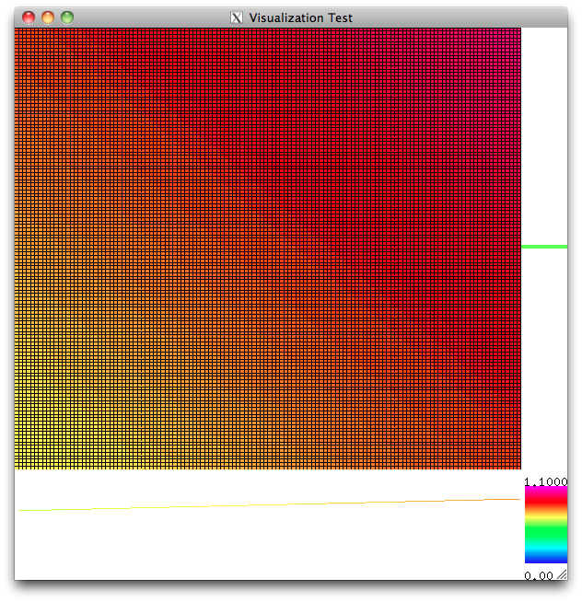
Viz example code

Slide 15
Terminal Window with events
Iteration: 0, Time: 0.00, Timestep: n/a
Iteration: 100, Time: 0.1000, Timestep: 0.0010
DEBUG mouse click is button 0 state 0 xloc 273 yloc 338
DEBUG mouse click is button 0 state 1 xloc 273 yloc 338
DEBUG key pressed is 120
Iteration: 200, Time: 0.2000, Timestep: 0.0010
DEBUG mouse click is button 2 state 0 xloc 273 yloc 331
DEBUG mouse click is button 2 state 1 xloc 273 yloc 331
DEBUG key pressed is 102
DEBUG key pressed is 103
DEBUG key pressed is 107
Iteration: 300, Time: 0.3000, Timestep: 0.0010
Iteration: 400, Time: 0.4000, Timestep: 0.0010
Iteration: 500, Time: 0.5000, Timestep: 0.0010
Iteration: 600, Time: 0.6000, Timestep: 0.0010
Iteration: 700, Time: 0.7000, Timestep: 0.0010
Iteration: 800, Time: 0.8000, Timestep: 0.0010
Iteration: 900, Time: 0.9000, Timestep: 0.0010
Iteration: 1000, Time: 1.0000, Timestep: 0.0010

