Slide 1
Growing Up With The Web:
What Computing Can Teach Us About Ourselves
Leila Al-Hemali
simtable

Slide 2
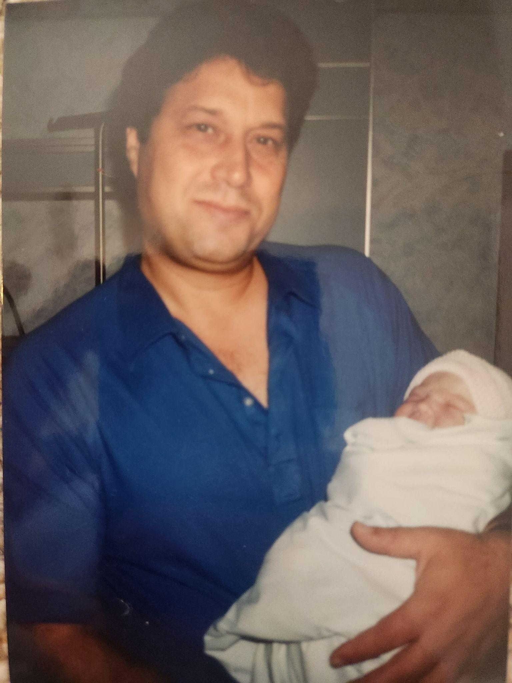
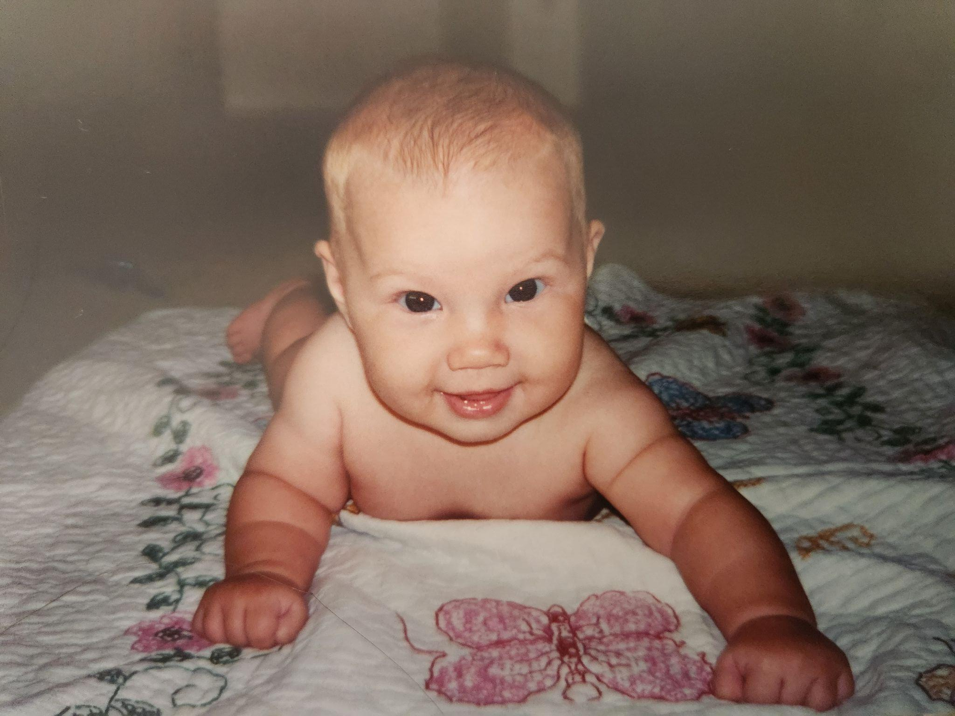
I was born in 1995…

Slide 3

So was the era of personal computing and the modern web…

Slide 4
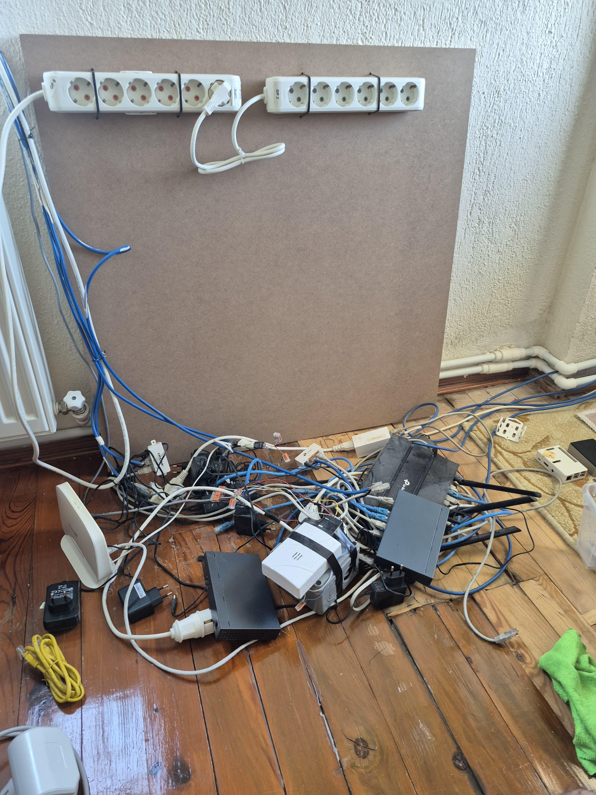
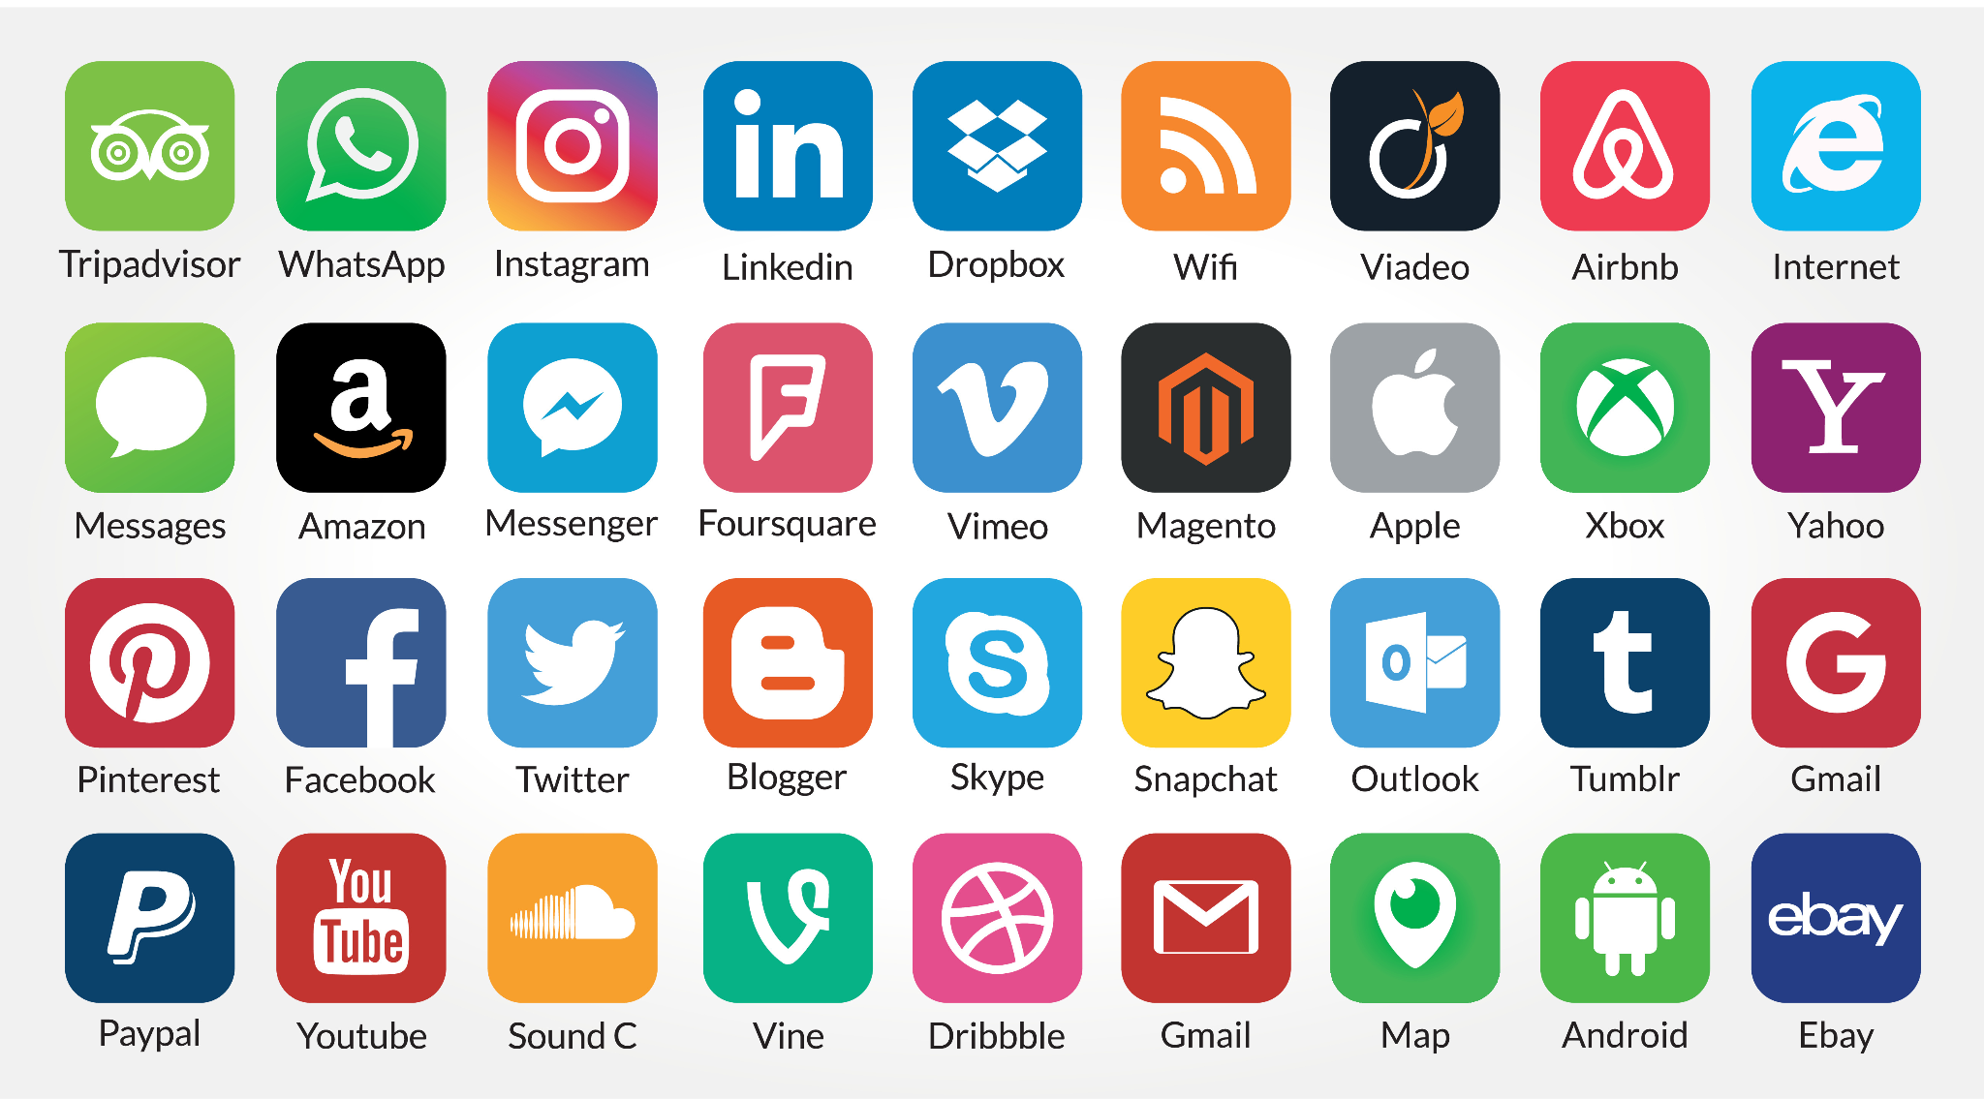
🌐 The Internet vs. 🕸 The Web

Slide 5
Adolescent Web Timeline
2013
1995
1998
2005
2010
1997 (2yo)
2005 (10yo)
2009 (15y0)
2013 (18yo)
React.js started new era of web apps
Javascript + HTML2.0
Google launched
Youtube founded
Instagram
My parents get their 1st internet subscription
Joined Club Penguin, 1st internet gaming phenomenon
Got my 1st smartphone
+ joined facebook
Graduated High School

Slide 6
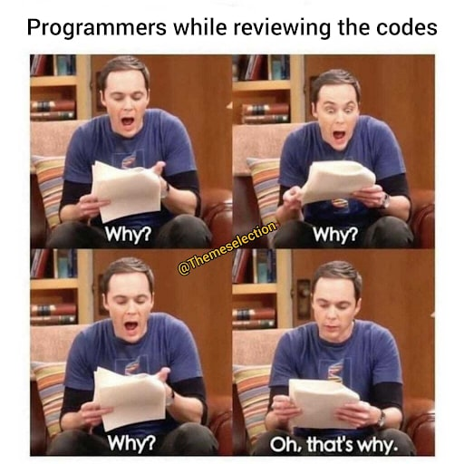
What made me want to work on the web?

Slide 7
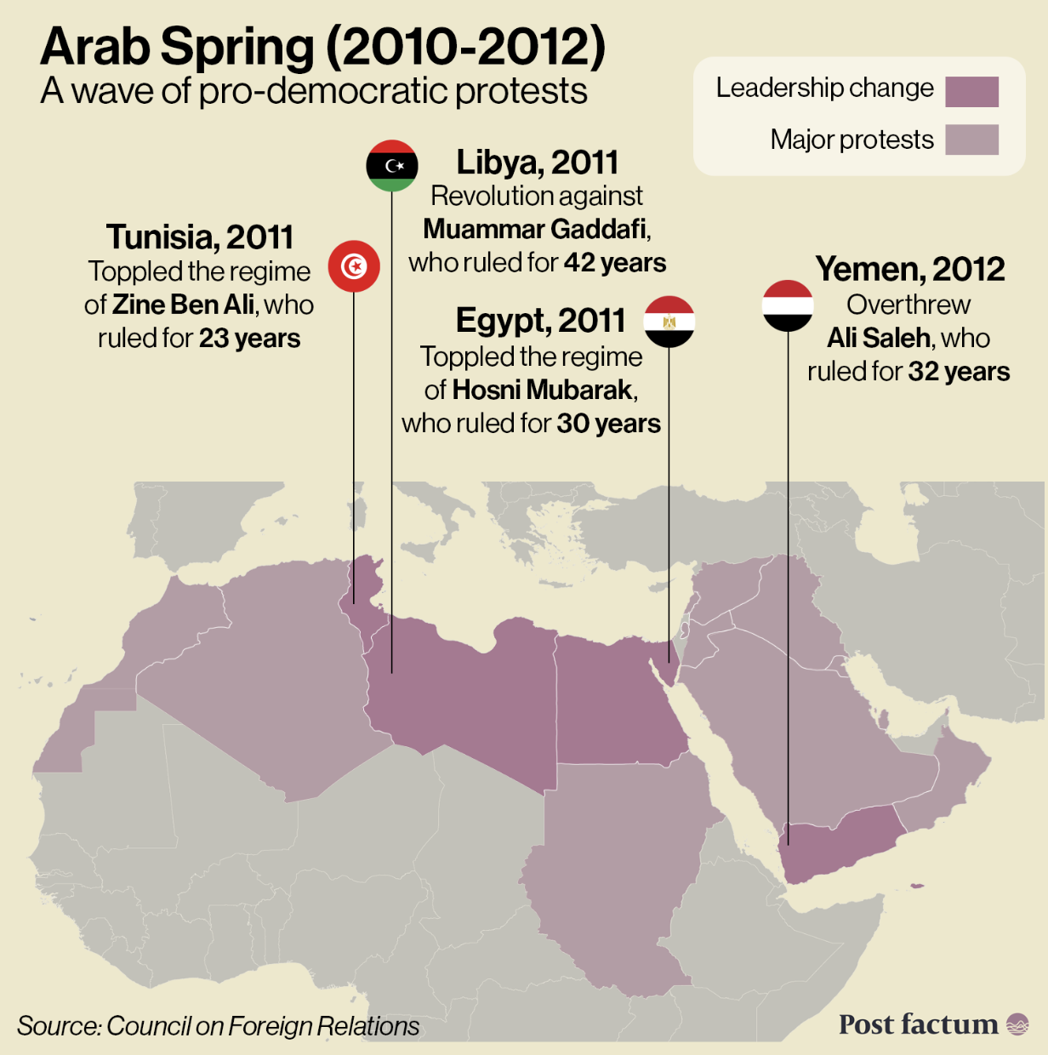
A wave of protests and uprisings across
the Arab world started by protests posted
on Twitter (founded 2006)
Citizens demanded freedom, democracy,
and economic reform
Sparked in Tunisia in late 2010,
led to leadership change Egypt,
Libya, Yemen, Syria

Slide 8

Protests escalated into civil war against dictator Muammar Gaddafi
After 42 years in power, Gaddafi was overthrown in 2011
My Dad was able to return home in 2012 after living in exile in the US for 37 years

Slide 9
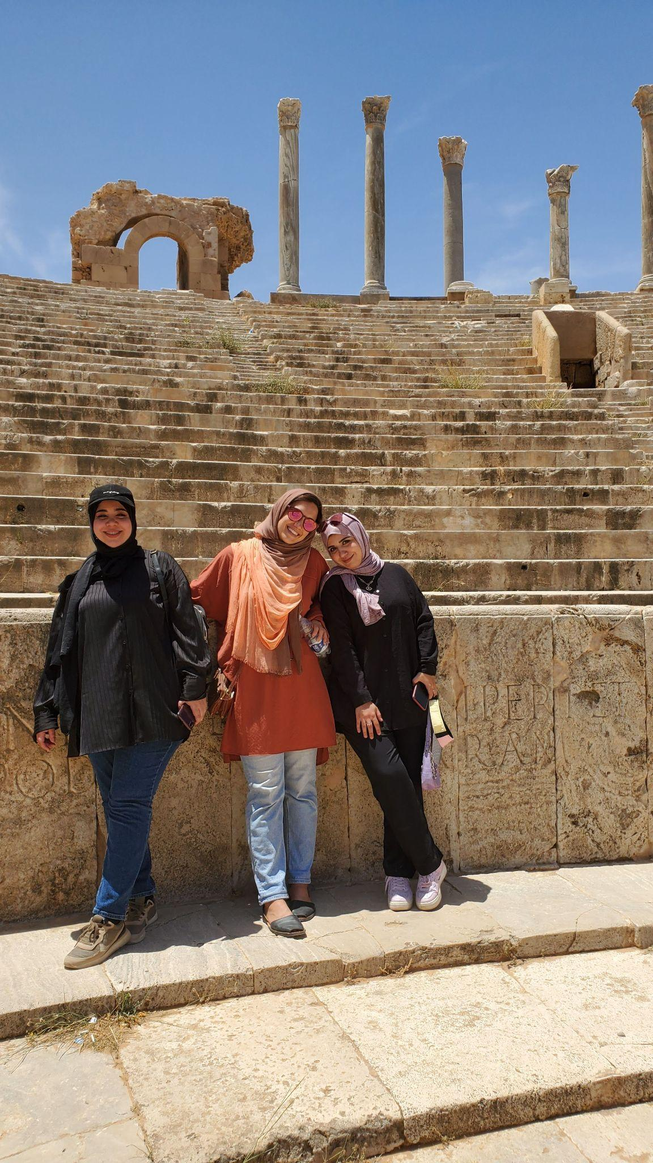
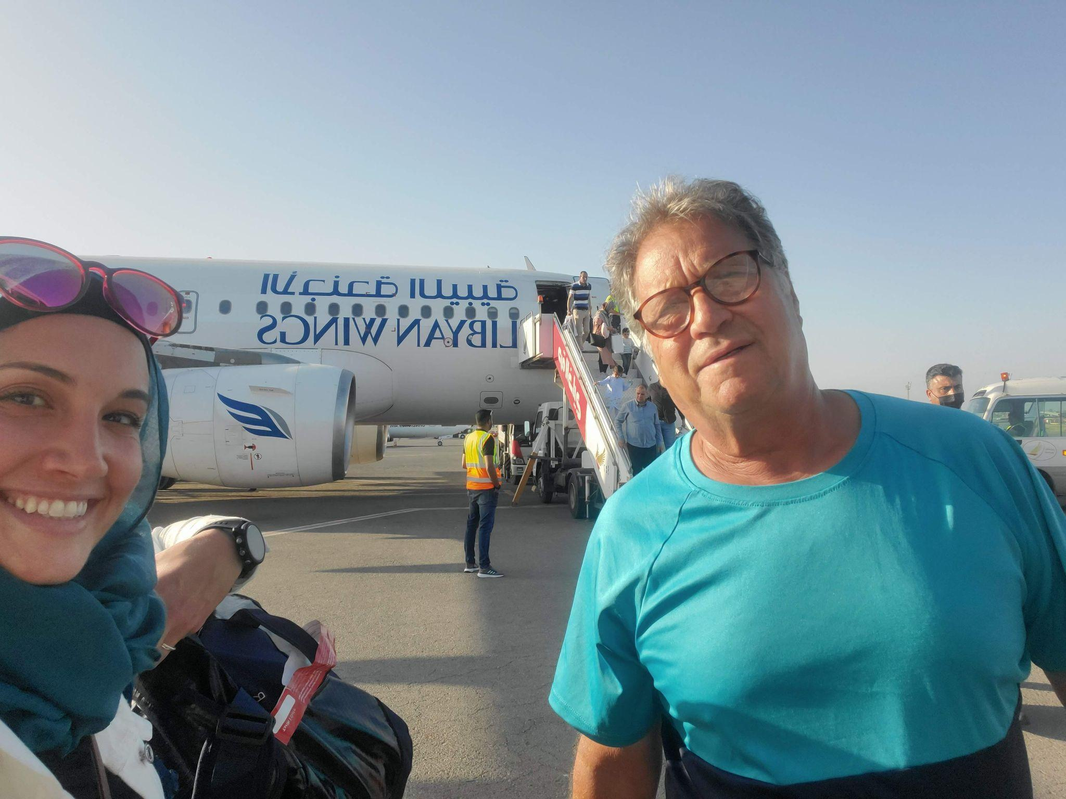
Showed how digital networks can empower people and challenge existing systems
Proved that technology isn’t neutral — it shapes politics, society, and history
Inspired later movements like #BlackLivesMatter and #MeToo

Slide 10
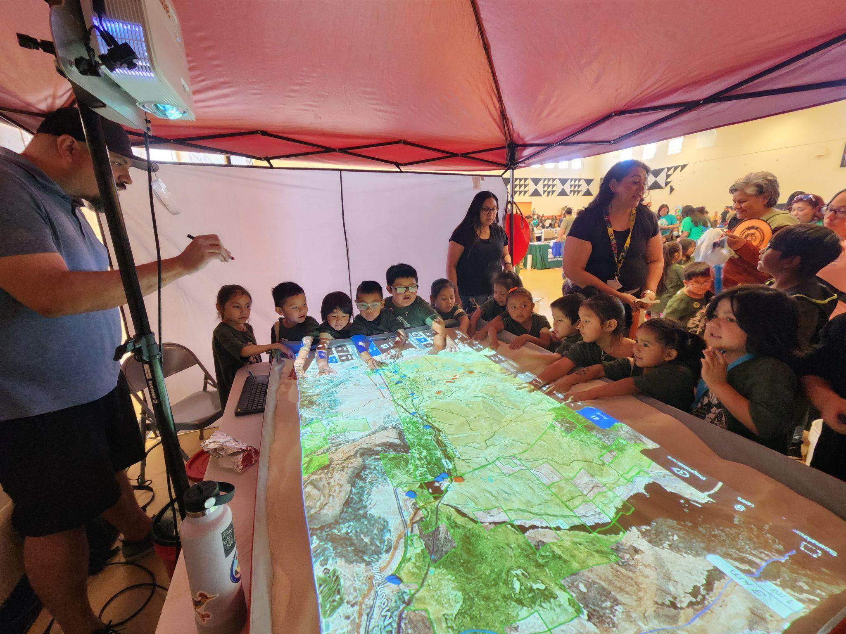
Web to Understand Climate Change
Modeling and Visualizing disaster scenarios with Agent-Based Models

Slide 11
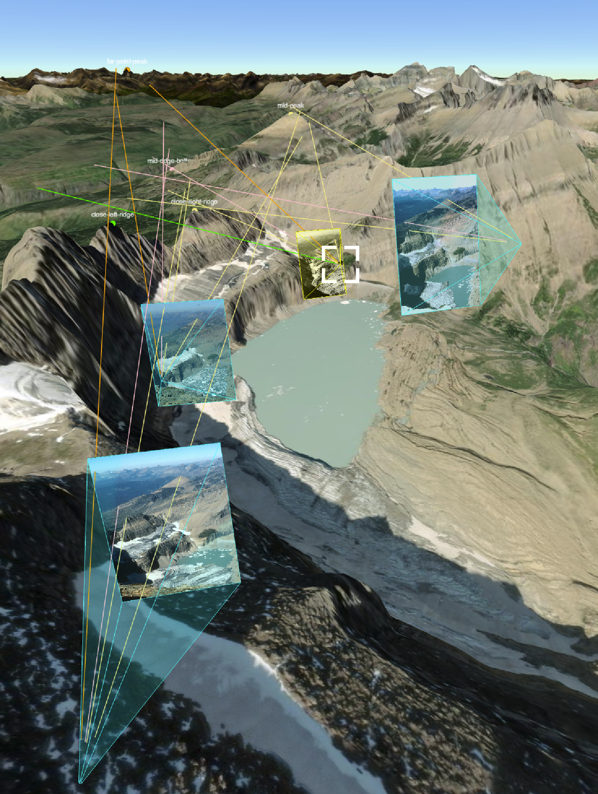
Measuring Glacial Retreat in the Browser
Step 1: Orient Four images of Grinnell
Glacier in Glacier National Park from
Wikipedia

Slide 12
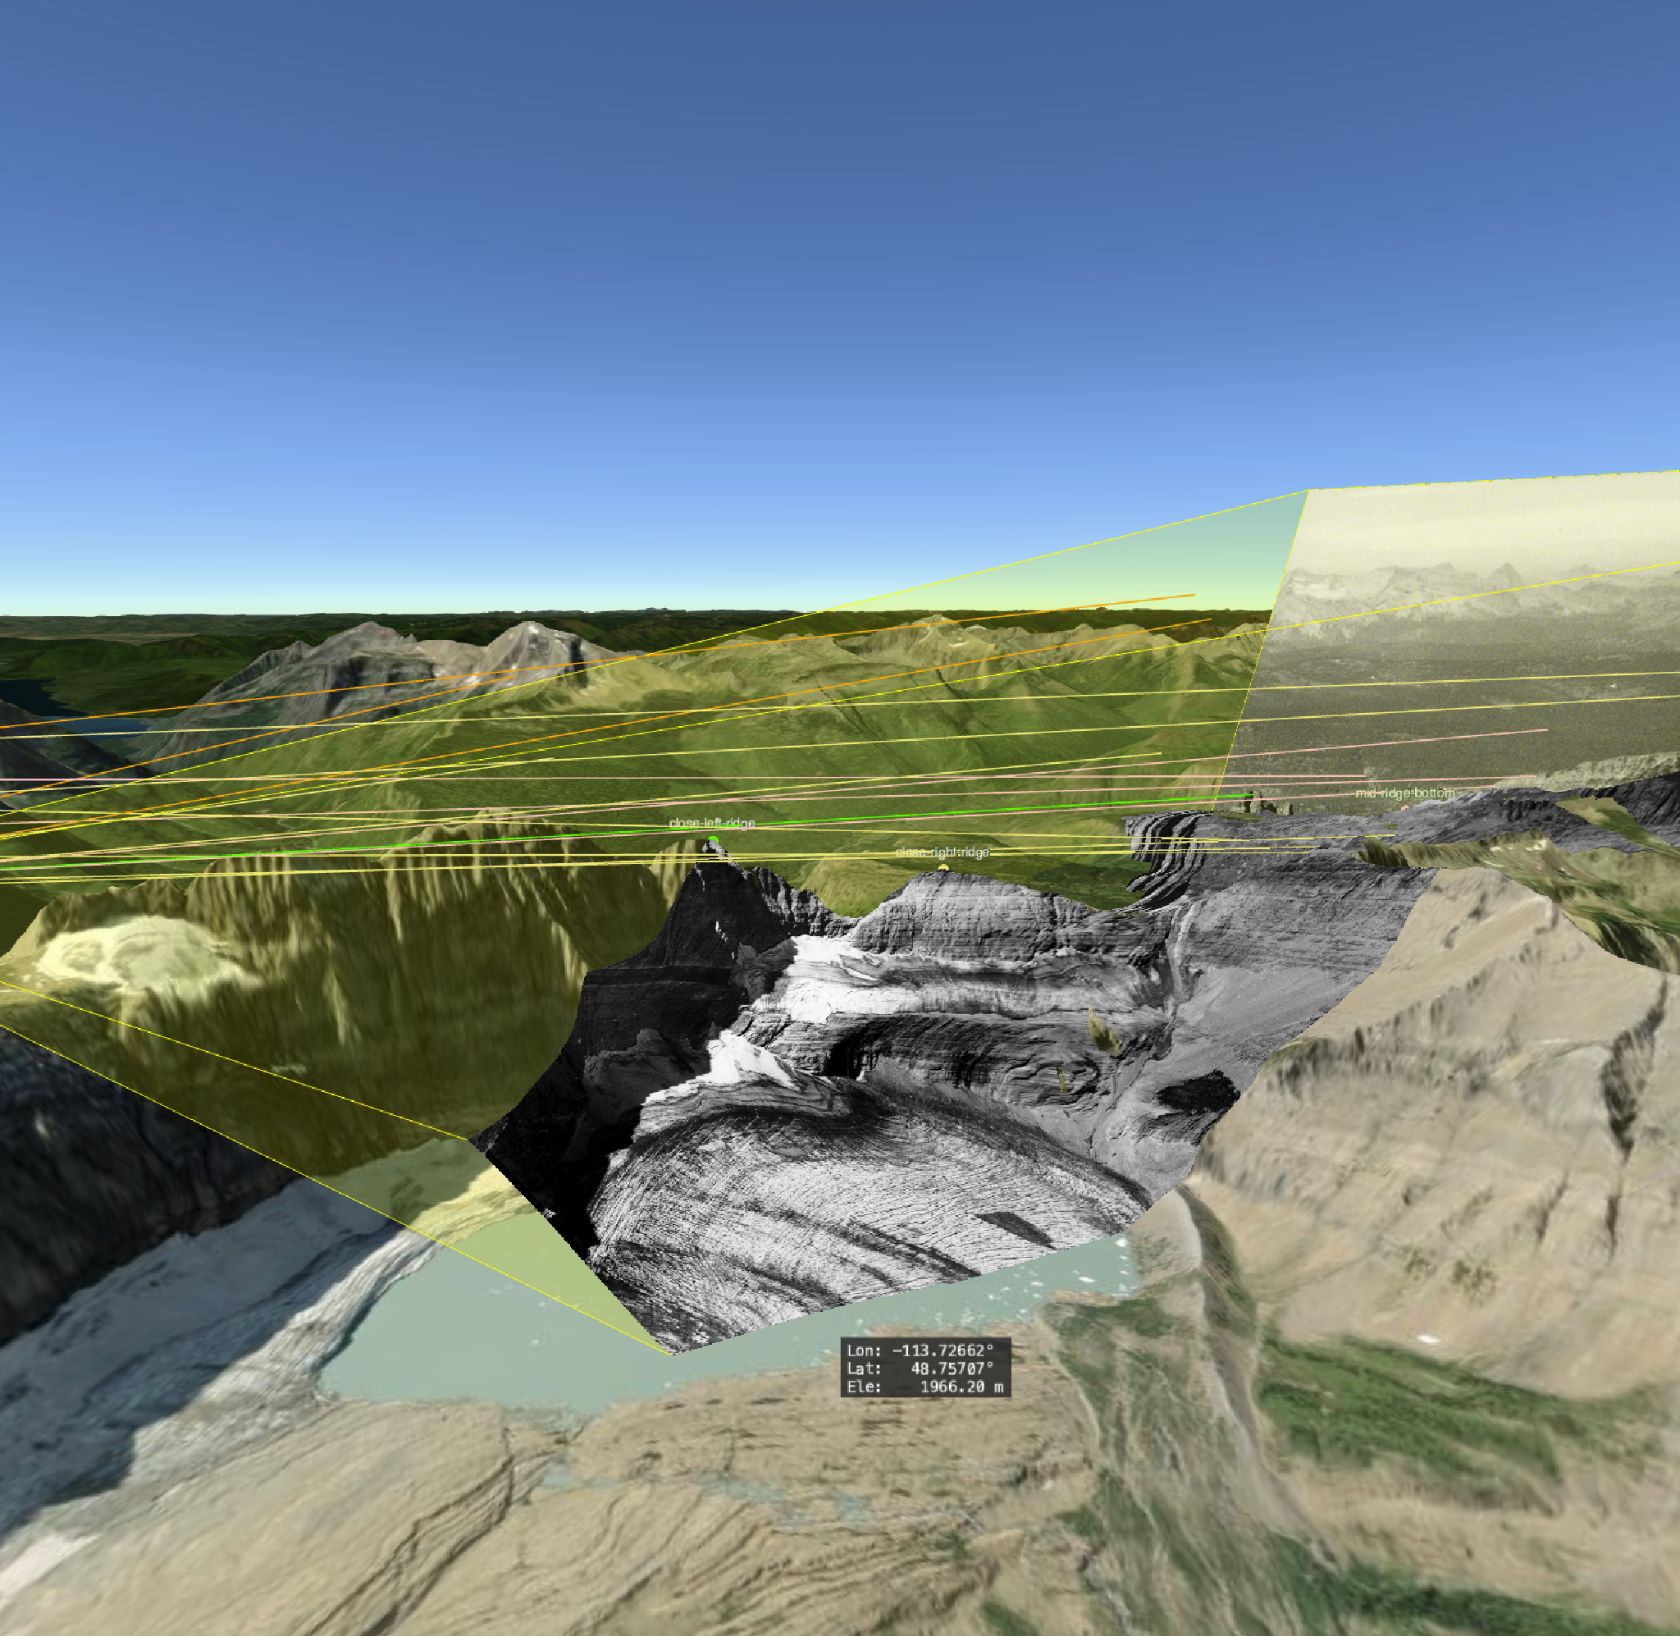
Measuring Glacial Retreat
Step 2: Project the images on to the terrain
to match images coordinates with real
world coordinates

Slide 13
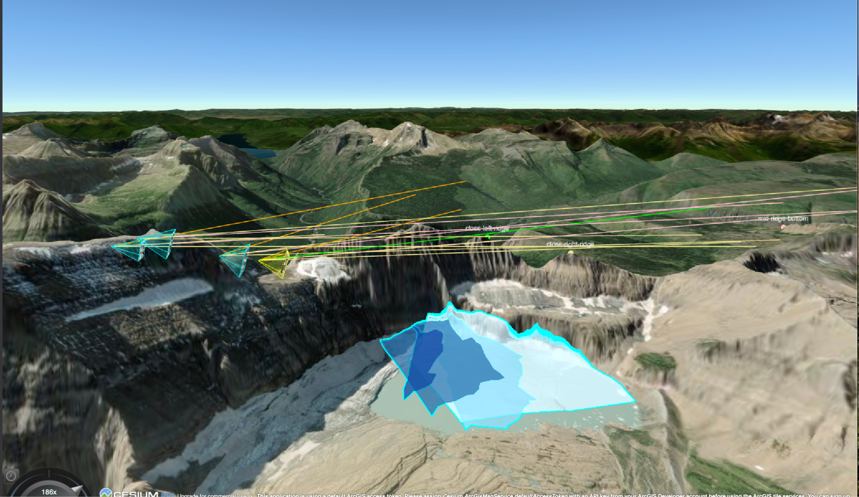
Measuring Glacial Retreat
Step 4: Create GIS Layer in our platform

Slide 14
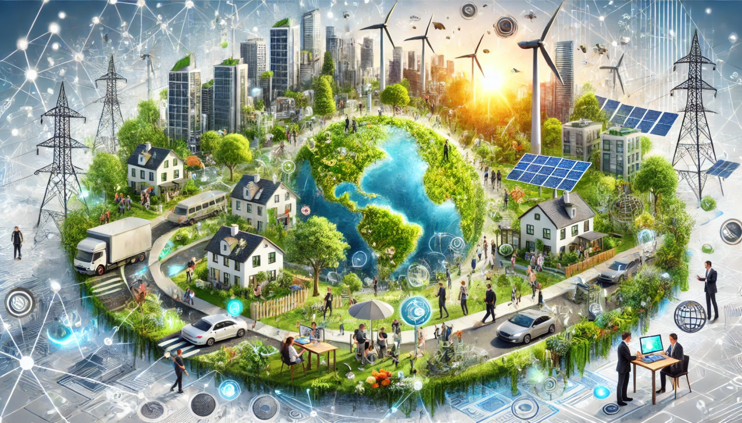
Point 1:
The problems you can solve
with computers aren’t just technical
- they’re human, political, environmental

Slide 15
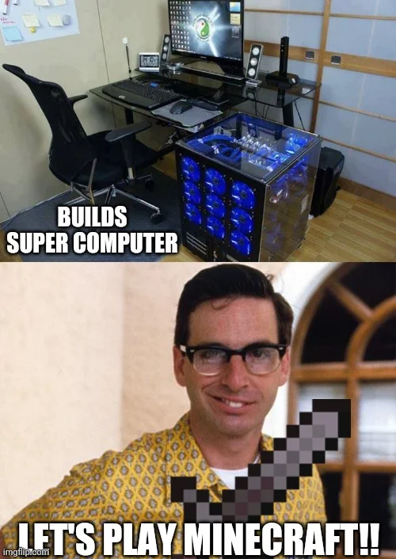
Now let’s move away from web technologies and think about what computing and intelligence is…

Slide 16

Computation is the transformation of information

Slide 17

Computation as a new kind of nature

Slide 18

Computation as poetry

Slide 19
Point 2: Create your own definition of computation

Slide 20
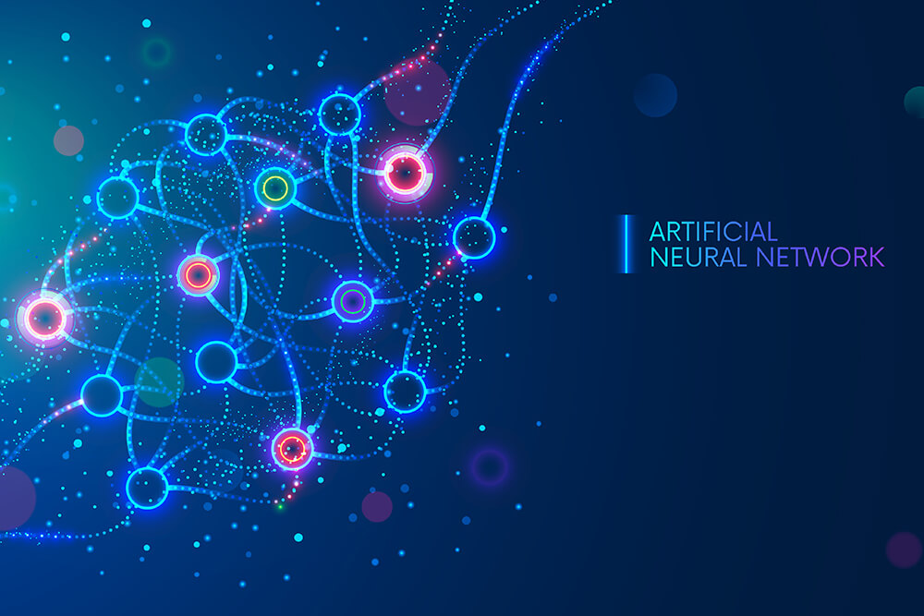
We are in a new era of computing: AI

Slide 21

Humans have always identified closely with the tools we make

Slide 22
Notebook -> Extends Memory
Cars -> increases access
AI -> extends synthesis and imagination

Slide 23

When cars came out, we didn’t give up moving our bodies, we created gyms.
With AI here, we won’t give up thinking, we’ll find new ways to train our minds

Slide 24
3 Conscious Use Practices:
One in three times you want to consult an LLM,
DONT
Ask AI for Package Suggestions,
Choose the best one yourself
Write the function,
Ask AI for feedback

Slide 25
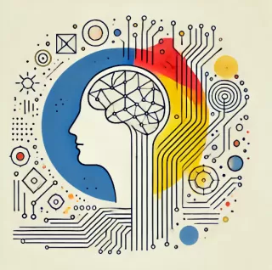
Point 3:
Use AI as
cognitive
extension

Slide 26

Point 1: The problems computers can solve are limitless
Point 2: Create your own definition for computation
Point 3: Use AI as cognitive extension

Slide 27
THANK YOU!
Contact: leila@simtable.com

