Slide 1
Computational Science and Mathematical Modeling
Notes:
What is Science? What do you think Computational Science is? What is a Model?
Science is a systematic enterprise that builds and organizes knowledge in the form of testable explanations and predictions about the universe
Modeling is the activity of representing something using existing knowledge.

Slide 2
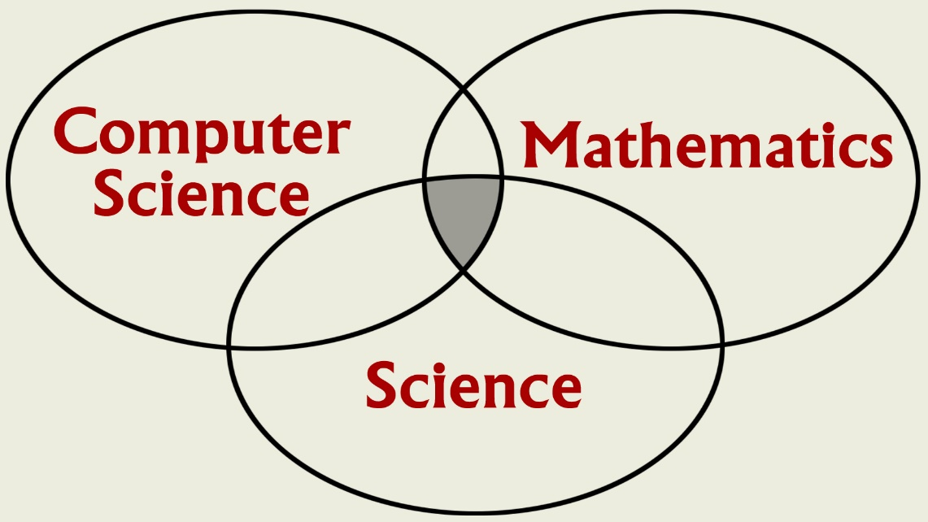
Computational Science?
Computational Science is the use of mathematics and computers to model “real world” problems in science, and conduct simulation experiments.
Computational Science involves teamwork
Notes:
Science?
Computational Science is a multidisciplinary activity, brings together people from a variety of disciplines.

Slide 3
Computational Science
Complements, but does not replace, theory and experimentation in scientific research.
Notes:
Validation, Can’t do computational Science in a vacuum. Why? Experimentation to validate your model.

Slide 4
Computational Science
Is often used in place of experiments when experiments are too large, too expensive, too dangerous, or too time consuming.
Can be useful in “what if” studies; e.g. to investigate the use of pathogens (viruses, bacteria, fungi) to control an insect population.
Is a modern tool for scientific investigation.
Notes:
Video of Burnt Frost. Graphics that show a “what if” simulation. Talk about fish and plankton

Slide 5
Example: Industry →
First jetliner to be digitally designed, "pre-assembled" on computer, eliminating need for costly, full-scale mockup.
Computational modeling improved the quality of work and reduced changes, errors, and rework.
www.boeing.com/commercial/
777family/index.html
Notes:
!00% digitally designed using 3D computer modeling.
Bottom line: Reduced cost/Reduced time to market.

Slide 6
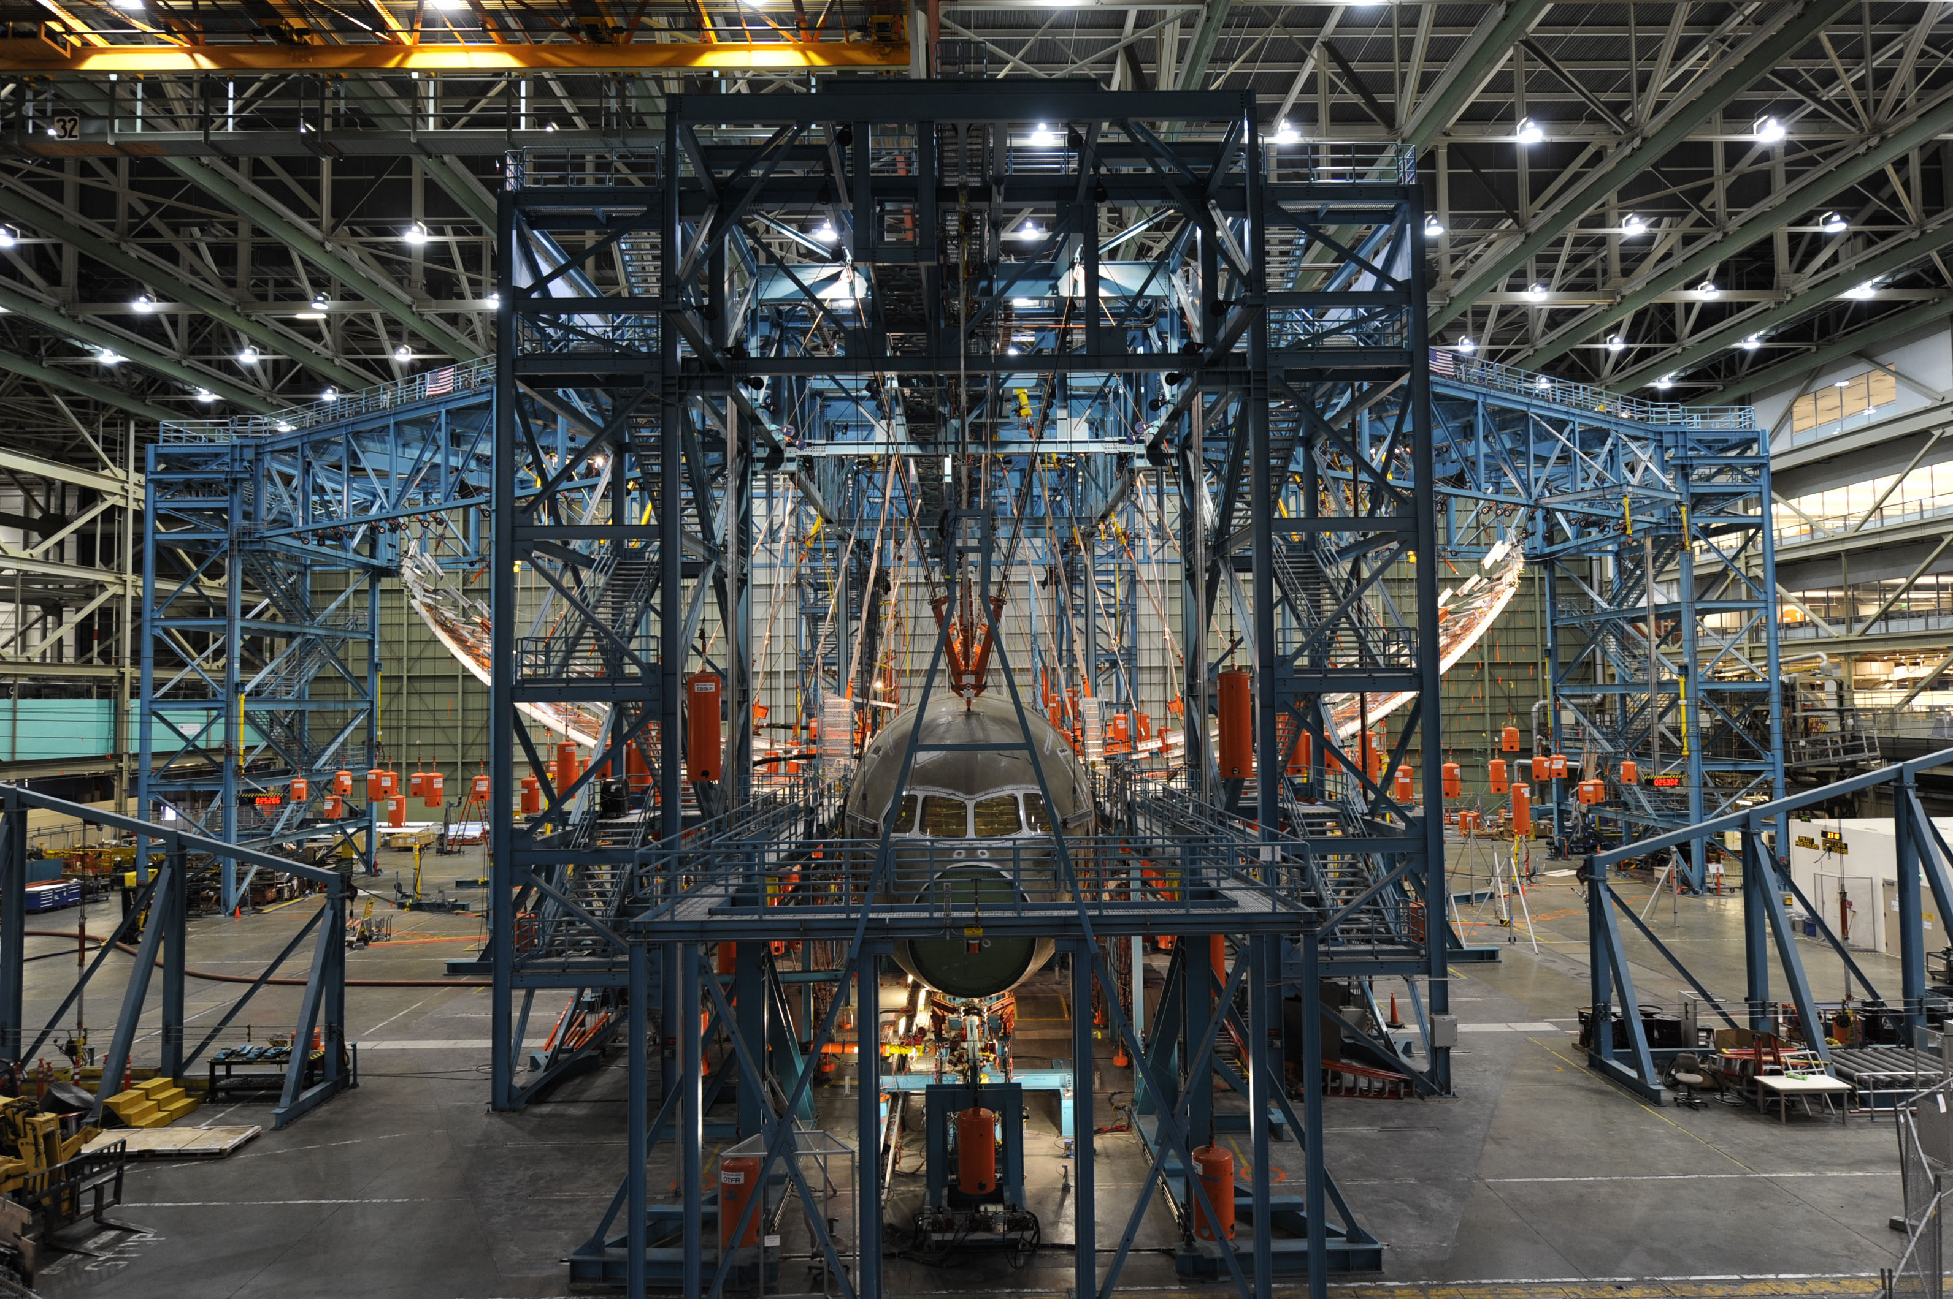
Example: Wing Flex Text
Photo courtesy Boeing
Notes:
Boeing 787 Dreamliner. Testing wing flexibility by raising them 25 feet, imposing 50% more load than expected during a plane’s lifetime. Demonstrates safety of design, and must be done for certification. Do you think they want to do this more than once? More information: http://www.wired.com/2010/03/boeing-787-passes-incredible-wing-flex-test/

Slide 7
Example: Operation Burnt Frost
US reconnaissance satellite dies shortly after launch
  1000lbs frozen hydrazine onboard, high risk to human life
Let’s shoot it down!
  When can we make the shot?
  From where?
  Using which kind of missile?
  Will it affect the space station, space shuttle, and other satellites?
  Hundreds of questions to answer
Source: https://vimeo.com/103946259
Notes:
Can show burnt frost video here, if deemed entertaining enough.

Slide 8

Example: Operation Burnt Frost
Notes:
Can show burnt frost video here, if deemed entertaining enough.

Slide 9
Computational Science
Has emerged as a powerful, indispensable tool for studying a variety of problems in scientific research, product and process development, and manufacturing.
Seismology
Climate modeling
Economics
Environment
Material research
Drug design
Manufacturing
Medicine
Biology
Analyze - Predict
Notes:
Seismology: oil exploration, earthquake prediction (Parallel computation reduced compute time from weeks to hours)
Global ocean/ climate modeling: global warming, weather prediction
Economics: growth of a local or national economy (Agent-based modeling), management of resources, analysis of tax strategies
Environmental: utilization of resources, population modeling, insect control
Materials research: design of new materials, smart materials; shape driven by temperature materials; materials aging issues (Stockpile stewardship)
Drug design: design of anti-cancer drugs, etc.
Manufacturing: optimization of manufacturing processes, automation
Medicine: Medical imaging, MRIs
Human genome: applications to understanding and treating disease

Slide 10
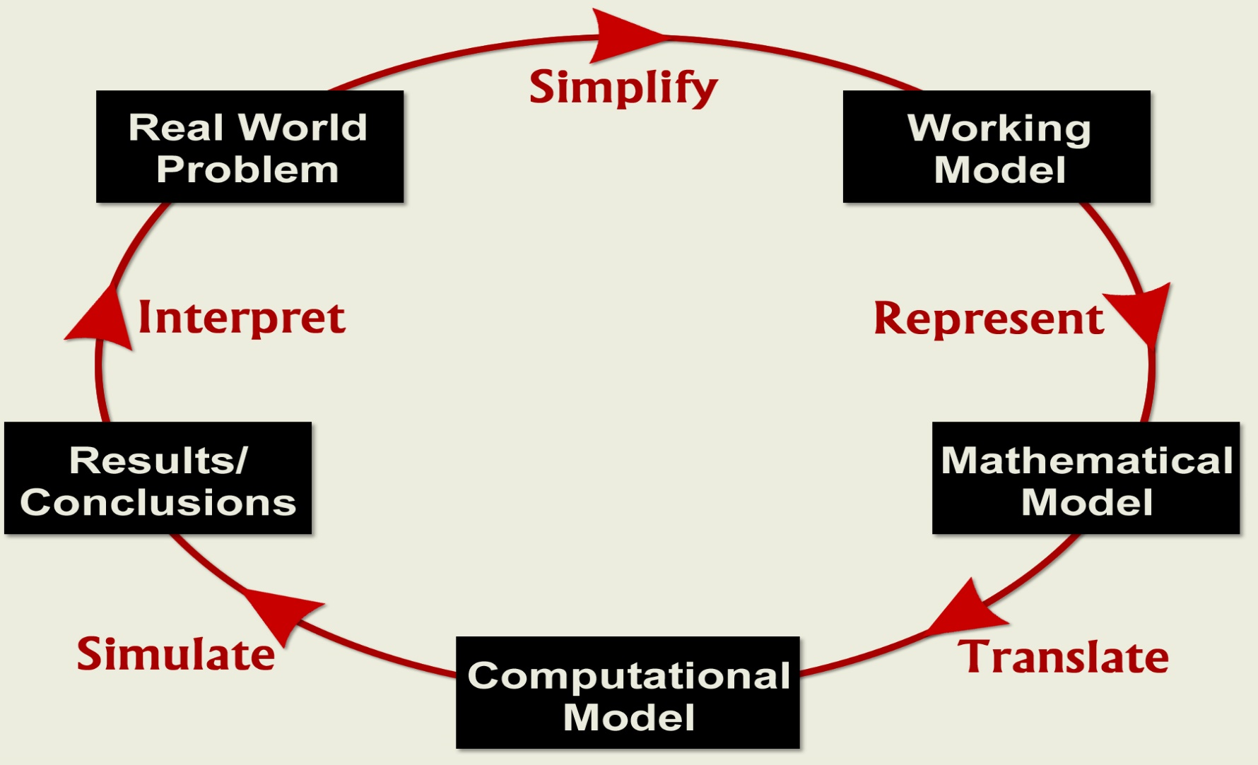
Computational Science Cycle

Slide 11
Design a building
2. Develop an idea
for a Working Model
1. Select a Real World Problem:
3. Select Mathematical
or Agent-based Model
Research
&
Simplify
Represent
&
Explain
(If you cannot talk about your model, do not move on to the next step.)
(If no data could be collected from a model like this, go back to step 1.)
Translate
Into
Code
Does the data describe the real world phenomena
6. Analyze the Data
5. Run the Computational Model
4. Design & Implement
the Computational Model.
Produce
Data
Setup the Experiments
(If the data doesn’t make sense, go back to step 4.)

Slide 12
2. Develop an idea
for a Working Model
1. Select a Real World Problem:
3. Select Mathematical
or Agent-based Model
How to design a building so people can escape in case of a fire.
Research
&
Simplify
Represent
&
Explain
Translate
Into
Code
Does the data describe the real world phenomena
6. Analyze the Data
5. Run the Computational Model
4. Design & Implement
the Computational Model.
Produce
Data
Setup the Experiments

Slide 13
2. Develop an idea
for a Working Model
1. Select a Real World Problem:
What needs to be represented? The floor plan, the peoples’ behavior, the fire’s behavior, obstacles.
3. Select Mathematical
or Agent-based Model
How to design a building so people can escape in case of a fire.
Research
&
Simplify
Represent
&
Explain
Translate
Into
Code
Does the data describe the real world phenomena
6. Analyze the Data
5. Run the Computational Model
4. Design & Implement
the Computational Model.
Produce
Data
Setup the Experiments

Slide 14
2. Develop an idea
for a Working Model
1. Select a Real World Problem:
What needs to be represented? The floor plan, the peoples’ behavior, the fire’s behavior, obstacles.
3. Select Mathematical
or Agent-based Model
How to design a building so people can escape in case of a fire.
Research
&
Simplify
Represent
&
Explain
Use agent-based to model people and things.
Translate
Into
Code
Does the data describe the real world phenomena
6. Analyze the Data
5. Run the Computational Model
4. Design & Implement
the Computational Model.
Produce
Data
Setup the Experiments

Slide 15
2. Develop an idea
for a Working Model
1. Select a Real World Problem:
What needs to be represented? The floor plan, the peoples’ behavior, the fire’s behavior, obstacles.
3. Select Mathematical
or Agent-based Model
How to design a building so people can escape in case of a fire.
Research
&
Simplify
Represent
&
Explain
Use agent-based to model people and things.
Translate
Into
Code
Does the data describe the real world phenomena
6. Analyze the Data
5. Run the Computational Model
4. Design & Implement
the Computational Model.
Produce
Data
Setup the Experiments
Combine steps #3 and #4, add detail, write a program!

Slide 16
2. Develop an idea
for a Working Model
1. Select a Real World Problem:
What needs to be represented? The floor plan, the peoples’ behavior, the fire’s behavior, obstacles.
3. Select Mathematical
or Agent-based Model
How to design a building so people can escape in case of a fire.
Research
&
Simplify
Represent
&
Explain
Use agent-based to model people and things.
Translate
Into
Code
Does the data describe the real world phenomena
6. Analyze the Data
5. Run the Computational Model
4. Design & Implement
the Computational Model.
Select the number of exits, people, obstacles, time limit, repetition. Increase the number of exits, run again.
Produce
Data
Setup the Experiments
Combine steps #3 and #4, add detail, write a program!

Slide 17
2. Develop an idea
for a Working Model
1. Select a Real World Problem:
What needs to be represented? The floor plan, the peoples’ behavior, the fire’s behavior, obstacles.
3. Select Mathematical
or Agent-based Model
How to design a building so people can escape in case of a fire.
Research
&
Simplify
Represent
&
Explain
Use agent-based to model people and things.
Translate
Into
Code
Does the data describe the real world phenomena
6. Analyze the Data
5. Run the Computational Model
4. Design & Implement
the Computational Model.
“Our data shows that 100 people can exit the building safely when there are at least 7 exits. For each exit below 7, 15% of the people were unable to exit.
Select the number of exits, people, obstacles, time limit, repetition. Increase the number of exits, run again.
Produce
Data
Setup the Experiments
Combine steps #3 and #4, add detail, write a program!

Slide 18
Summary
Modeling is an important component of doing science today
Modeling helps answer hard-to-answer questions
  Use it to ask questions before and after a scientific experiment
The computational cycle: The scientific method of computational science
  It is the key to a successful project
Notes:
Seismology: oil exploration, earthquake prediction (Parallel computation reduced compute time from weeks to hours)
Global ocean/ climate modeling: global warming, weather prediction
Economics: growth of a local or national economy (Agent-based modeling), management of resources, analysis of tax strategies
Environmental: utilization of resources, population modeling, insect control
Materials research: design of new materials, smart materials; shape driven by temperature materials; materials aging issues (Stockpile stewardship)
Drug design: design of anti-cancer drugs, etc.
Manufacturing: optimization of manufacturing processes, automation
Medicine: Medical imaging, MRIs
Human genome: applications to understanding and treating disease

Slide 19
Implementation Approach:
Technical Application
Device Control
Numerical Computing
Fortran
Monte Carlo Simulation
Continuous Simulation
C
Discrete Event Simulation
C++
Cellular Automata
Java
Agent-based Simulation
StarLogo

