Slide 1
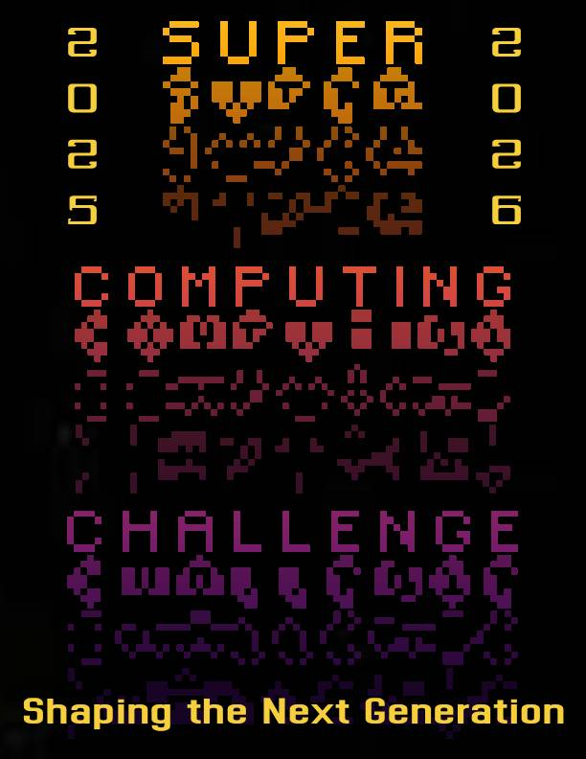

Welcome to the
36th
Annual Awards Ceremony

Slide 2
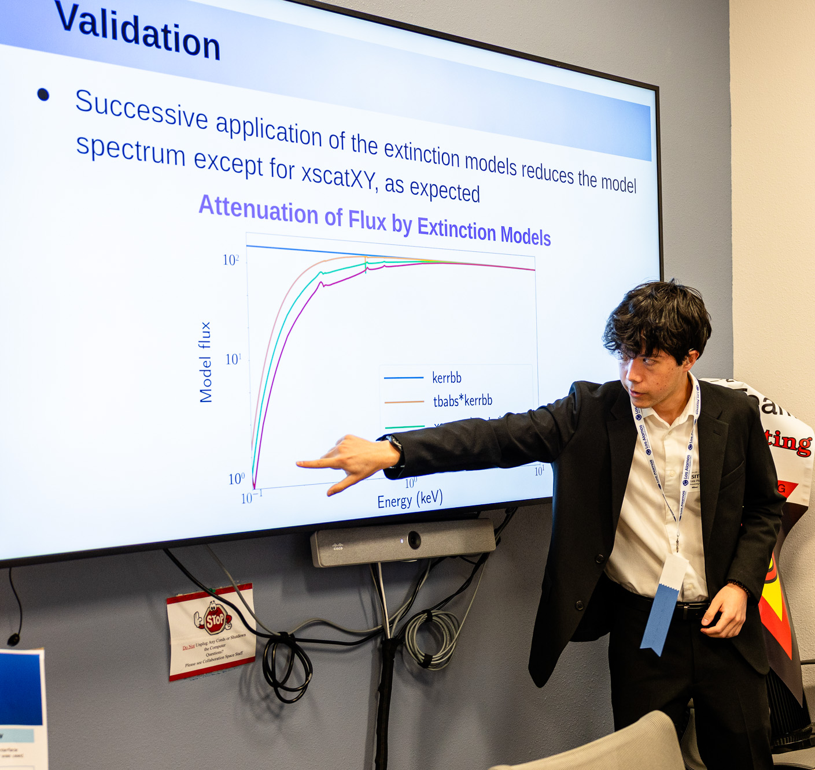
FIRST PLACE
Los Alamos High School
Dust Busters: The Effects Of
Dust Scattering On
Observations Of X-Ray
Binaries
Team member: Tate Plohr
Sponsor: JeeYeon Plohr
Mentor: Greg Salvesen
VERY NICE WORK!!

Slide 3
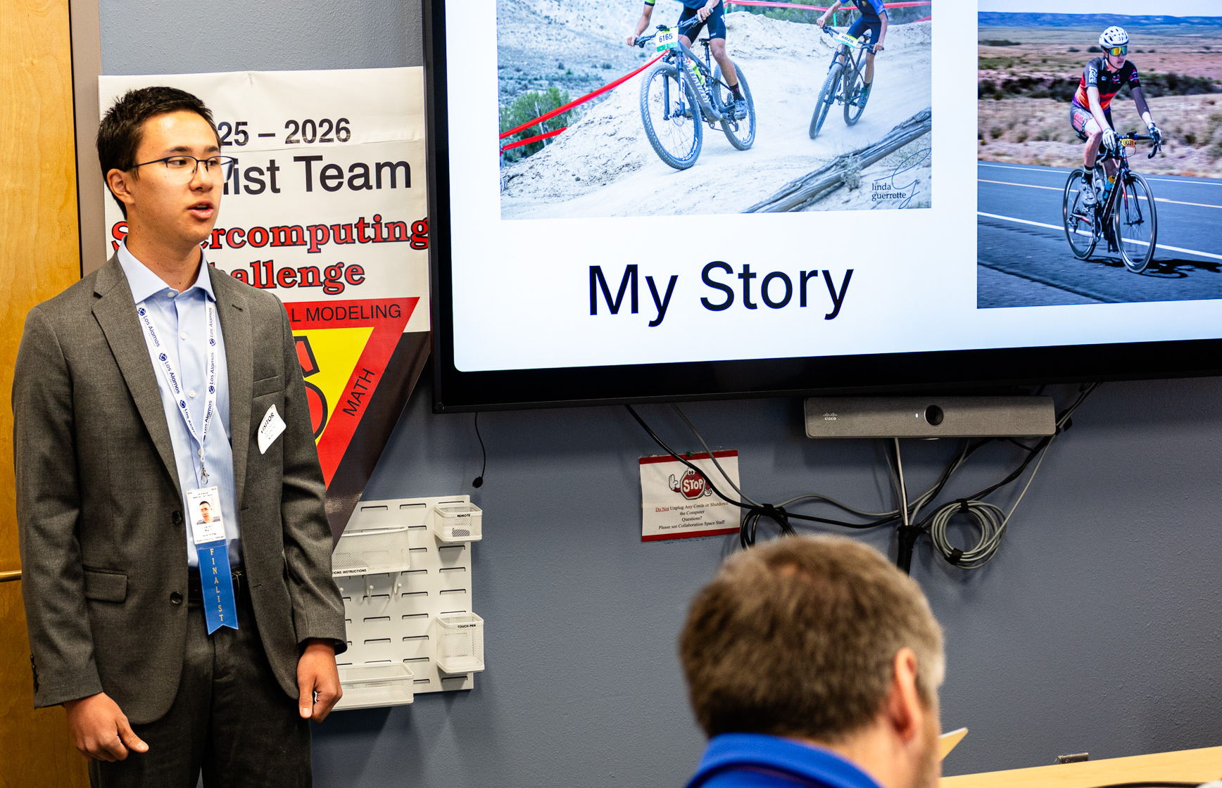
SECOND PLACE
Santa Fe Preparatory School Pacing Optimization for
Cycling Performance
Through Neural Evolution
Team Member: Jaden Rand
Sponsor: Jocelyne Comstock
WELL DONE!!

Slide 4
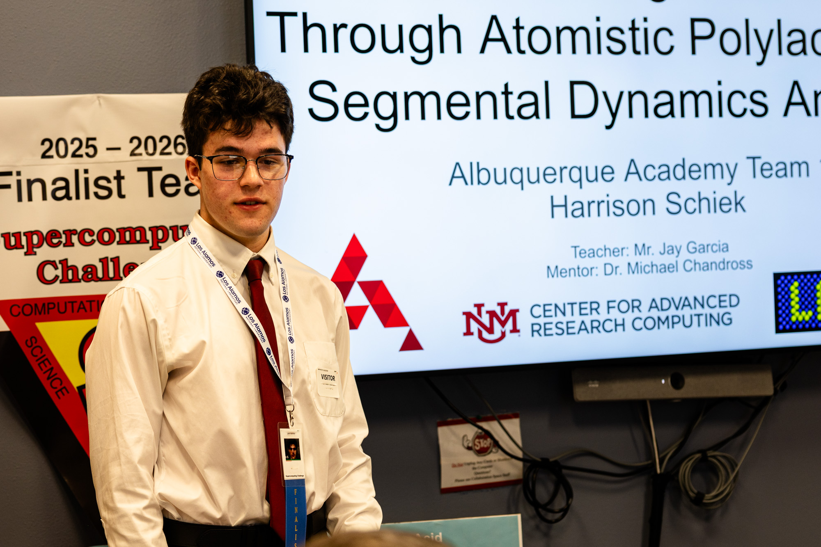
THIRD PLACE
Albuquerque Academy
Understanding 3D Printing
Through Atomistic Polylactic
Acid Segmental Dynamic
Analysis
Team Member: Harrison Schiek
Sponsors: Jay Garcia
Mentor: Michael Chandros
CONGRATULATIONS!

Slide 5
Congratulations to the
2025-2026 Finalists Teams!

Slide 6
The Finalists
Albuquerque Academy
Understanding 3D Printing Through Atomistic Polylactic Acid Segmental Dynamics Analysis
Team Member: Harrison Schiek
Sponsors: Jay Garcia
Mentor: Michael Chandros

Slide 7
The Finalists
Los Alamos High School
Dust Busters: The Effects Of Dust Scattering On Observations Of X-ray Binaries
Team member: Tate Plohr
Sponsor: JeeYeon Plohr
Mentor: Greg Salvesen

Slide 8
The Finalists
Los Alamos High School
Collective Intelligence: Driving Lessons from Ants
Team Member: Linus Plohr

Slide 9
The Finalists
Santa Fe Preparatory School
Pacing Optimization for Cycling Performance Through Neural Evolution
Team Member: Jaden Rand
Sponsor: Jocelyne Comstock

Slide 10
The Finalists
Santa Fe Preparatory School
Development of an Open-Source, High-Precision N-Body Solar-System Gravitational Simulation
Team: Marlow Lichty, Nik Szczepanski
Sponsor: Jocelyne Comstock

Slide 11
The Finalists
Welch Home School
Application of Game Theory to Analysis of Machine Versus Human Strategies
Team Members: Helena Welch
Kalliope Luna Welch
Sponsor: Cindy Welch
Mentor: Paul Welch

Slide 12
NetLogo Agent Based Model
New Futures
Fighting Shadows
Team Members: Nadia Montano, Jazmin Aquino
Teacher/Mentor: Rachel Kilman

Slide 13

Excellence in Teamwork Award
Santa Fe Preparatory School
Development of an Open-Source, High Precision N-body Solar System Gravitational Simulation
Team: Marlow Lichty, Nik Szczepanski
Sponsor: Jocelyne Comstock

Slide 14
Excellence in Research Award
New Mexico Academy for the Media Arts
When Will New Mexico Run out of Water?
Team: Eduardo Dorado, Anasofia Rodriguez, Zaaliyah Thomas
Sponsor: Tanya Muller

Slide 15

Human Computer Interaction Award
Justice Code
CommuniEats
Team: Mekhi Bradford
Sponsor: Becky Campbell

Slide 16
Environmental Modeling Award
New Mexico Academy for the Media Arts
When Will New Mexico Run Out of Water
Team: Eduardo Dorado, Anasofia Rodriguez, Zaaliyah Thomas
Sponsor: Tanya Mueller

Slide 17

Community Impact Award
New Futures School
Fighting Shadows
Team: Nadia A. Montano, Jazmin N. Aquino
Sponsor: Rachel Kilman, Kelly Lasater, Soni Buda-Thornburgh
Mentor: Richard Barrett

Slide 18
Creativity and Innovation Award
Santa Fe Preparatory School
Identifying Piano Composers from MIDI Files Using Machine Learning
Team: Ari Chan-Chiu
Sponsor: Jocelyne Comstock

Slide 19

Middle School Award
Albuquerque Academy
Do GLP1 agonists, a new weight loss
drug, cost us muscle? A Python
simulation study
Team: Zoheb Barrantes
Sponsor: Arfa Khan

Slide 20
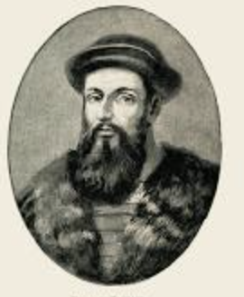
Magellan Award
An Explorer and a Risk Taker
New Futures School
Fighting Shadows
Team: Nadia Montano, Jazmin Aquino
Sponsor: Rachel Kilman, Kelly Lasater,
Soni Buda-Thornburgh
Mentor: Richard Barrett

Slide 21
Teacher Appreciation Award
Mekhi Bradford please come to the stage.

Slide 22

LOGO for Year 2026-2027
Santa Fe Preparatory School
Team: Luke Rand, Isaac Olson
Sponsor: Jocelyne Comstock

Slide 23
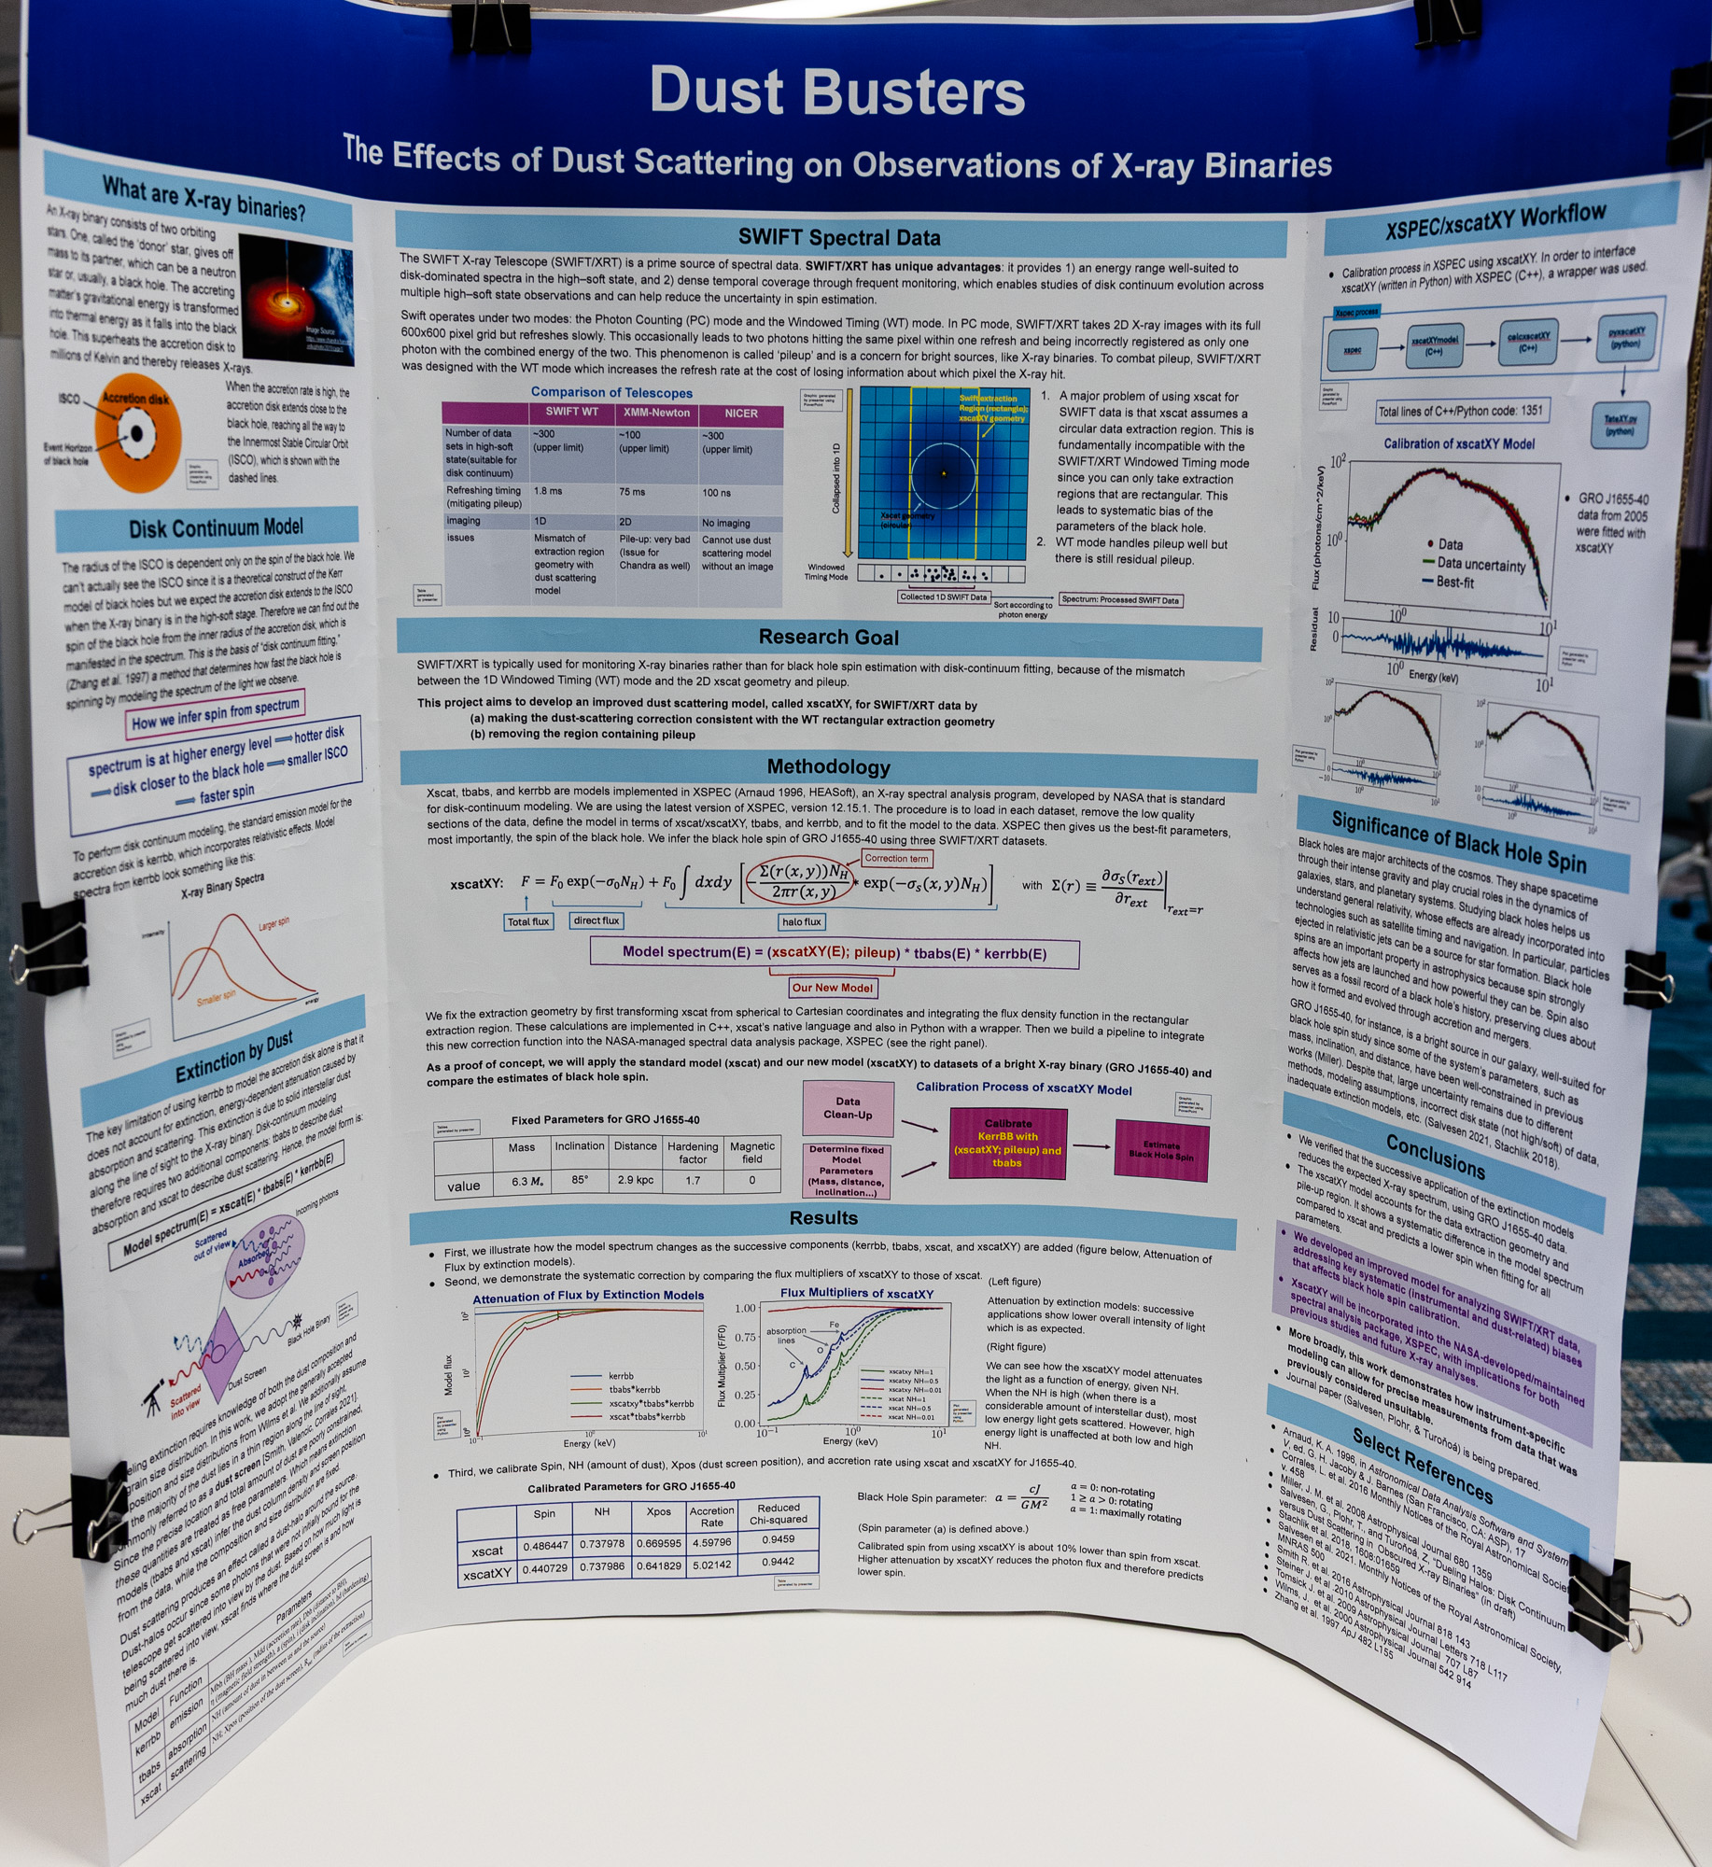
Technical Poster Award
Los Alamos High School
Dust Busters: The Effects of Dust Scattering on Observations of S-Ray Binaries
Team: Tate Plohr
Sponsor: JeeYeon Plohr

Slide 24
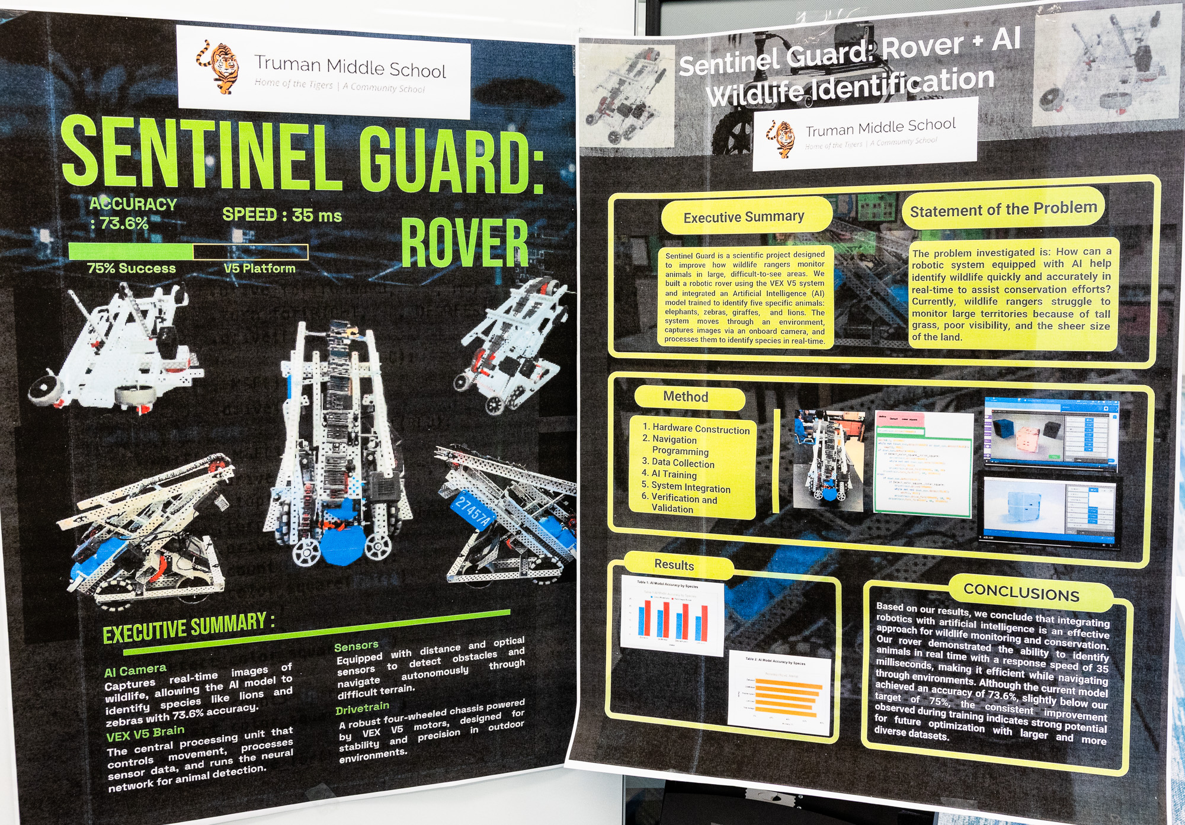
Crowd Favorite Award
Truman Middle School
Sentinel Guard: Rover + AI for Rapid Wildlife Identification
Team: Brian Rios, Abraham Montijo, Karin Urbina
Sponsor: Natali Barreto Baca

Slide 25
New Mexico Network for Women in Science and Engineering
Albuquerque Academy
Low-Cost Raspberry Pi & Molecular Simulations for Microplastic-Drug Classification via LF
Team Member: Ahana Koushik
Sponsor: Jay Garcia

Slide 26
Longevity Award
Congratulations to
Mekhi Bradford

Slide 27
Professional Presentation
Congratulations to
Albuquerque Academy
Understanding 3D Printing Through Atomistic Polylactic Acid Segmental Dynamics Analysis
Team: Harrison Schiek
Sponsor: Jay Garcia

Slide 28
Technical Writing
Congratulations to
Welch Home School
Application of Game Theory to Analysis of
Machine Versus Human Strategies
Team Members: Helena Welch
Kalliope Luna Welch
Sponsor: Cindy Welch
Mentor: Paul Welch

Slide 29
High Performance Computing
Congratulations to
Albuquerque Academy
Understanding 3D Printing Through Atomistic Polylactic Acid Segmental Dynamics Analysis
Team member: Harrison Schiek
Sponsor: Jay Garcia

Slide 30
Judges’ Special Award
Shark Tank
Santa Fe Preparatory School
Pacing Optimization for Cycling Performance
Through Neural Evolution
Team Members: Jaden Rand
Sponsor: Jocelyne Comstock

Slide 31
Judges’ Special Award
Best Agent Based Modeling
Los Alamos High
Collective Intelligence:
Driving Lessons from Ants
Team: Linus Plohr
Mentor: JeeYeon Plohr

Slide 32
Judges’ Special Award
Health Awareness
Capital High School
PFAS Chemicals in School Water
Team: Dafne Ramirez Guajardo, Briana Ramirez
Sponsor: Irina Cislaru

Slide 33
Judges’ Special Award
Science Rocks
Santa Fe Preparatory School
SCORAV: Single-Camera Off-Road Autonomous Vehicle
Team: Luke Rand, Isaac Olson
Sponsor: Jocelyne Comstock

Slide 34
Judges’ Special Award
Significant Engineering Efforts
Capital High
AVALANCHERS: Detection Device for Finding People After an Avalanche
Team: David Chavez, Raul Alvarado Villalobos, Angel Vega, Antonio Baca
Sponsors: Barbara Teteryez, Irina Cislaru

Slide 35
Scholarship Recipients
NAME COLLEGE HIGH SCHOOL
Jazmin Aquino CNM & UNM New Futures HS
Antonio Baca Archuleta SFCC/NMTech Capital HS
Nevaeh Birner CNM New Futures HS
Dafne Ramirez-Guajardo NMTech Capital HS

Slide 36
Scholarship Recipients
NAME COLLEGE HIGH SCHOOL
Marlow Lichty Harvey Mudd Santa Fe Prep
Briana Ramirez UNM Capital HS
Helena Welch Out of State Welch Home School

Slide 37


Recognition of Expo Judges
Hats off to our 22 Expo and Finalist Judges from Challenge Alums, Grad Students, National Labs, Nonprofits, Small and Large Businesses.
Please stand up and take a bow!

Slide 38
Sponsor Recognition
Kudos for our sponsors!!
The people in these businesses and companies helped us
reach the Finish Line!!

Slide 39
Primary Partners
Los Alamos National Laboratory
Triad National Security, LLC
NMSU STEM Innovation Network
Gold Partners
Sandia National Laboratories

Slide 40
Silver Partners
*Gulf Stream Group and bigbyte.cc
* Westwind
Bronze Partners
* New Mexico Technology in Education (NMTIE) in conjunction with NMCHECS
* Simtable/Redfish Group

Slide 41
Educational Partners
The Center for Connected Learning CCL and Computer-Based Modeling/NetLogo
Central New Mexico Community College
CNM Ingenuity, Inc.
Eastern New Mexico University
MIT Starlogo Nova
New Mexico Highlands University

Slide 42
Educational Partners Continued
New Mexico Institute of Mining and Technology
New Mexico Public Education Department
New Mexico State University
Northern New Mexico College
San Juan College
Santa Fe Community College
University of New Mexico
UNM CARC, Center for Advanced Research Computing

Slide 43
Friends of the Challenge
Computer Science Alliance
Creighton Edington
Daniel and Mel Fuka
Clint Hubbard
David Janecky

Slide 44
Friends of the Challenge, Continued
Hugo Rivera Calzadillas
Dave Ritter
Maximo Lazo
NM Network for Women in Science and Engineering

Slide 45


You too can be a Challenge Sponsor!
Support the Supercomputing Challenge when you shop!
Visit http://www.smithsfoodanddrug.com/inspire. Search for Supercomputing Challenge either by name or MY603 and then click Enroll.
New users need to create an account requiring some basic information, a valid email address and a rewards card.
Over $500 this year!!

Slide 46
Recognition of Expo Judges
Ed Angel Gennie Barrett Richard Barrett
Melany Cordova Rusty Davis Umanga De Silva
Clint Hubbard Omar Ishak Carene Larmat
Scott Levy Monique Morin James Overfelt
Paige Prescott Mario Serna Lee Rand
Lonnie Rednour Eleanor Walther

Slide 47

Finalist Judges
Daniel Appel USAF / MTSI
Joan Appel Flatiron Health
Phil Jones Los Alamos National Labs/Retired
Kasra “Kaz” Manavi Simtable
Kaley Woelfel AV

Slide 48
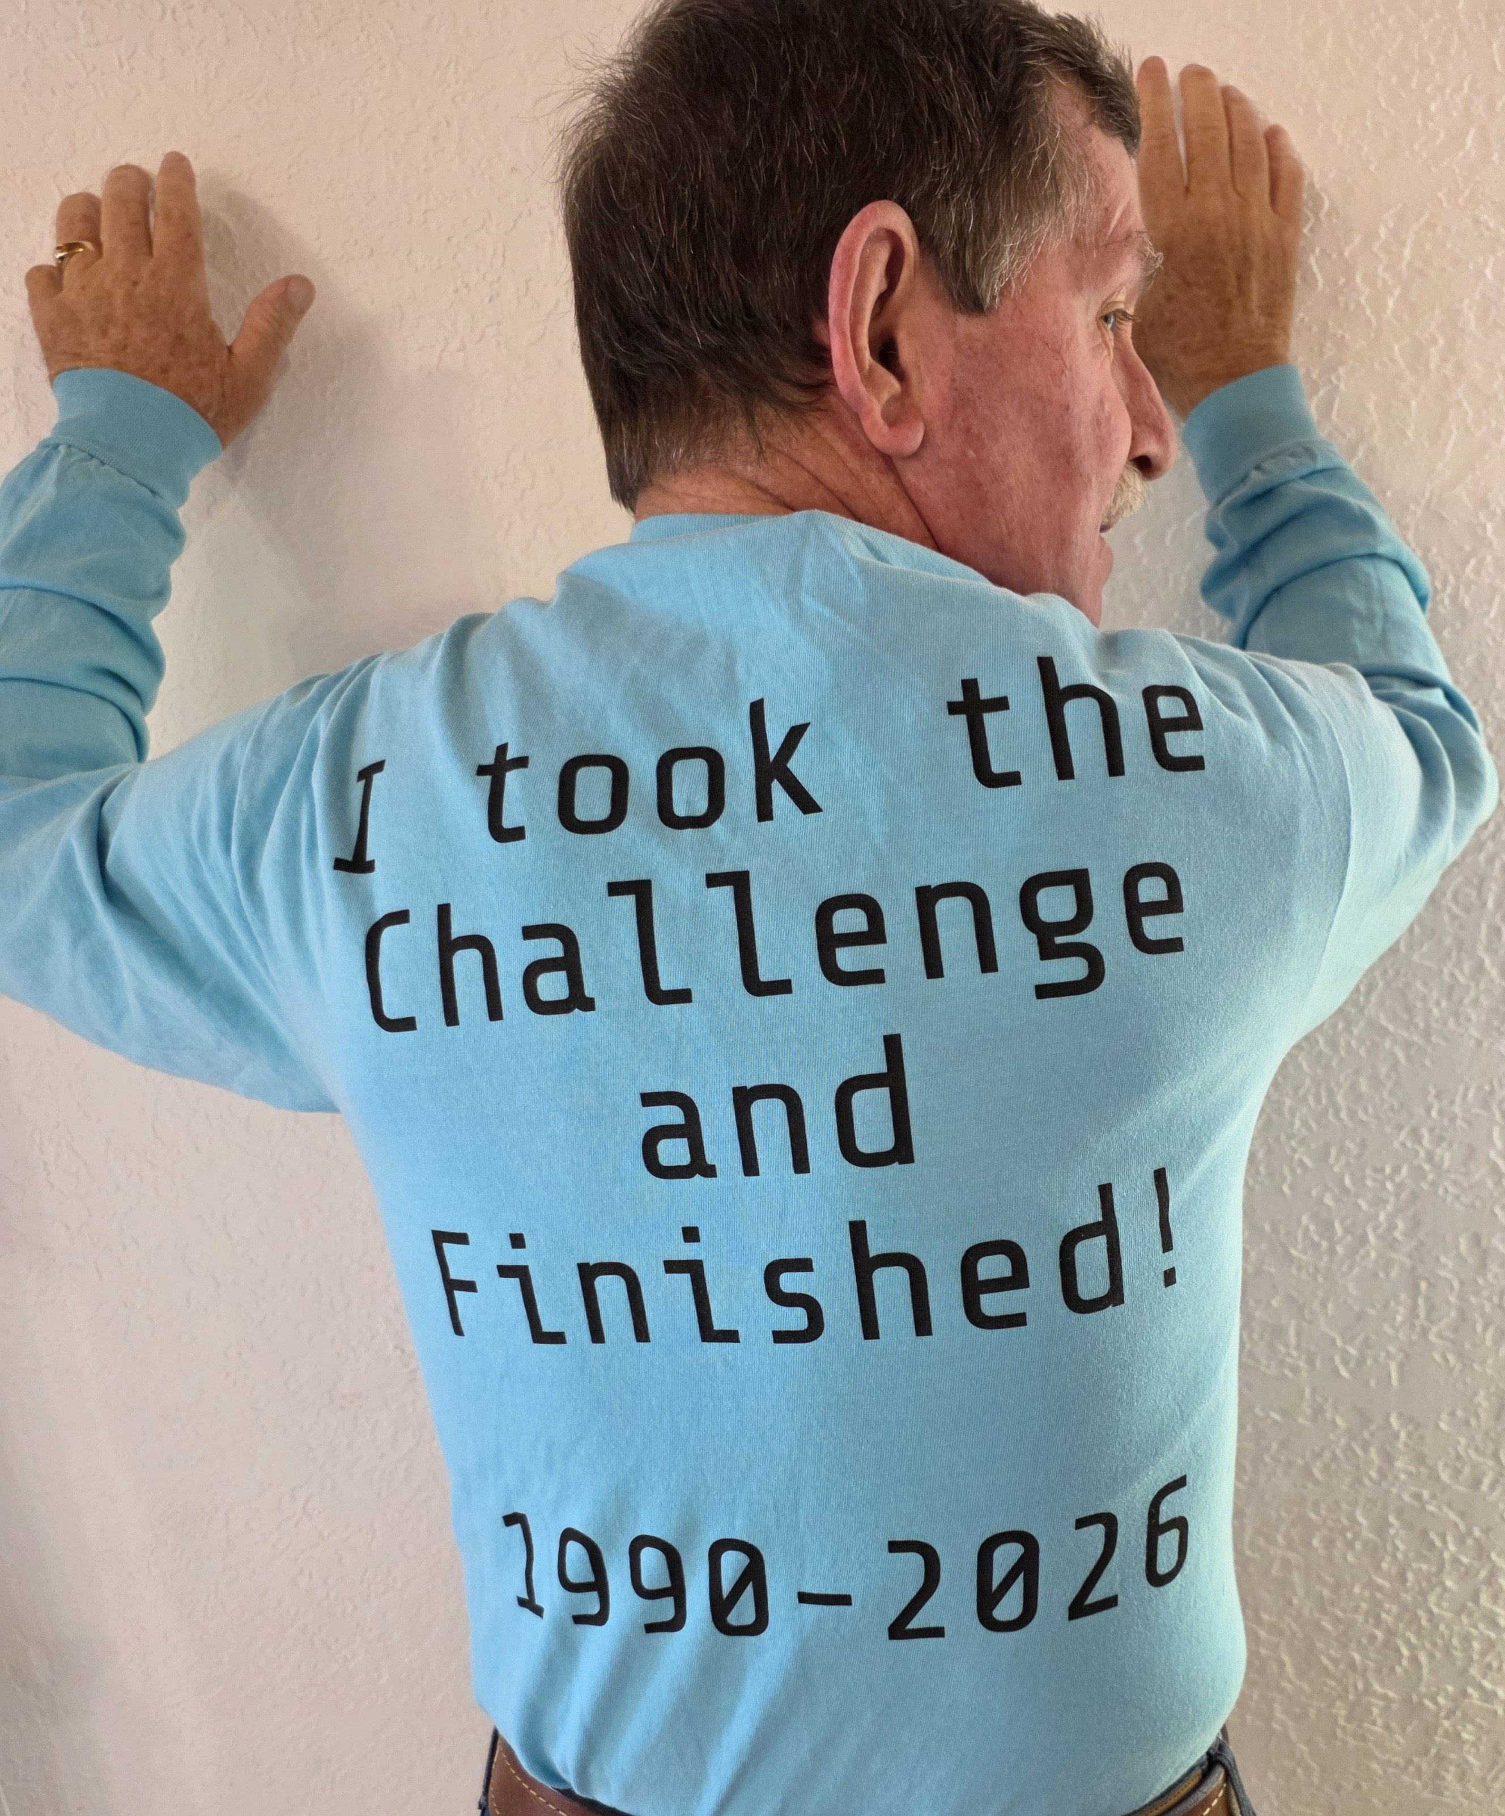
Closing Comments from our
Executive Director
David Kratzer

